Slide 1
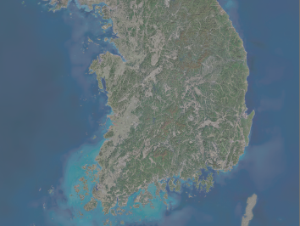

THE NATIONAL ATLAS OF KOREA
and AP HUMAN GEOGRAPHY
Doug Andersen
Oak Canyon Jr. High
dandersen@alpinedistrict.org

Slide 2
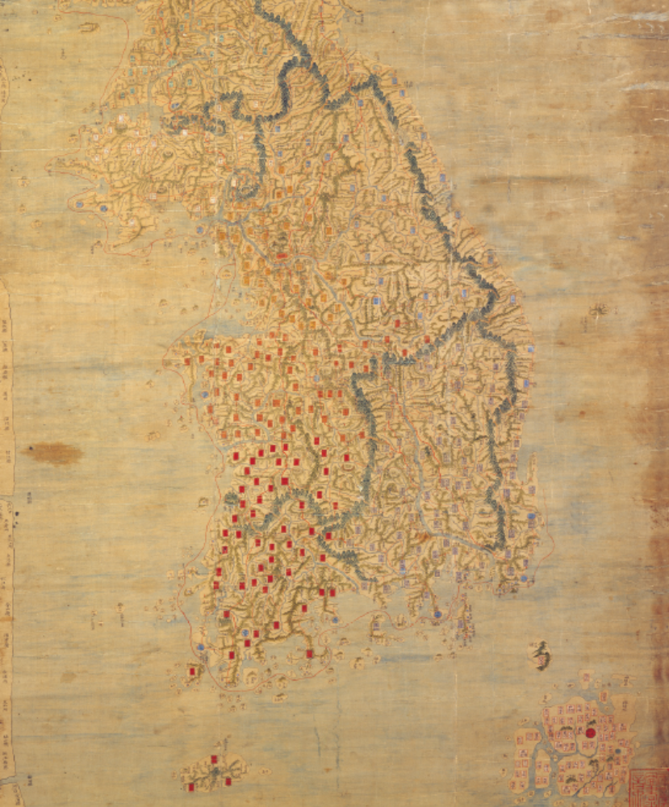
Why Use the National Atlas of Korea?
AP Human Geography Course Goals
  Interpret maps and analyze geospatial data
  Understand and explain the implications of associations and networks among phenomena in places.
  Recognize and interpret the relationships among patterns and processes at different scales of analysis.
  Define regions and evaluate the regionalization process.
  Characterize and analyze changing interconnections among places.

Slide 3
Why Use the National Atlas of Korea?
“If teachers are finding it difficult to refer to a map, chart, graph, or photograph to support the topic they are discussing, then they could be straying away from geography.” (College Board, AP Human Geography Course Description 2015, p. 12)
The need for case studies or examples from different world regions

Slide 4
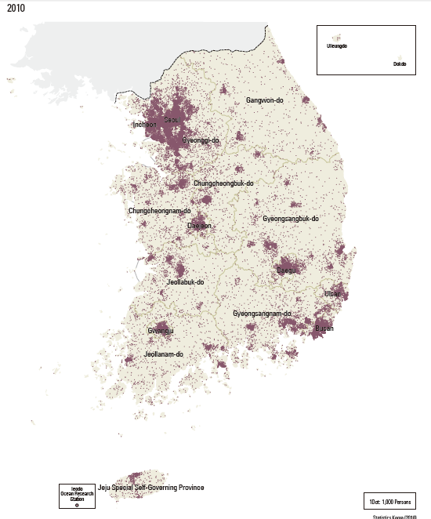
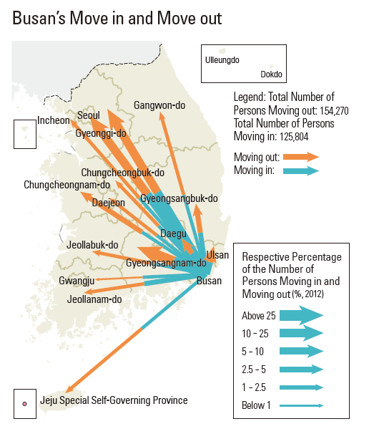
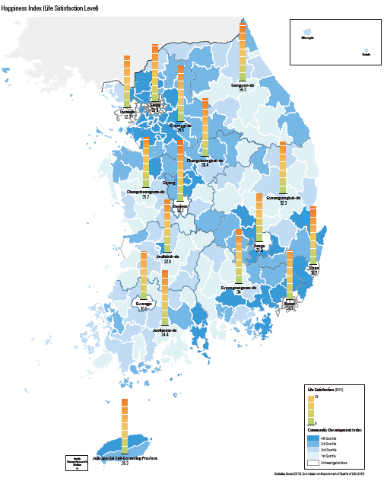
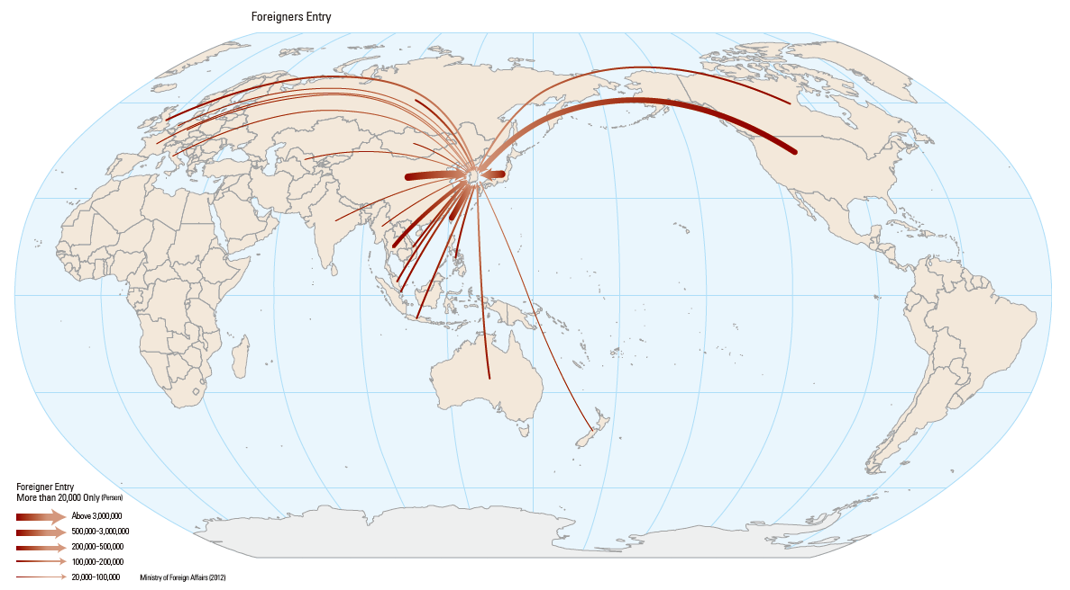
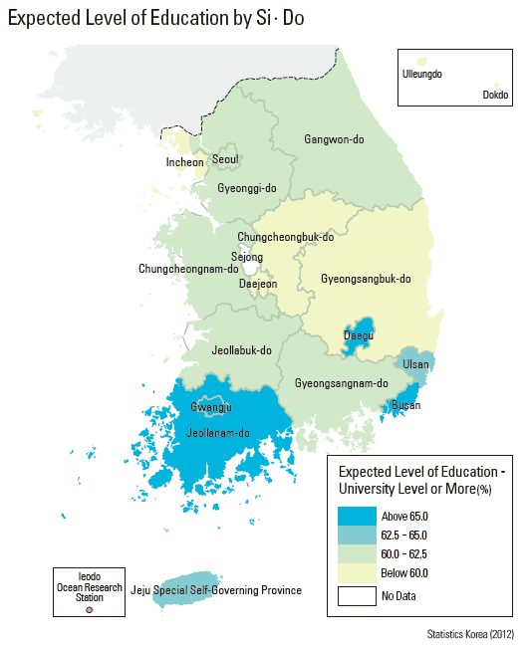
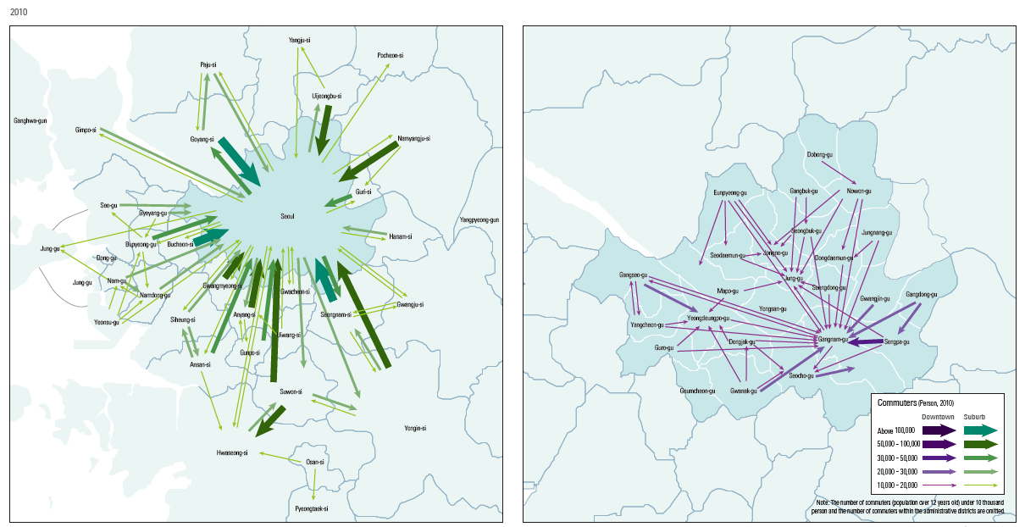
Maps
Notes:
Screenshots of maps from the National Atlas of Korea

Slide 5
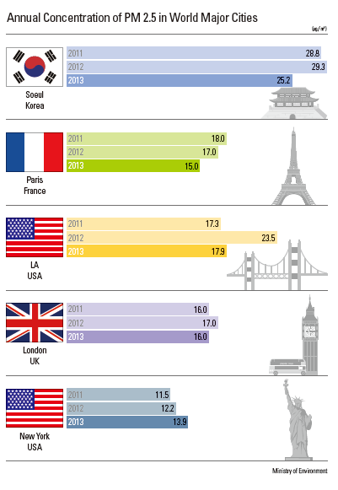
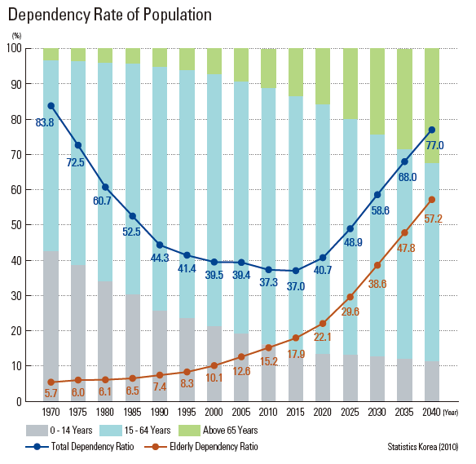
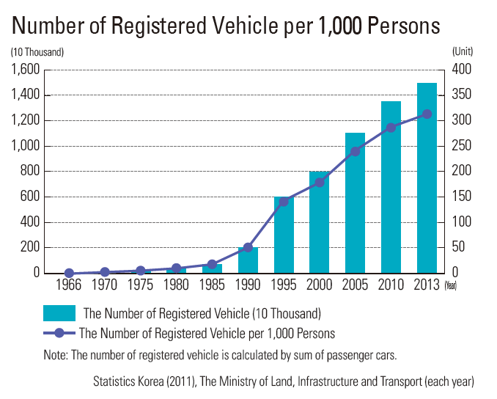
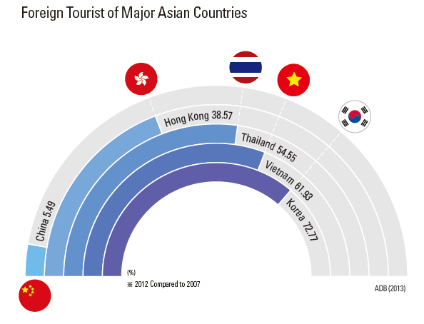
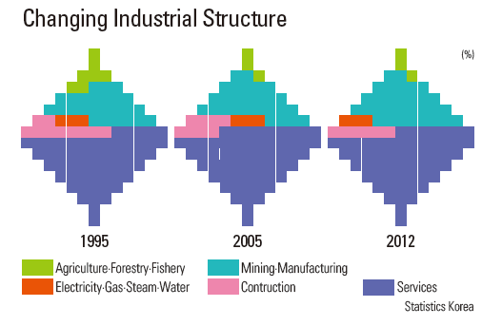
Graphs
Notes:
Screenshots of graphs from the National Atlas of Korea

Slide 6
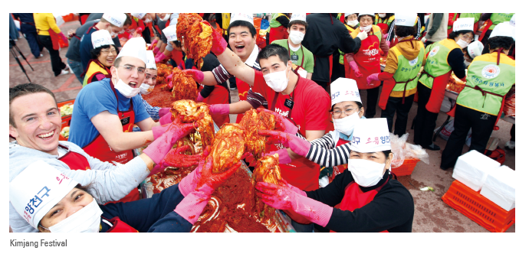
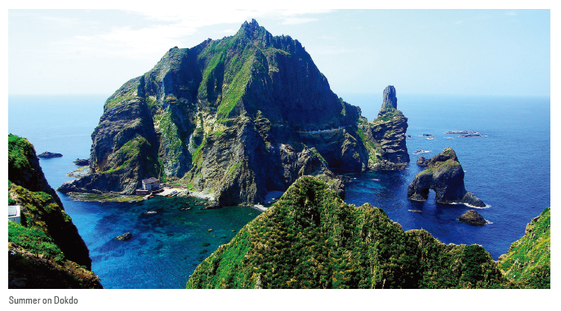
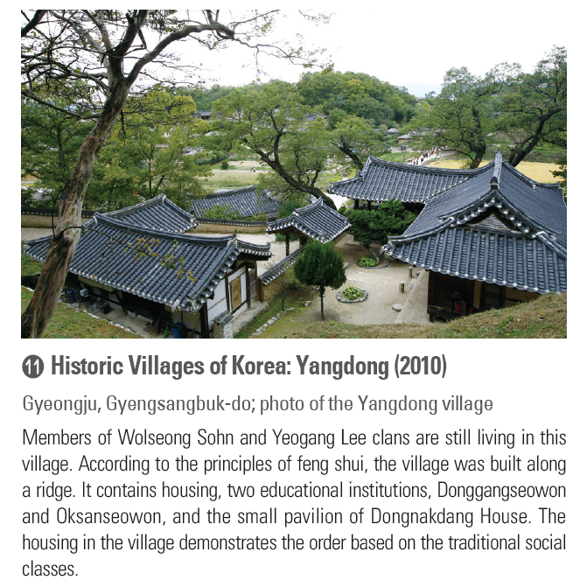
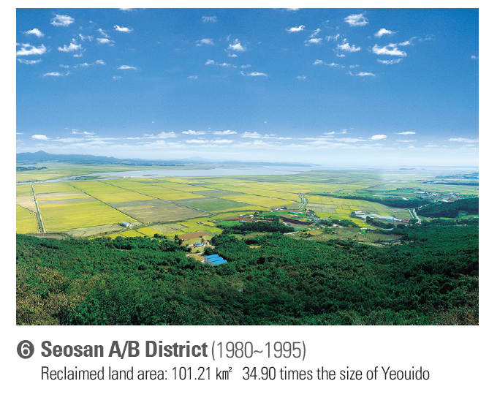
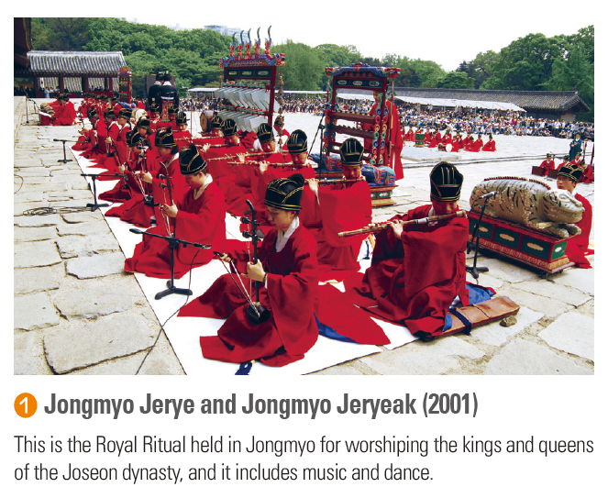
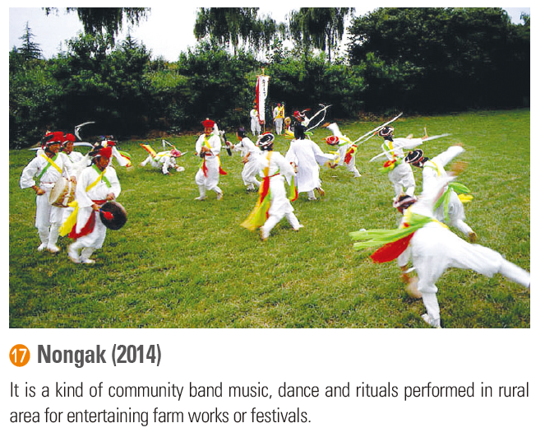
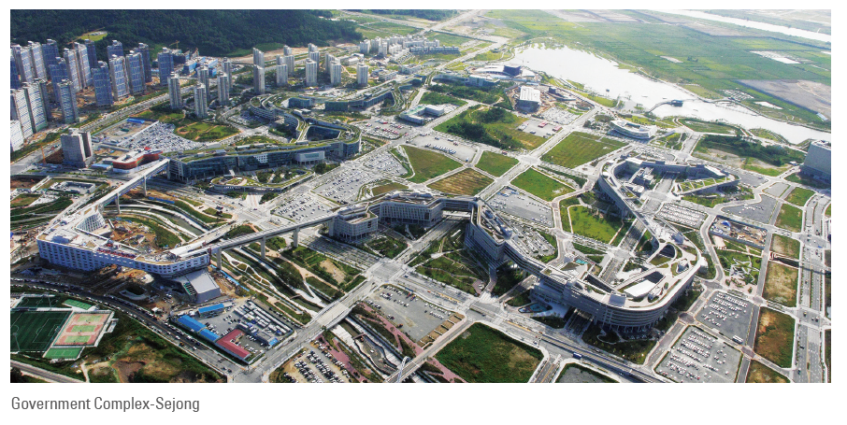
Photographs
Notes:
Screenshots of images from the National Atlas of Korea

Slide 7
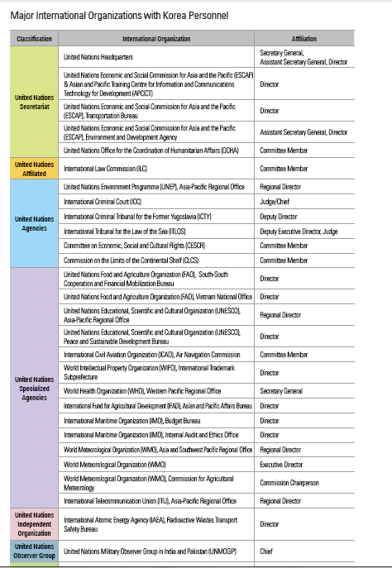
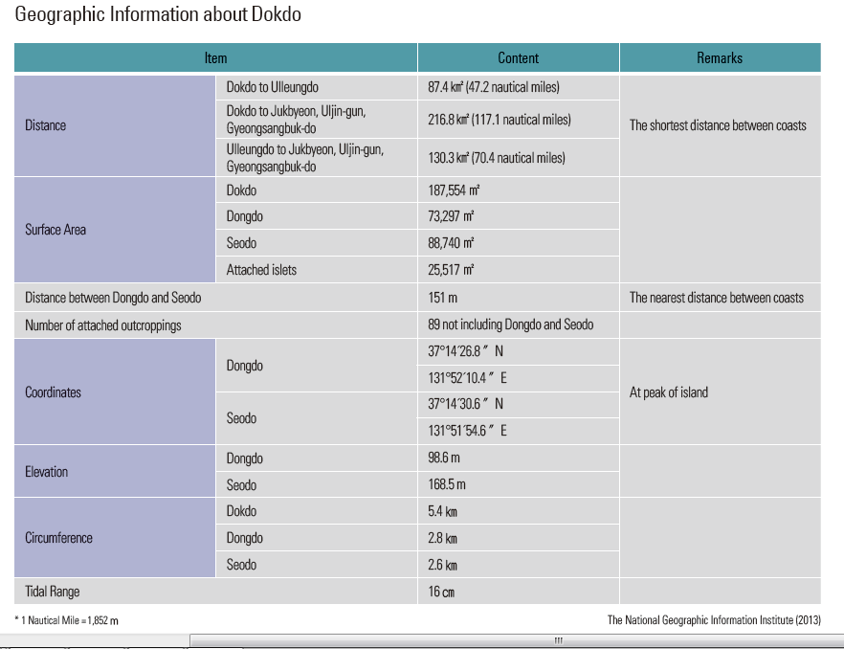
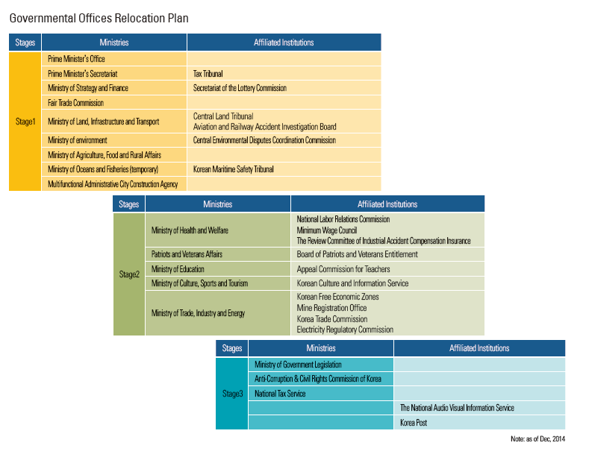
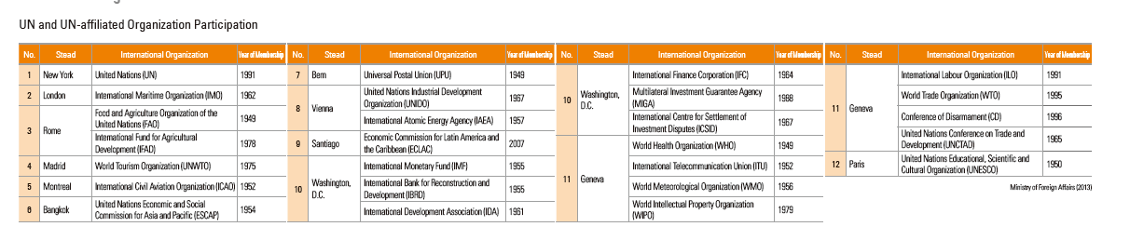
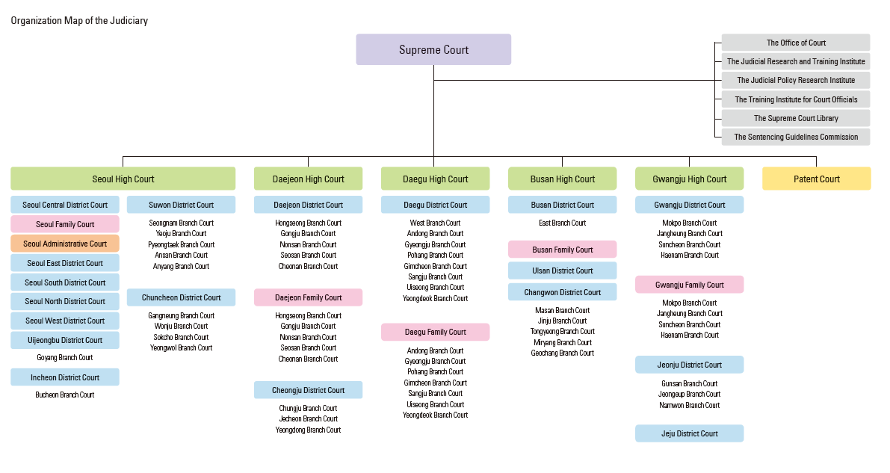
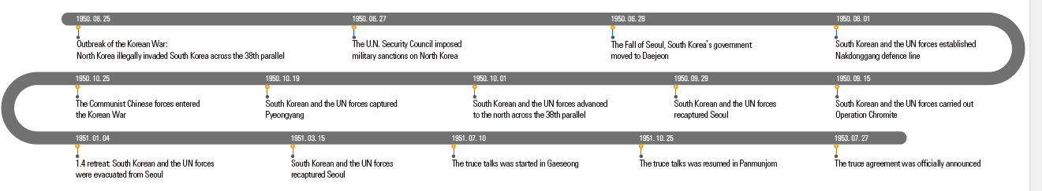
Charts
Notes:
Screenshots of charts or timelines from the National Atlas of Korea

Slide 8
Why Use the National Atlas of Korea?
“I expect this newly revised edition of The National Atlas of Korea will be the keystone for disseminating information about the physical, social, economic, and cultural changes in our land and people’s lives. In this era of globalization and unlimited international competition, this precious national archive will contribute greatly to promoting Korea’s territorial sovereignty and national status throughout the world.”
  Suh, Seoung-hwan
  Minister, Ministry of Land, Infrastructure and Transport
  Forward to the National Atlas of Korea

Slide 9
AP Human Geography and National Atlas of Korea Correlation
Enduring Understandings: | Learning Objectives: | Essential Knowledge: | Resources from the National Atlas of Korea Page numbers in parentheses ( )
Topic I: C. Geographical skills provide a foundation for analyzing world patterns and processes. | Analyze changing interconnections among places. | Interconnection among places include exchanges of natural resources, agricultural commodities, finished products, services, people, information, money, and pollutants. | Asian Highway (12-1); Trans-Eurasian Railway (12-2); Airlines Network (13-1); International Air Transportation by Country (13-2); Marine Network (13-3); Liner Shipping Connectivity Index (13-4)
Topic IV: B. Spatial political patterns reflect ideas of territoriality and power at a variety of scales. | Evaluate the nature and function of international and internal boundaries. | Boundaries can influence identity and promote or prevent international or internal interactions and exchanges. | Demilitarized Zone and Civilian Control Zone (23-2); History of Inter-Korean Trade and Economic Cooperation (51); Exchanges of Separated Families by Year (51-3)
Topic IV: B. Spatial political patterns reflect ideas of territoriality and power at a variety of scales. | Describe patterns of local and metropolitan governance. | Local and metropolitan forms of governance (e.g., municipalities, school districts, regional planning commissions) are subnational political units that have varying degrees of local control. | Special Administrative Region: Sejong (44); Special Administrative Region: Jeju (45)
Topic VI: A. The Industrial Revolution, as it diffused from its hearth, facilitated improvements in standards of living. | Identify the different economic sectors. | The economy consists of primary, secondary, tertiary, quaternary, and quinary sectors. | North Korea Trend in the Growth Rate of Various Industries (50-2 through 50-9); Working Population by Major Industry Group/ Occupation (50-10; 50-11)
Topic VII: A. The form, function, and size of urban settlements are constantly changing. | Explain the factors that initiate and drive urbanization and suburbanization. | Site and situation influence the origin, function, and growth of cities. | Expansion of Seoul (42); Expansion of Busan; Daegu; Incheon; Gwangju; Daejeon; Ulsan (43-1 through 43-6)
Notes:
Provide pdf or printed copy of AP Human Geography Curriculum Articulation 2015 and the National Atlas of Korea

Slide 10

Sample lesson plan using the Atlasn Using the National Atlas
Talking SMAC
  A case study of Sejong Metropolitan Autonomous City and the impact of development and urbanization in South Korea
  Students use a variety of primary and secondary sources including the new National Atlas of Korea to investigate the impact of development and urbanization on the selection and creation of Sejong Metropolitan Autonomous City as the home of 36 government agencies in South Korea. Students present the advantages and disadvantages of creating a new government center in a class role play debate and propose solutions to some of the problems associated with this type of regional development model.

Slide 11
Learning Outcomes
Essential Understandings:
Students will understand that built landscapes and social space reflect the attitudes and values of a population. (Topic VII D)
Students will understand that measures of development are used to understand patterns of social and economic differences at a variety of scales. (Topic VI B)
Learning Objectives:
Students will be able to explain the planning and design issues and political organization of urban areas.
Students will be able to analyze spatial patterns of economic and social development.
Essential Knowledge:
Students will know that sustainable design initiatives include walkable mixed-use commercial and residential areas and smart-growth policies (e.g., new urbanism, greenbelts, slow-growth cities).
Students will know that models like Rostow’s Stages of Economic Growth and Wallerstein’s World System Theory help explain spatial variations in development.

Slide 12
Vocabulary
Smart growth
Sustainable urban planning
New urbanism
Mixed-use developments
Rostow International Trade model
Balanced Growth model
Decentralization
Greenbelt

Slide 13
Brainstorm
Imagine that you are to plan a city from scratch. List the things that you would need to consider to make a viable city.
60 seconds
Compare list with partner. Note unique items on your list.

Slide 14
Brief Background
Seoul has been the capital of Korea for over 600 years. Though nearly destroyed during the Korean War, it has been the center of South Korea’s economic and urban development. Today nearly half of the entire population of South Korea lives in the Seoul metropolitan area. Over the years, concerns were voiced about the location of the capital so near the North Korean border (within range of North Korean rockets), and the growing dominance of the city compared to other regions. In 2002, President Roh Moo-hyun announced a plan to move the country’s capital from Seoul to the central provinces of Chungcheong. As plans moved forward, the Constitutional Court ruled that the capital could not be moved from Seoul without a national referendum. Eventually a new administrative center was built from scratch about 125 km south of Seoul. Thirty six government agencies were scheduled to move to the new Sejong Metropolitan Autonomous City. It is anticipated that by 2030, the city will have up to 800,000 residents.
(see Sejong Timline)

Slide 15
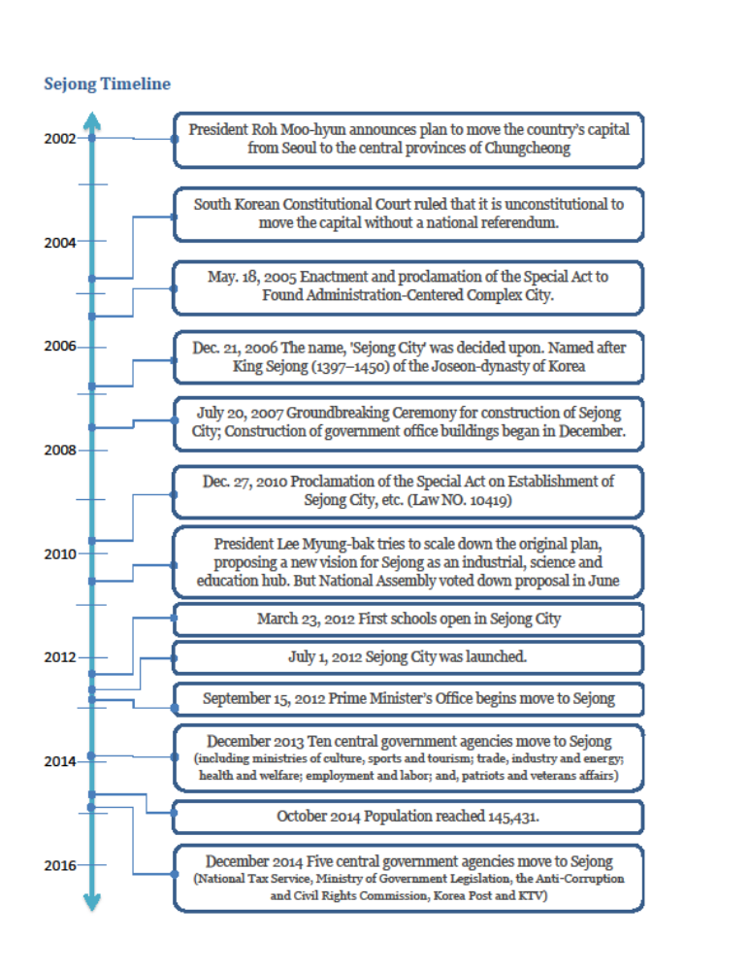

Slide 16
Atlas Guided Questions
Reading Text
Analyzing images
Hypothesizing

Slide 17
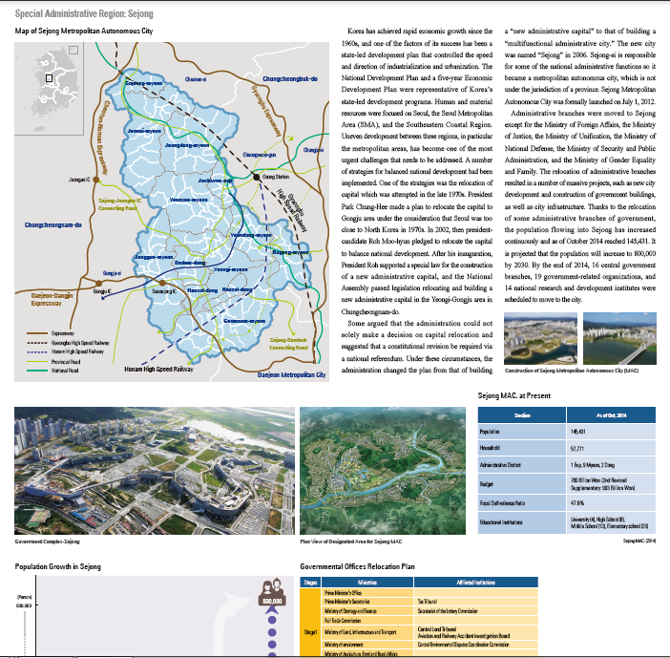

Slide 18
Role Play Debate
Who are some stakeholders in developing a new administrative city?
  President of South Korea
  Urban planner
  Architect
  Transportation Manager
  Worker or Minister of government agency moved to Sejong
  Worker or Minister of government agency that remained in Seoul
  Sustainable energy company
  Private business owner located in Sejong
  Public education teacher in Sejong
  Mayor of Sejong

Slide 19
Position Question
Is the creation of Sejong Metropolital Autonomous City an effective regional development strategy? Why or why not?
If not, what would make the Sejong MAC more effective?

Slide 20
Reseach
Master Plan for the Public Administrative Town, Designed by the Team of Balmori Associates, H Architecture, and Haeahn Architecture (http://www.architectmagazine.com/design/buildings/master-plan-for-the-public-administrative-town-designed-by-the-team-of-balmori-associates-h-architecture-and-haeahn-architecture_o)
Civil servants seek to avoid Sejong City move (http://www.koreaherald.com/view.php?ud=20111120000172)
Korea looks to balance its development (http://www.koreaherald.com/view.php?ud=20120702001192)
[Editorial] Fighting inefficiency (http://www.koreaherald.com/view.php?ud=20140819000402)
Sejong City boosts area’s land prices (http://www.koreaherald.com/view.php?ud=20120701000271)
Sejong City readies a charm offensive (http://www.koreaherald.com/view.php?ud=20120629000876)
Sejong City to open Sunday (http://www.koreaherald.com/view.php?ud=20120628001115)
South Korea: a model of development? (http://www.theguardian.com/global-development/poverty-matters/2011/nov/28/south-korea-development-model)

Slide 21
Presentation
4 minute presentation per stakeholder group
Questions from class
1 minute summary
Must include at least 3 vocabulary terms in presentation

Slide 22
Summary Discussion
What were some of the planning and design issues related to Sejong?
How did the built landscape and social space of Sejong reflect the attitudes and values of South Korea?
Do you think that the sustainable design initiatives like walkable mixed-use commercial and residential areas and smart-growth policies in Sejong will result in “happy” communities?
In the long run, do you think Sejong will be effective in the regional development of Korea?

Slide 23
Extension
Have students compare and contrast what they have learned about Sejong compared to other new capital cities:
Brasilia, Brazil
Canberra, Australia
Naypyidaw, Burma (Myanmar)
Abuja, Nigeria
Astana, Kazakstan

