Slide 1
Using the National Atlas of Korea to teach about Scale and Types of Maps
Lesson plan and associated web links and resources.
Kenneth H. Keller
George Walton HS, Marietta, GA
November 2017

Slide 2
Georgia World Geography Standards
The world geography course provides students with an analytical view of how geographic factors
have and continue to influence human behavior on the earth. Students will examine how the
physical and cultural geographic factors contribute to varying levels of cooperation within the
major world regions. Additionally, students will examine the importance that political,
environmental, and economic factors have in a region’s development.
https://www.georgiastandards.org/Georgia-Standards/Documents/Social-Studies-World-Geography-Georgia-Standards.pdf

Slide 3
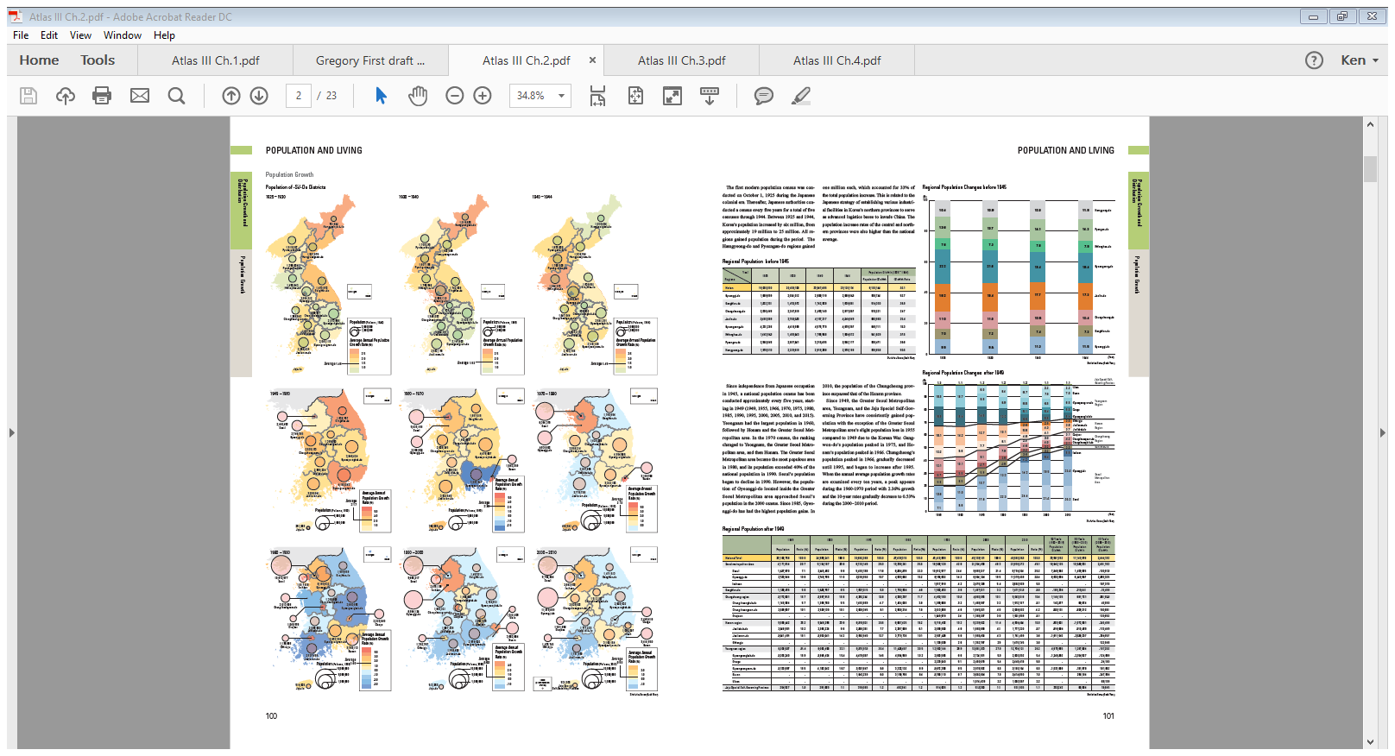
Some Important Intro Questions to Discuss:
With the current emphasis on technology and learning how to use GIS to make thematic maps in secondary school level geographic education, there are several often neglected or forgotten and yet simple questions that need to be asked in order to promote spatial understanding.
For what reason or purpose do we make a particular map?
How well does a map convey its geographic meaning?
How well does a student understand the intended message of the map?
What is the proficiency or ability of a student’s interpretation of a map given that there are so many kinds of maps and so many ways a cartographer can make it?
How great is the effort on the part of the teacher to teach map reading, analysis, and interpretation?
Historical Atlas III. Chapter 2, Page 2.
Graduated Circle Map showing South Korea’s
Population over time, 1925-2010.

Slide 4
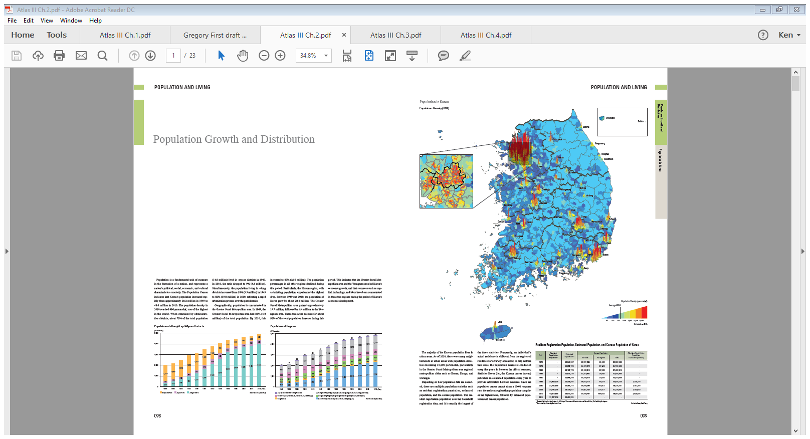
Intro Questions Continued:
The preceding questions relate to spatial thinking and spatial understanding. Being able to answer the “why of where” question. Map interpretation is unquestionably a key issue for the improvement of geographic education.
Since each map is unique, so is its interpretation. Some of the common, unwritten rules relate to the analysis of the logic between title, legend, scale, data, mapping method, and visual presentation. Experienced cartographers and map designers manage a symphony of all these components in the creation of a map. As a map reader, adding some common sense is almost a requirement; but the greatest asset a map reader can have is a general, or even specific, knowledge of the geography of the place being mapped. Applying the element of geographic knowledge as an aid to map interpretation can be very helpful. Several examples are provided in this presentation to illustrate this connection.
National Atlas III. Chapter 2. Pages 98-99.
Many thanks to my colleague Gregory Chu for sharing text from the Children’s Atlas companion to this National Atlas titled:
National Atlas of Korea IV: Children’s Edition. Chapter 1. All Maps Are Not Created Equal

Slide 5
The Importance of Scale
The scale of a map is critical to the map reader as it may imply how accurate a map can be and how much spatial information can be effectively presented on that map. There has been some confusion about the terminologies that relate to map scale. This section is an attempt to clarify all these confusions.
Since the map drawn on a piece of paper cannot have a one-to-one size relationship with the land, the map is thus a one-to-many size relationship with the real world that it represents. In other words, one unit of measurement on the map is designated to represent many of the same units of in the real world. Thus, the map scale is actually a mathematical ratio. Map scale can be expressed in three ways:
Representative Fraction
Verbal
Graphic/Bar

Slide 6
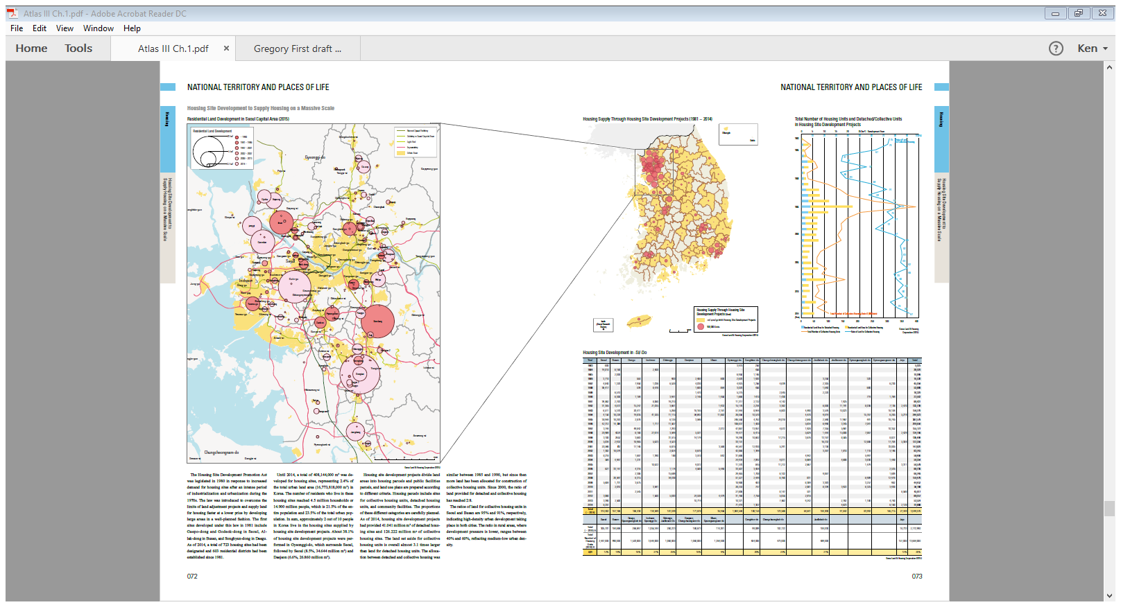
Large Scale vs. Small Scale Maps
Large scale maps refer to those that cover a small area of land and showing a great deal of local details. An example would be a map showing local tax/mill rates. Small scale maps, on the other hand, cover large areas of land and cannot include local details. An example would be a world map on a regular book page.
Above image: Residential housing supply in Seoul Metro area vs South Korea as a whole.
Large Scale vs. Small Scale maps. National Atlas III. Pages 72-73

Slide 7
Transportation Route Maps
Route maps are those that are specifically created to guide us from one place to another. They have provided us with the freedom to move about and reach our intended destinations. Since humans travel on land, on water, and in the air, these route maps include navigation or sailing charts, aeronautic charts, and the traditional folded paper maps that are kept in our cars for many decades. Today, with GPS technology, people opt for the convenience of voice-guided GPS navigation maps and systems that are built into our cars’ dashboards or delivered from our cell phones. They are very effective in guiding us through our routes. *As accurately as GPS maps may perform, they are NOT 100% fool-proof. *PERSONALLY I STILL LIKE PAPER ROAD MAPS ☺
See Atlas III, Chapter I, Pages 30-33.

Slide 8
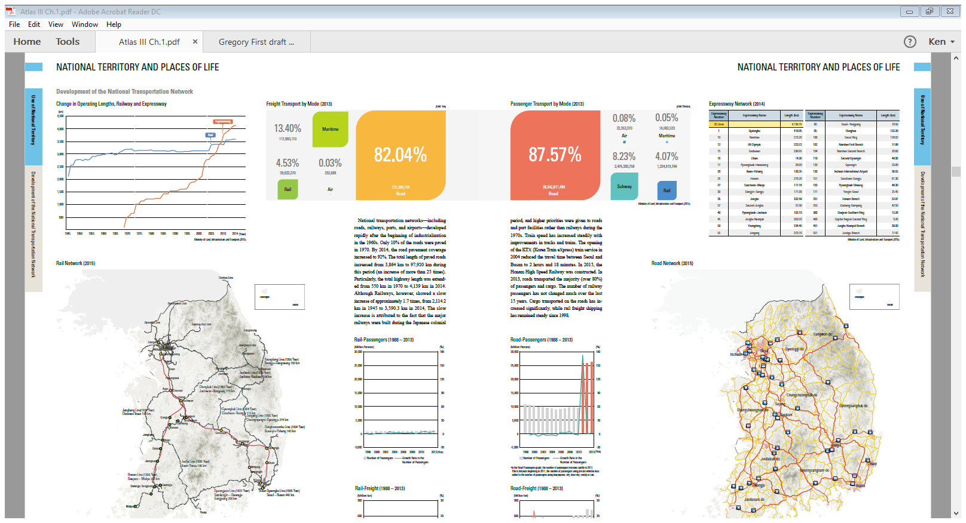

Slide 9
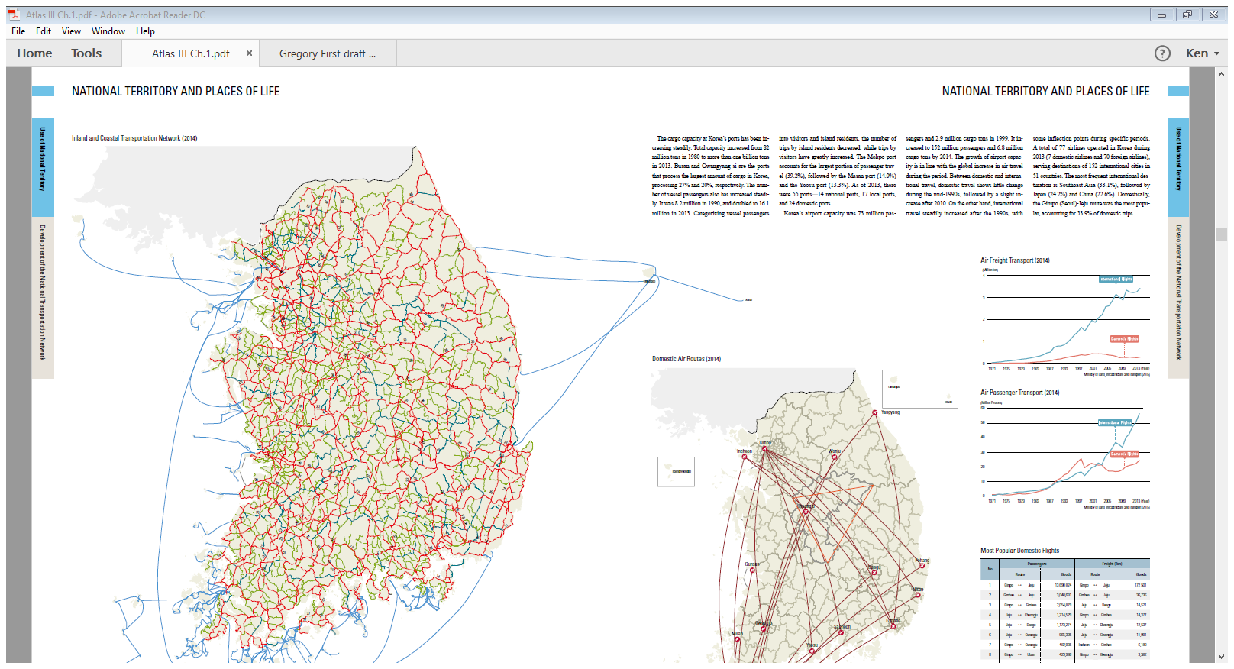

Slide 10
Thematic Maps
These may be poor in reference information, but are specially made maps to illustrate a particular theme to highlight a particular event in a particular space at a specific time. A map depicting population density (or any special topic or any theme) is considered a thematic map. The range of topics is extremely wide, so long as there is a way to collect data or information about the theme. Some of the largest government agencies that specialize in producing large volumes of thematic maps are the census bureaus and statistics-collection agencies of nations.

Slide 11
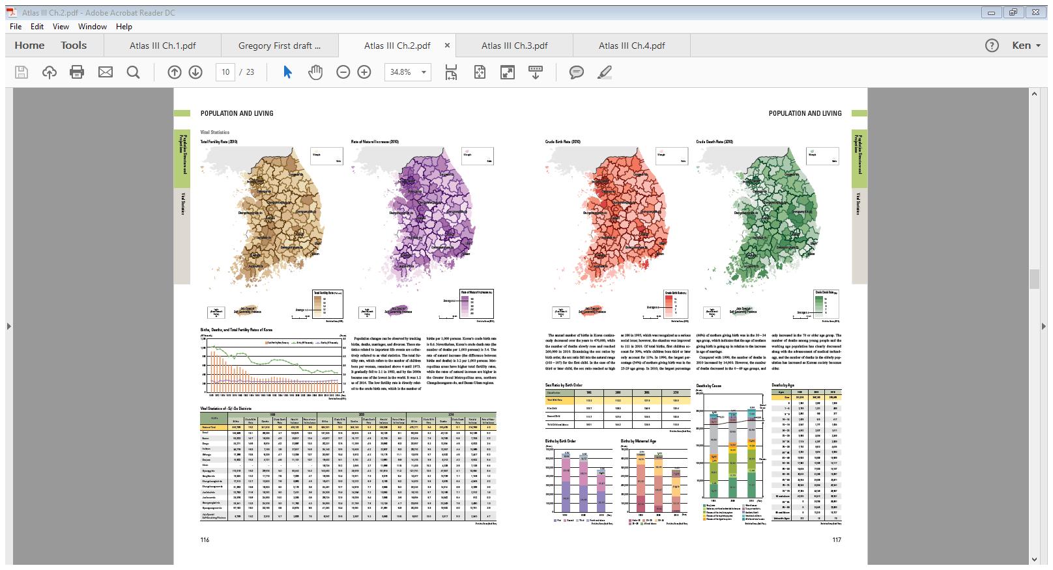
Choropleth Maps
A choropleth map (from Greek χῶρος ("area/region") + πλῆθος ("multitude")) is a type of thematic map in which areas are shaded or patterned in proportion to the measurement of the statistical variable being displayed on the map, such as population density or per-capita income.
There are MANY examples of Choropleth maps in the National Atlas III. Chapter 2.
National Atlas III. Choropleth Maps of Population
Structure. Pages 162-163.

Slide 12
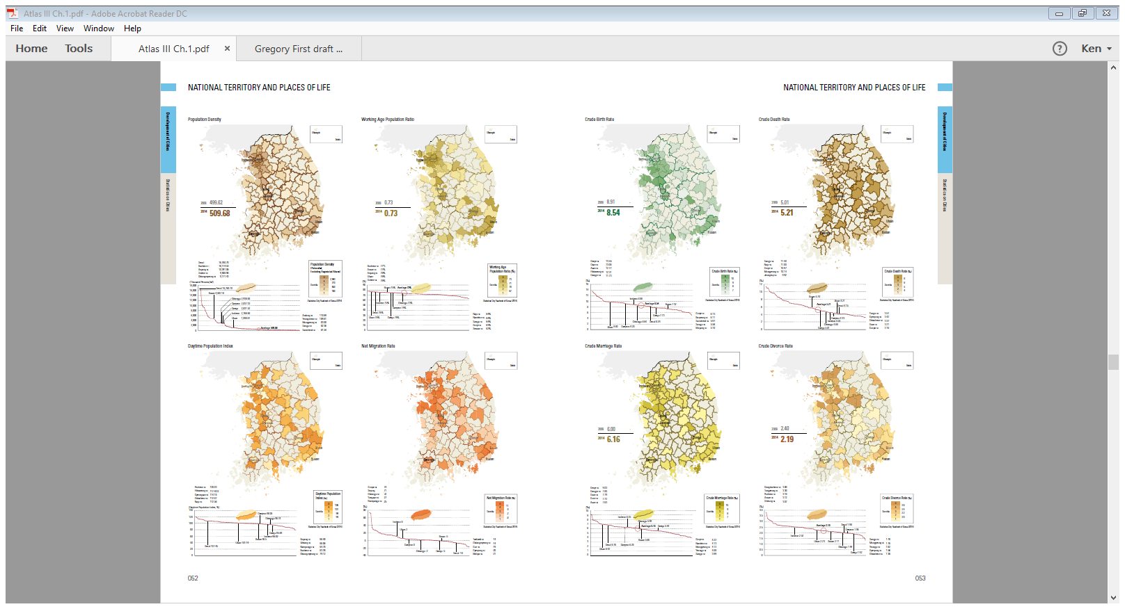

Slide 13
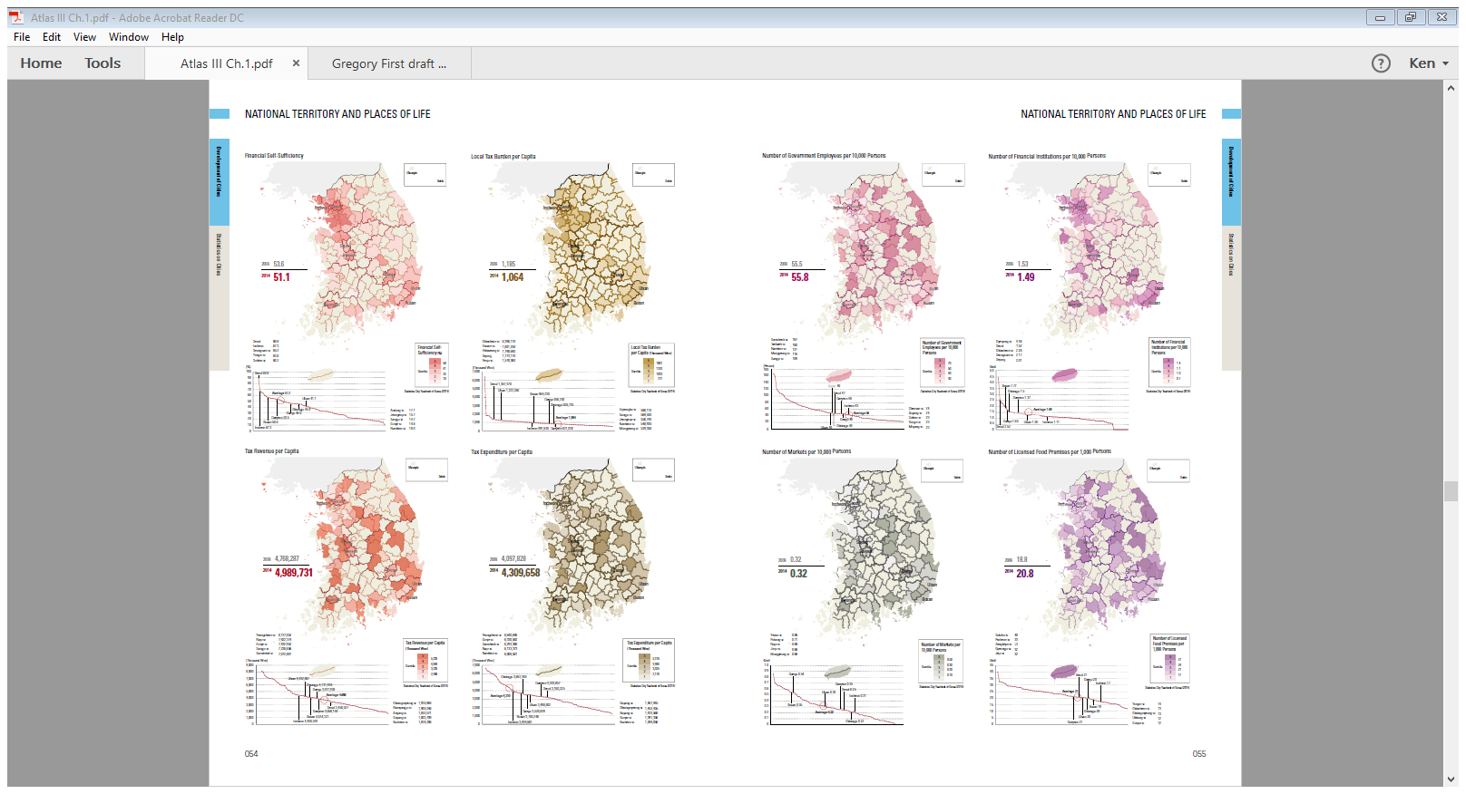

Slide 14
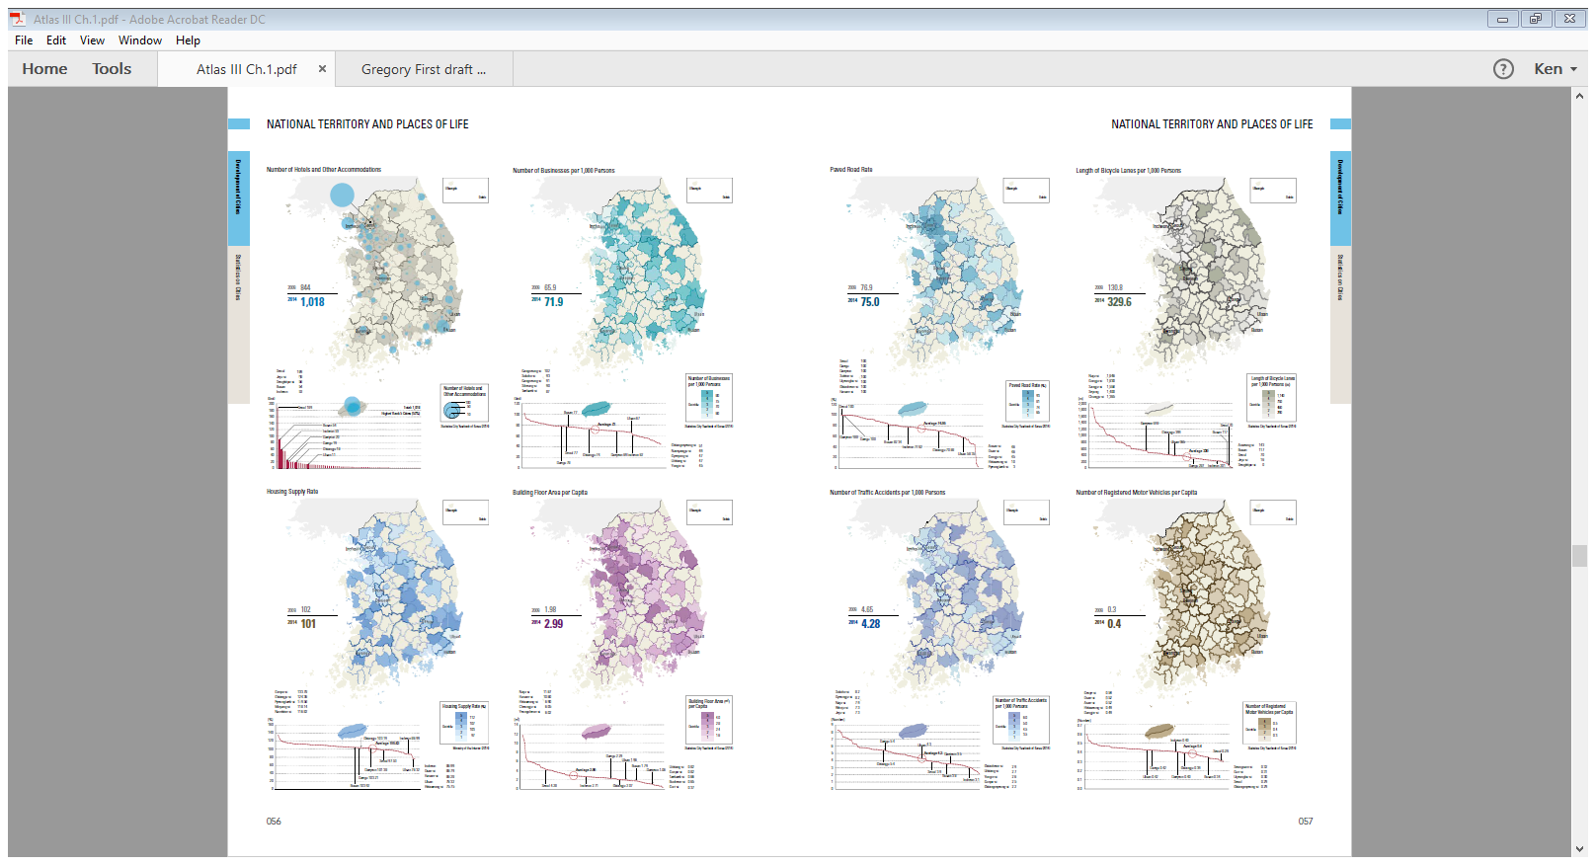

Slide 15
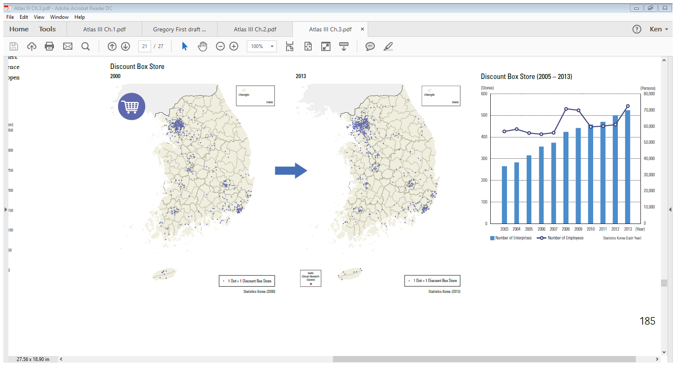
Dot Density Maps
Dot density maps are a simple yet highly effective way to show density differences in geographic distributions across a landscape. Dot density maps are easy to understand and, at a glance, show us intuitively where things clump or cluster. There are two basic types: one-to-one dot density maps (one dot represents one object or count) and one-to-many dot density maps in which one dot stands for a number of things or a value (e.g., 1 dot = 1,000 acres of wheat production).
All dot density maps should be drawn on an equal area map projection. This is critical — using a map projection which does not preserve the size of areas will distort the perceived density of the dots.
National Atlas III, Chapter 3, page 185.
Discount Box Stores 2008 compared to 2013.
http://www.axismaps.com/guide/dot_density/

Slide 16
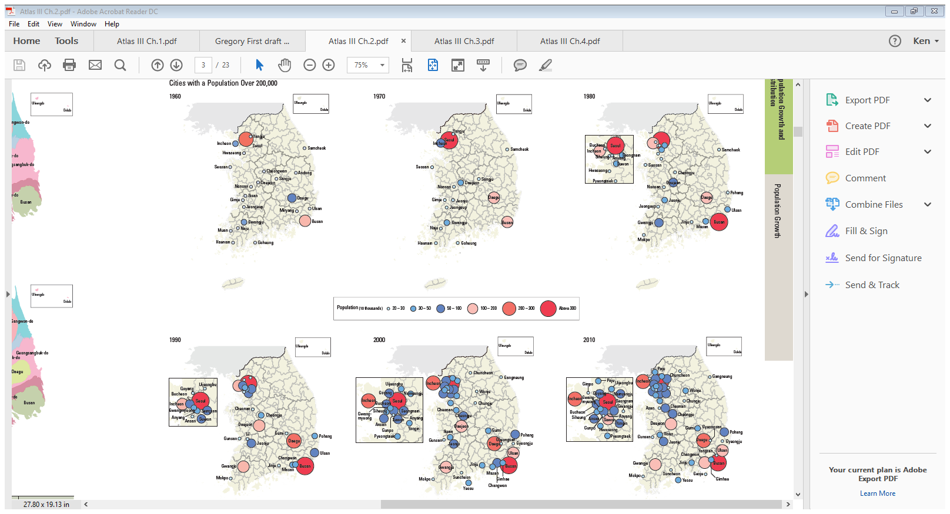
Proportional/Graduated Circle Maps
Graduated and proportional symbol maps are a class of maps that use the visual variable of size to represent differences in the magnitude of a discrete, abruptly changing phenomenon, e.g. counts of people. Like choropleth maps, you can create classed or unclassed versions of
these maps. The classed ones are known as range-graded or graduated symbols, and the unclassed are called proportional symbols, where the area of the symbols are proportional to the values of the attribute being mapped.
National Atlas III, Chapter 2, Page 3. Graduated circle
Map of South Korean cities with a population of over
200,000. 1960-2010.
https://www.e-education.psu.edu/geog486/node/1869

Slide 17
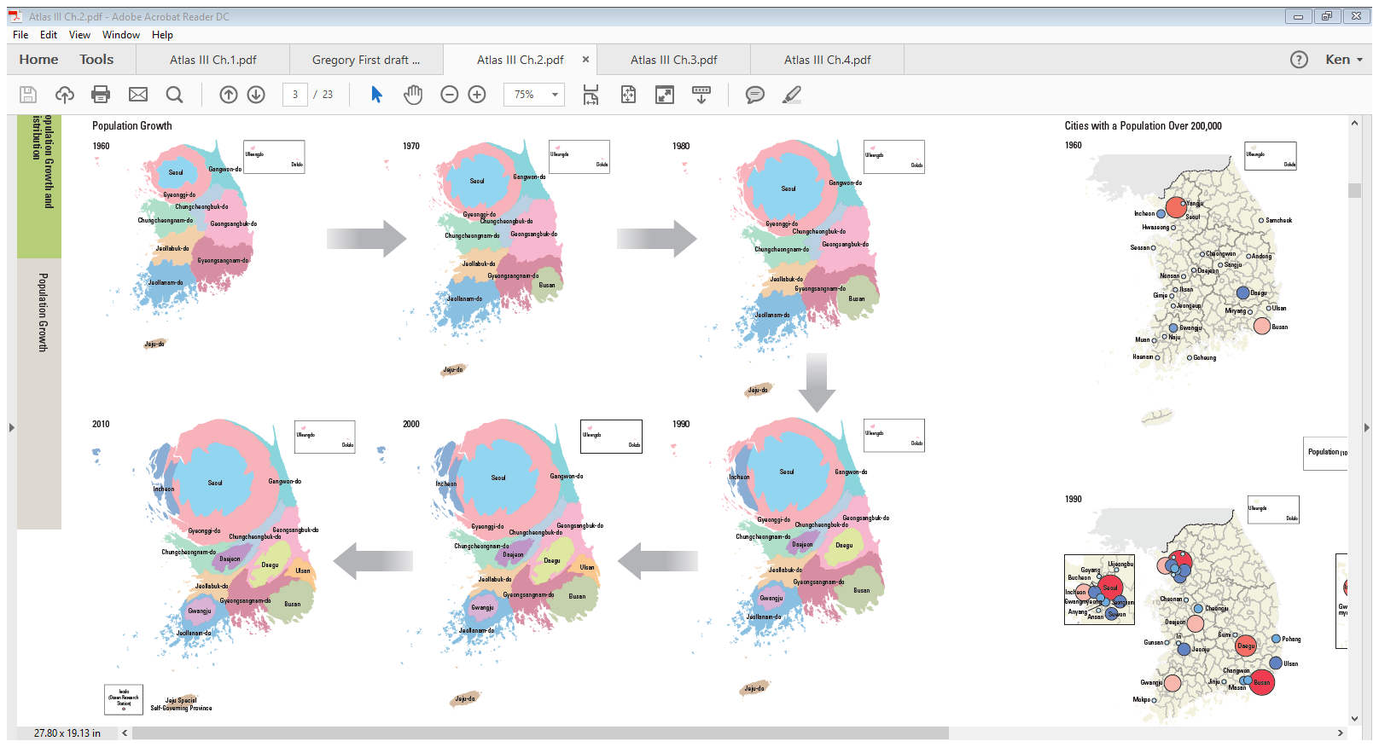
Cartograms
Simply put, a cartogram is a map. But a cartogram is a unique type of map because it combines statistical information with geographic location. Physical or topographical maps show relative area, distance, and terrain, but they do not provide any data about the inhabitants of a place.
Cartograms on the other hand take some measurable variable: total population, age of inhabitants, electoral votes, GDP, etc., and then manipulate a place’s area to be sized accordingly. The produced cartogram can really look quite different from the maps of cities, states, countries, and the world that are more recognizable. It all depends on how a cartographer needs or wants to display the information.
National Atlas III, Chapter 2, Page 3. Cartogram
of population growth of South Korean cities from
1960-2010.
https://www.populationeducation.org/content/what-cartogram

Slide 18
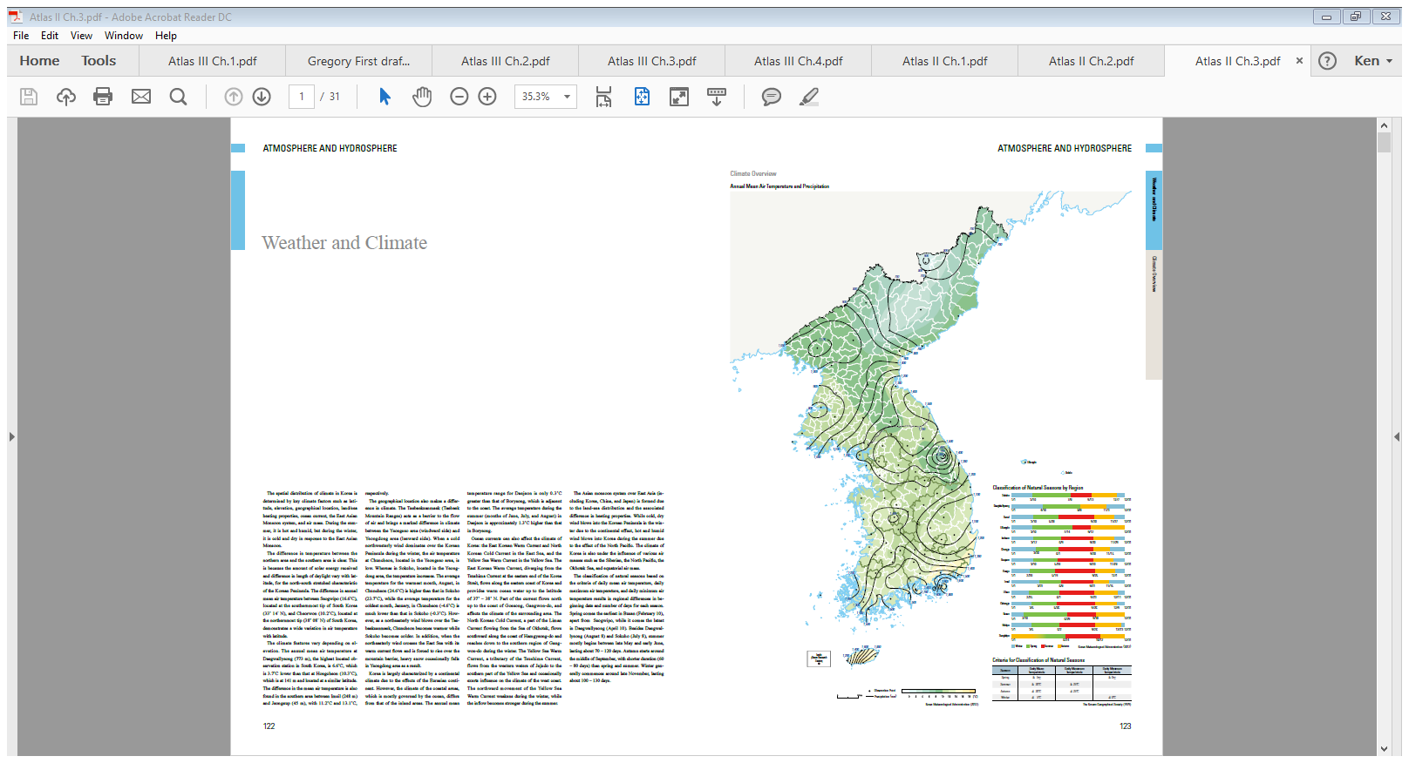
Isoline Maps
Isolines are lines drawn to link different places that share a common value. The prefix 'iso' is a Greek word meaning equal, so an Isoline must be a line joining equal points. For example, a line drawn on a map to join up all the places that are the same height above sea level is called a contour.
National Atlas II. Chapter 3. Pages 122-123.
http://www.geography-site.co.uk/pages/skills/fieldwork/stats/isolines.html

Slide 19
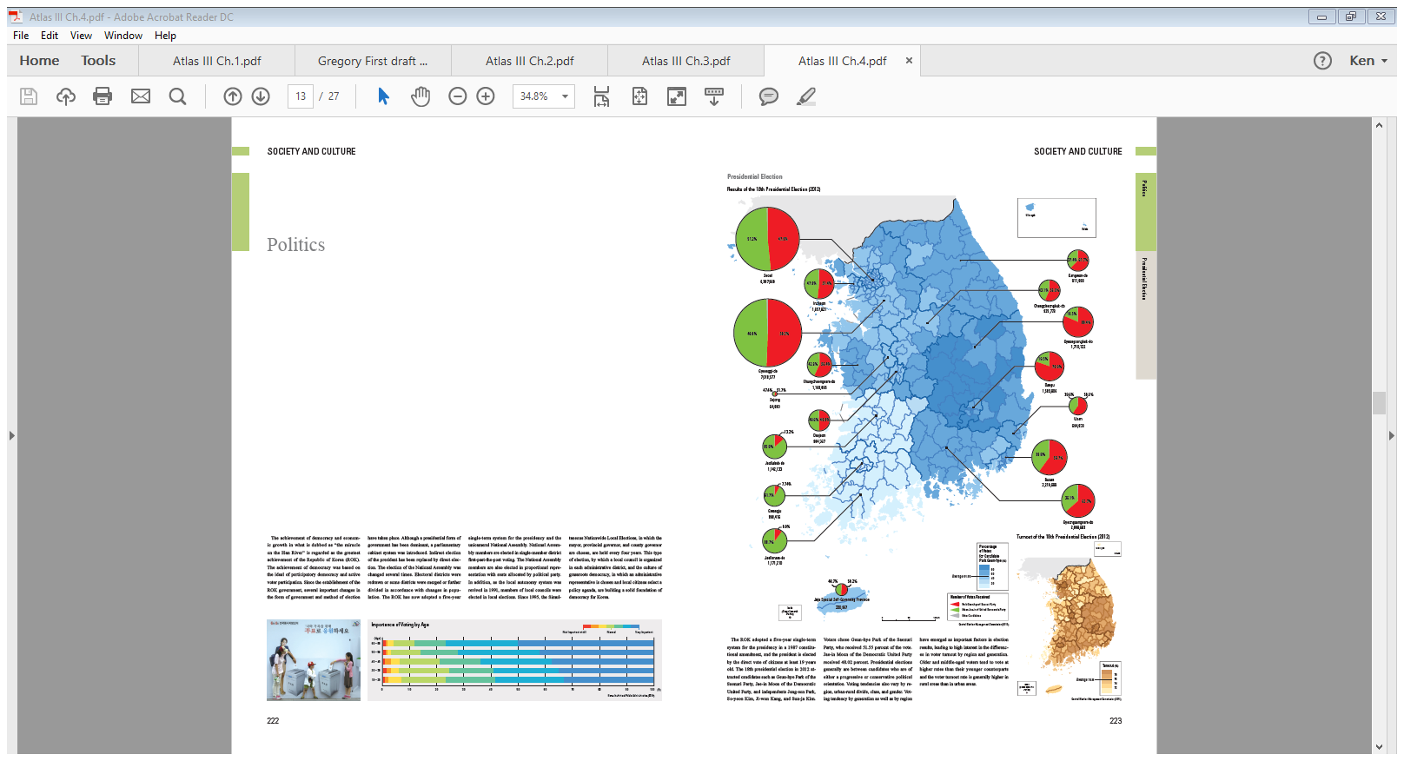
Maps with other embedded Stimulus
Choropleth Map with embedded
pie graphs.
% of votes for winning candidate vs.
number of votes for each candidate
represented in pie graph.
National Atlas III. Chapter 4.
Pages 222-223.

Slide 20
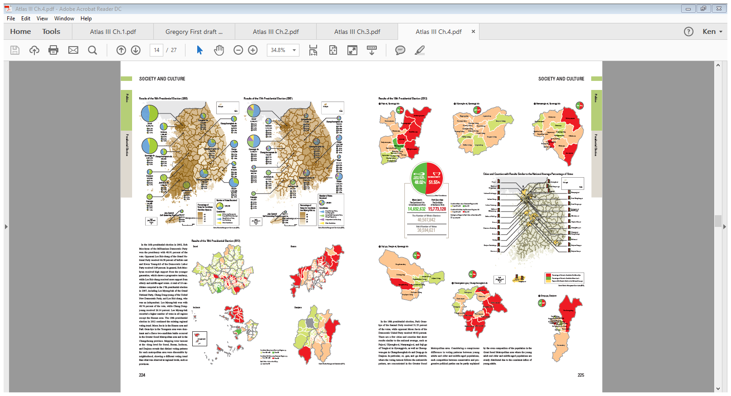
Same electoral map at larger scales
(showing similar data differently)
National Atlas III. Chapter 4.
Pages 224-225.

Slide 21
Lesson Plan
Social Studies Georgia Standards of Excellence Georgia Department of Education June 9, 2016. Page 139 of 156
Locate maps in the National Atlas of Korea (5-7, instructor can determine exact number range based on
their own parameters related to class time management, etc.) These maps should be similar in style and
context to the ones that appear on the following slides and are used as examples.
Identify the title of the map, what type of scale is being used (don’t forget about large or small, fractional
graphic or verbal).
How is the data being aggregated?
What is being identified within the legend?
Is it an accurate representation of what the data shows? If yes, explain why, if no explain why not and
what would be a better way to represent this data?
6. Out of all the examples of maps you took a look at which maps best represented the concept of scale.
Finally, based on how the data was represented which maps, of each of all the different types did the best job in
representing the data?

Slide 22
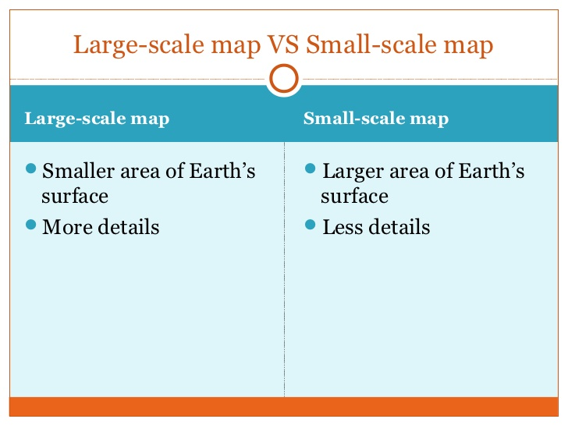
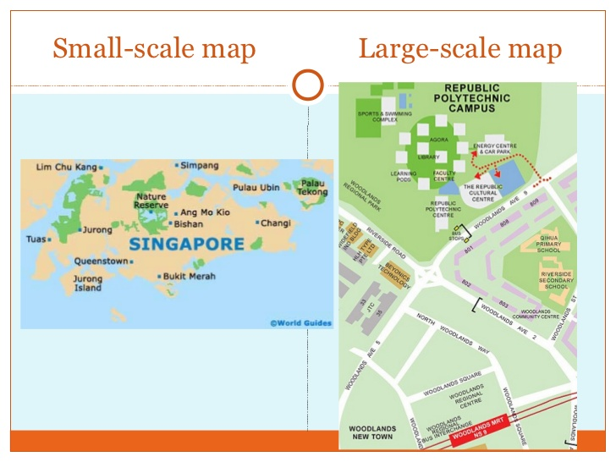
Large Scale vs. Small Scale Maps
https://image.slidesharecdn.com/secondary1nageographye-learning7thaugust2012-2nddraft-120801210453-phpapp01/95/secondary-1-na-geography-e-learning-7th-august-2012-9-728.jpg?cb=1344316902
http://image.slidesharecdn.com/secondary1nageographye-learning7thaugust2012-2nddraft-120801210453-phpapp01/95/secondary-1-na-geography-e-learning-7th-august-2012-10-728.jpg?cb=1344316902

Slide 23
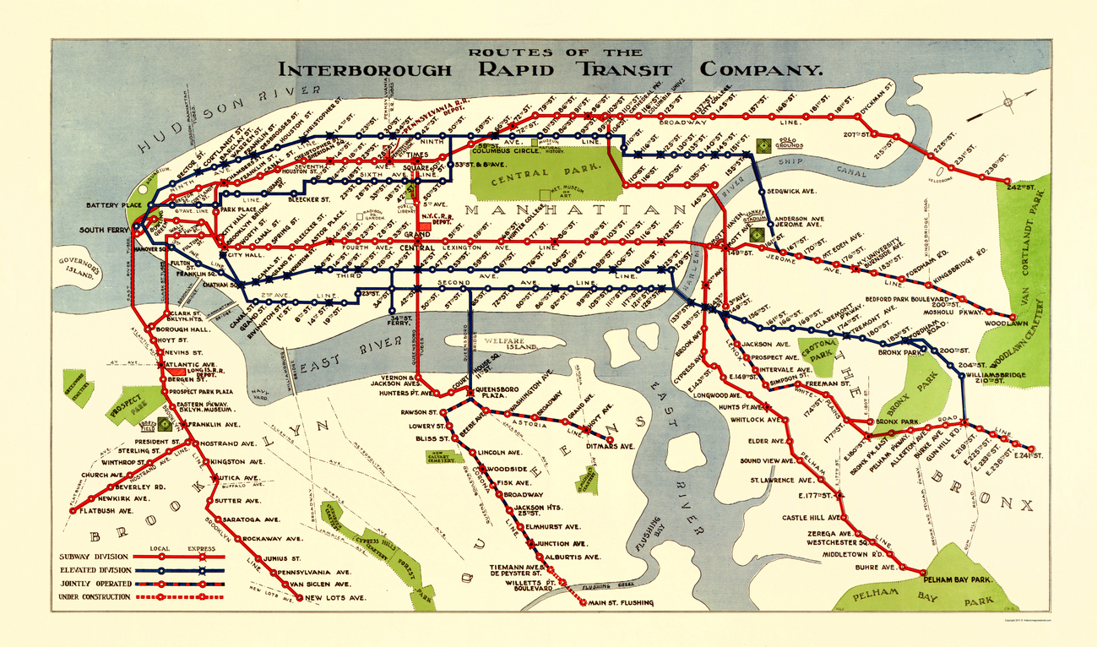
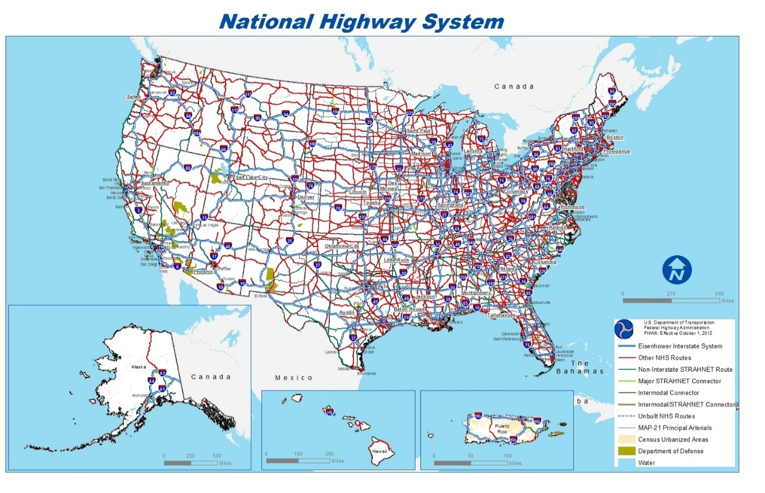
Transportation Route Maps
http://www.mapsofthepast.com/mm5/graphics/00000001/NYNY0003_a.jpg
https://globalforwarding.com/sites/default/files/ckeditor-uploader/nhs.jpeg

Slide 24
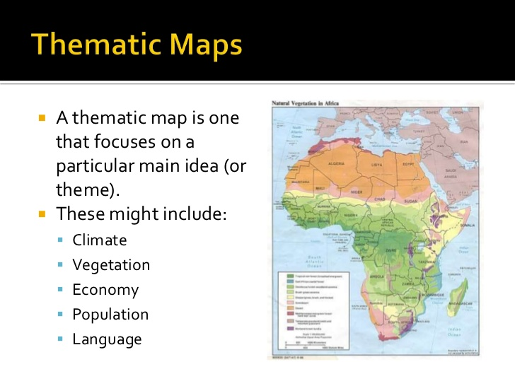
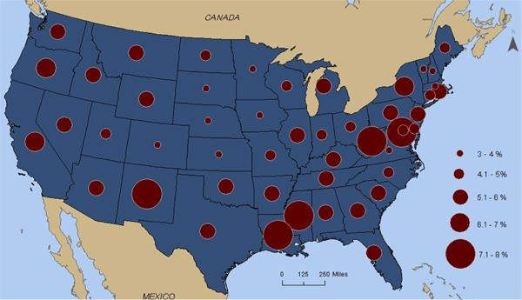
Thematic Maps
http://image.slidesharecdn.com/socialstudiesgeographyskills-thematicmapsclimate-forweb-120222135229-phpapp01/95/geography-skills-thematic-maps-climate-9-728.jpg?cb=1347936417
https://www.e-education.psu.edu/geog160/sites/www.e-education.psu.edu.geog160/files/image/Chapter03/Unemployment.png

Slide 25

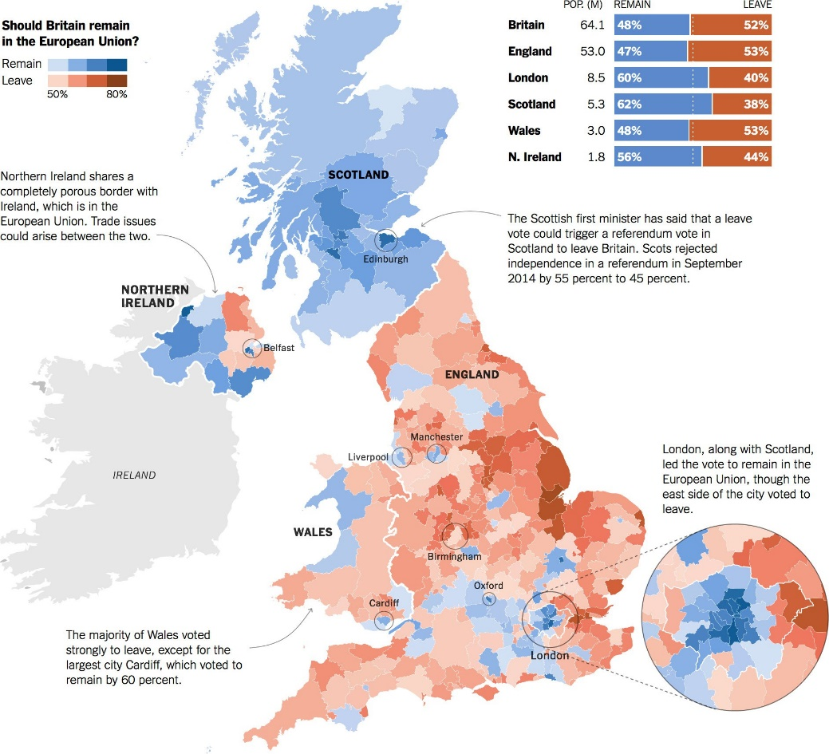
Choropleth Maps
http://static4.businessinsider.com/image/583c8f6bba6eb67d058b66d9-1190-625/heres-the-final-2016-electoral-college-map.jpg
https://i1.wp.com/www.maproomblog.com/xq/wp-content/uploads/2016/06/brexit-nyt.jpg?fit=1884%2C1713

Slide 26
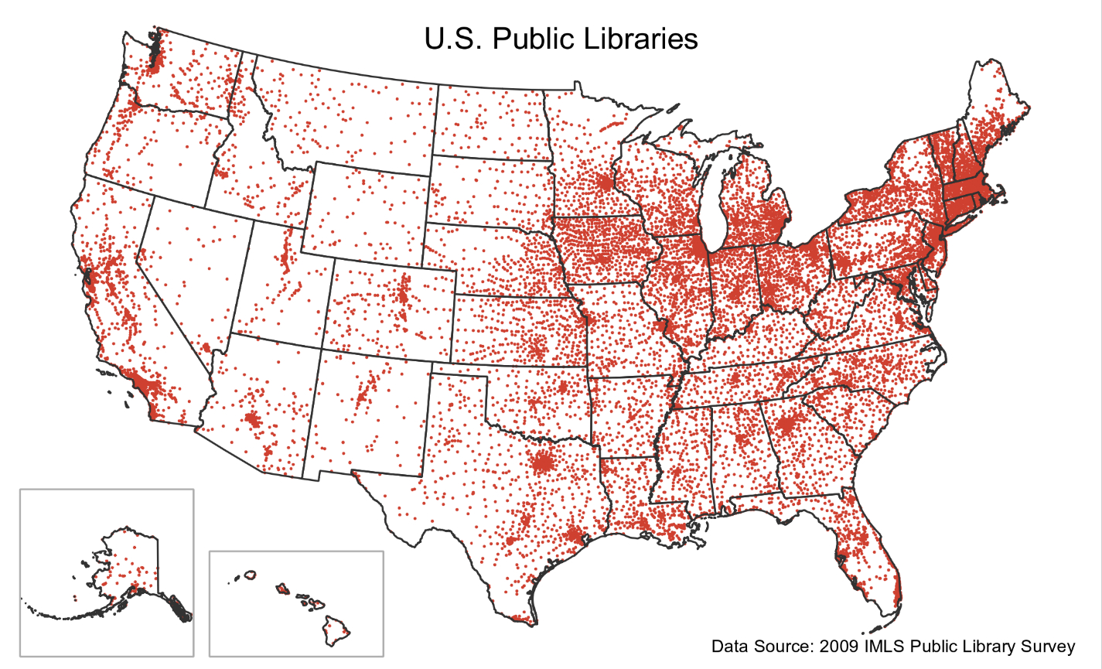
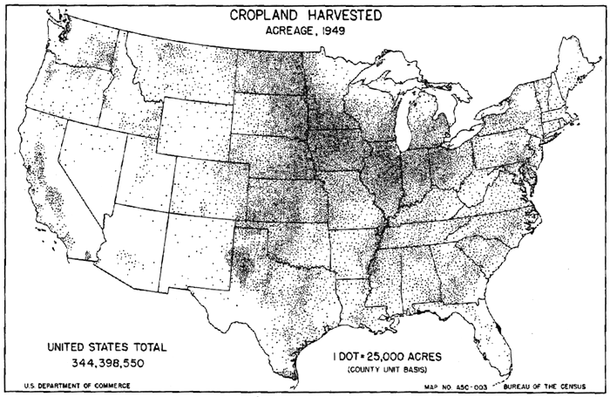
Dot Density Maps
https://www.e-education.psu.edu/geog486/sites/www.e-education.psu.edu.geog486/files/image/cropland_dotdensity.png
http://gothos.info/wp-content/uploads/2013/03/publibs_2009.png

Slide 27
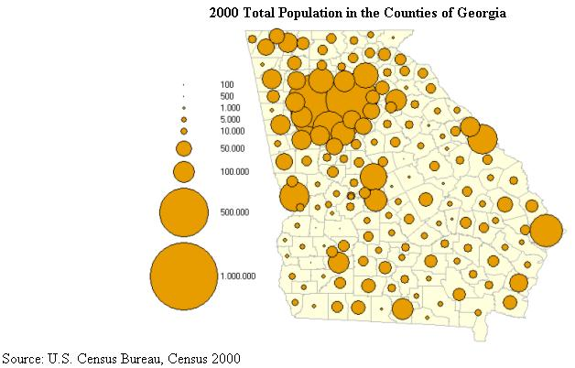
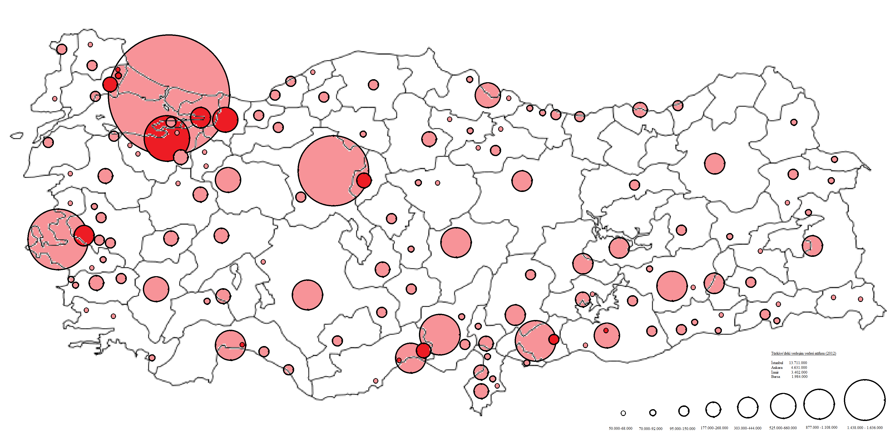
Proportional/Graduated Circle Maps
http://3.bp.blogspot.com/-XeSrbVWEFJs/T-puIeIZOGI/AAAAAAAAAA0/NpTTmUtPTxc/s1600/Proportion+dot+map+of+Georgia.jpg
https://upload.wikimedia.org/wikipedia/commons/e/ef/Proportional_circle_Turkey_city_town_population_map_2012.png

Slide 28
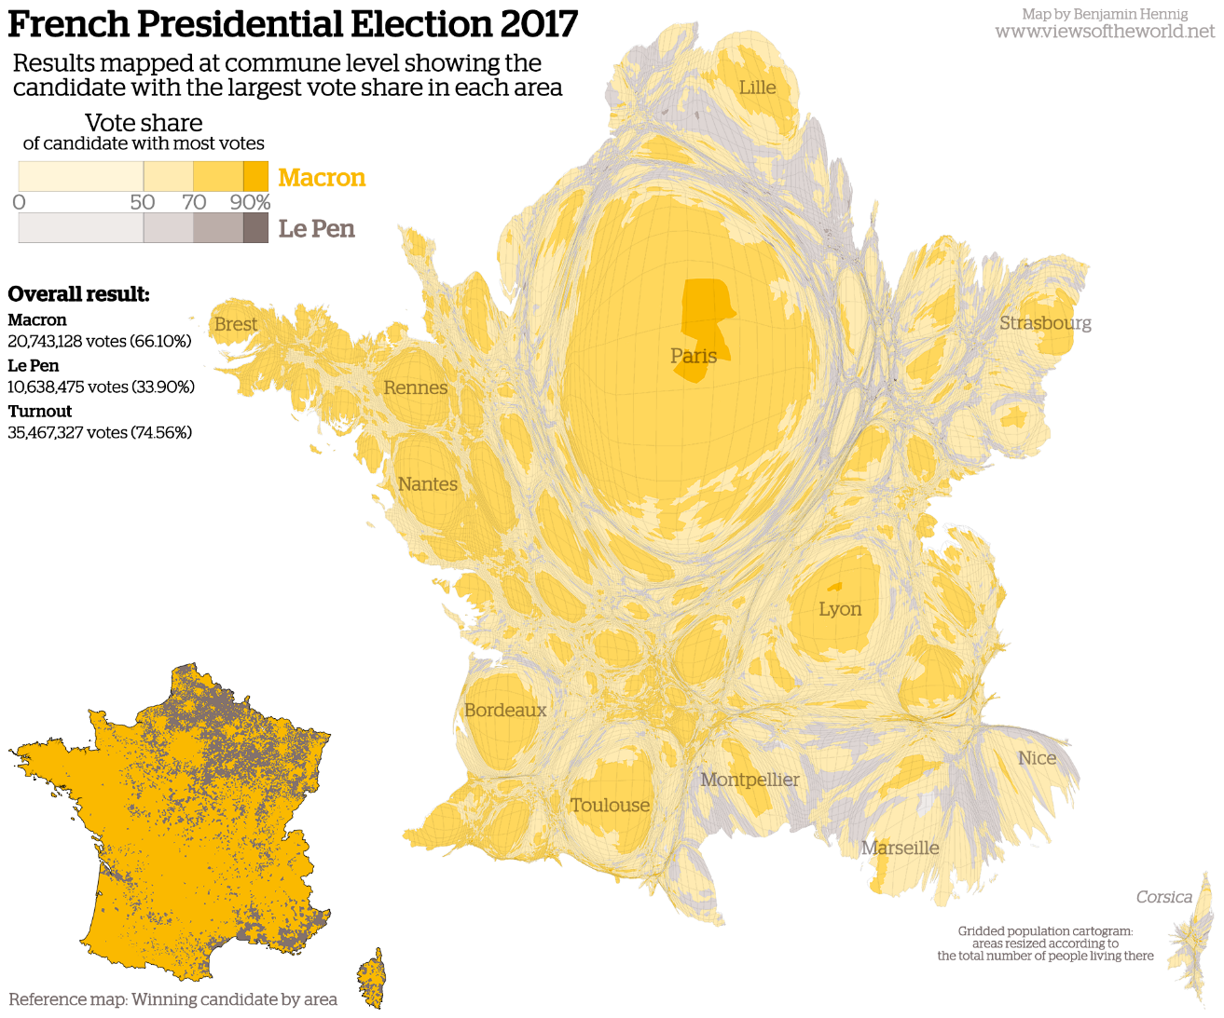
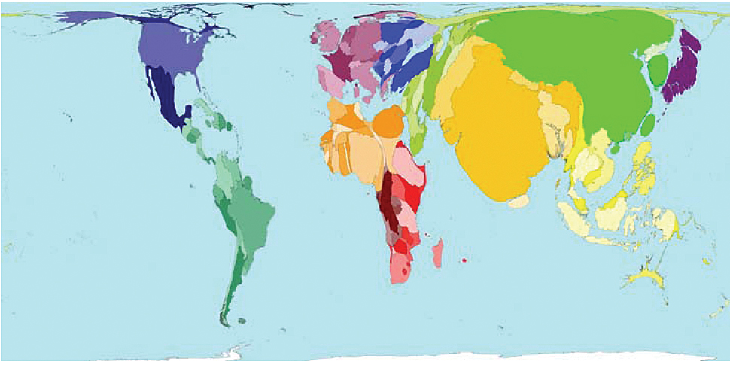
Cartograms
http://www.esri.com/news/arcuser/0110/graphics/cartogram_1-lg.jpg
http://www.viewsoftheworld.net/wp-content/uploads/2017/05/FrancePresidentialElectionMap2017.png

Slide 29
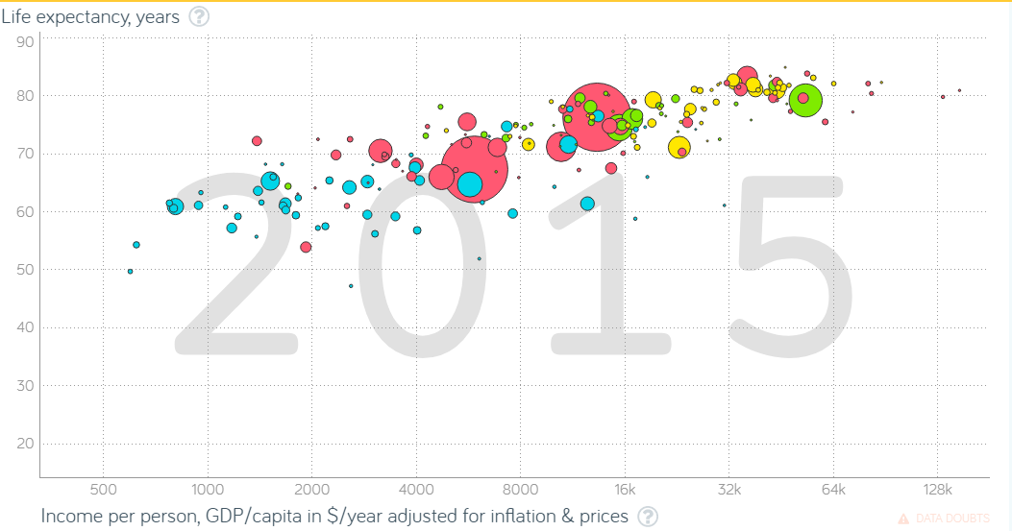
Cartograms (cont.)

Slide 30
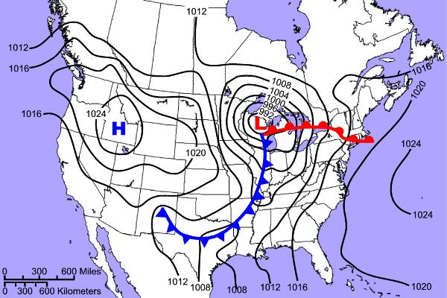
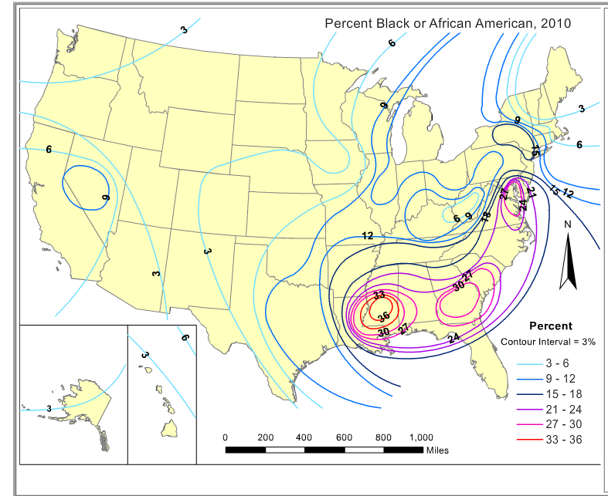
Isoline Maps
http://4.bp.blogspot.com/_7XZEj3oJhR0/TPv4d5sDRNI/AAAAAAAAADg/G694otkmsBY/s1600/isoline.gif
http://higheredbcs.wiley.com/legacy/college/kuby/1118422570/compchact/ch01/startUSA.html?newwindow=true

Slide 31
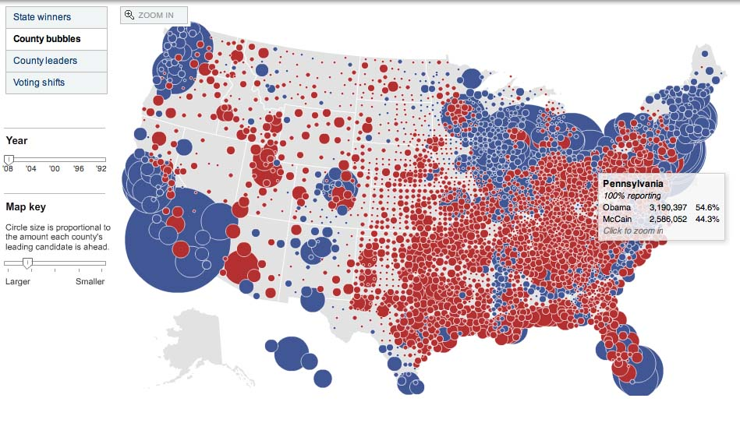
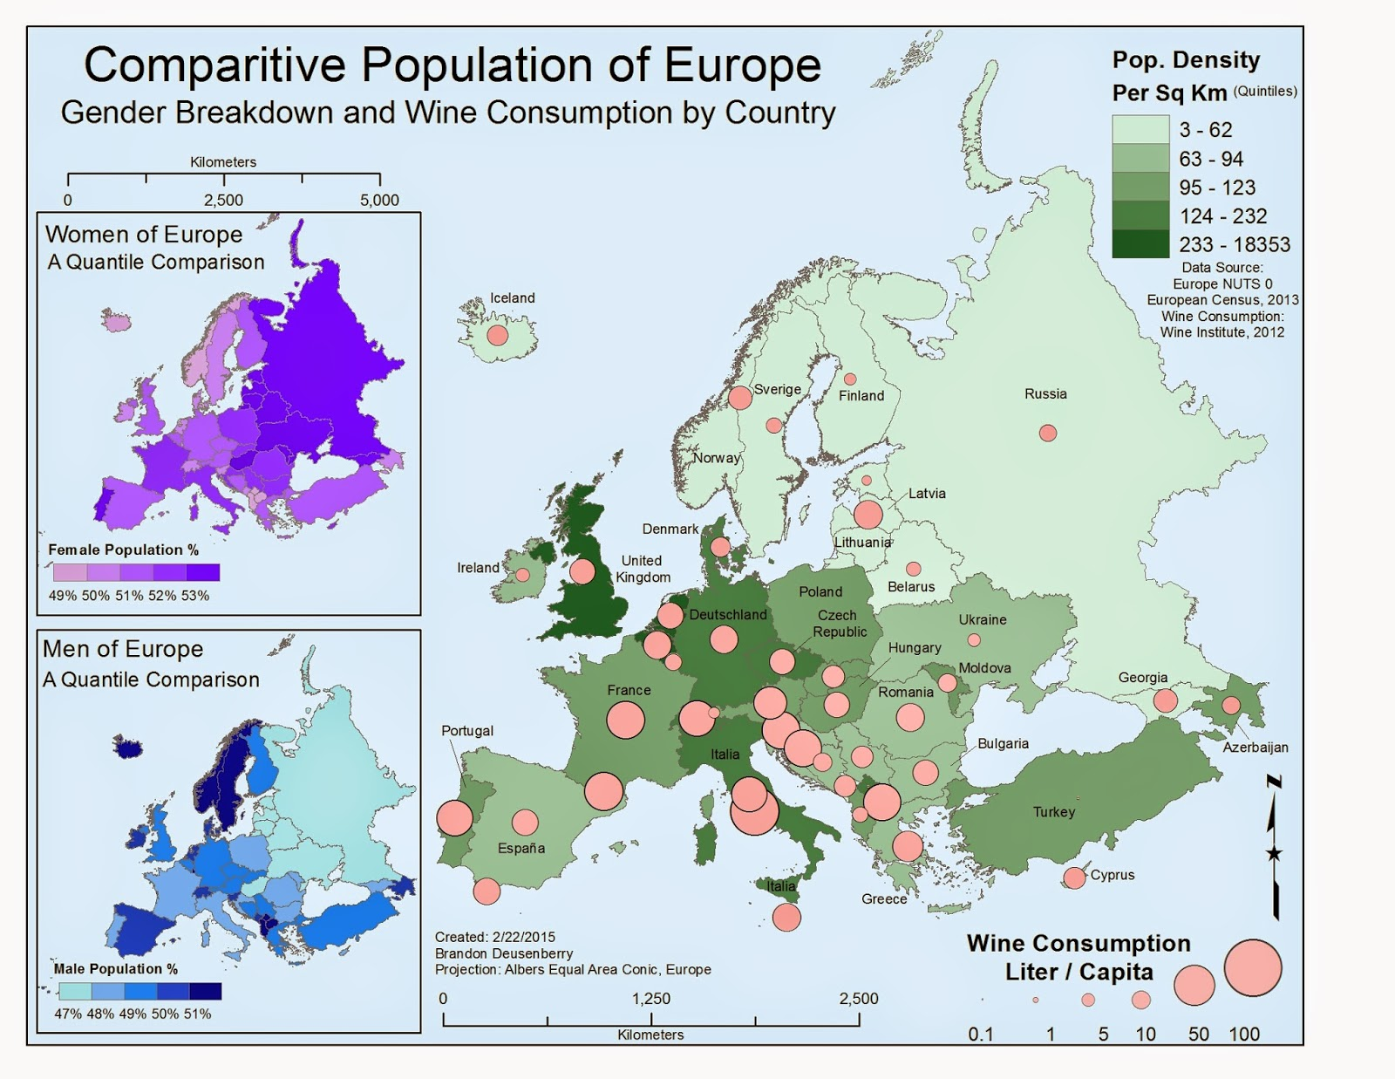
Maps with other embedded Stimulus
http://1.bp.blogspot.com/__9NRMYP3OGc/SxMuL7p8pkI/AAAAAAAAAG4/cnhk-QS8Xt4/s1600/circle+circle.jpg
http://2.bp.blogspot.com/-qmNfcqhwiwk/VOsULzlog2I/AAAAAAAAAe8/vOuKe0iU8OE/s1600/EuroMap.jpg

Slide 32
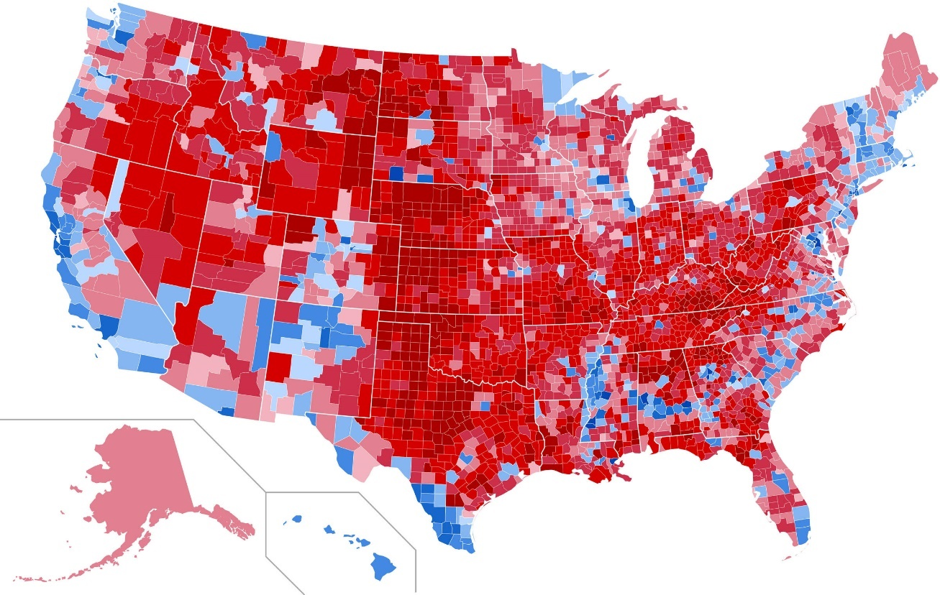
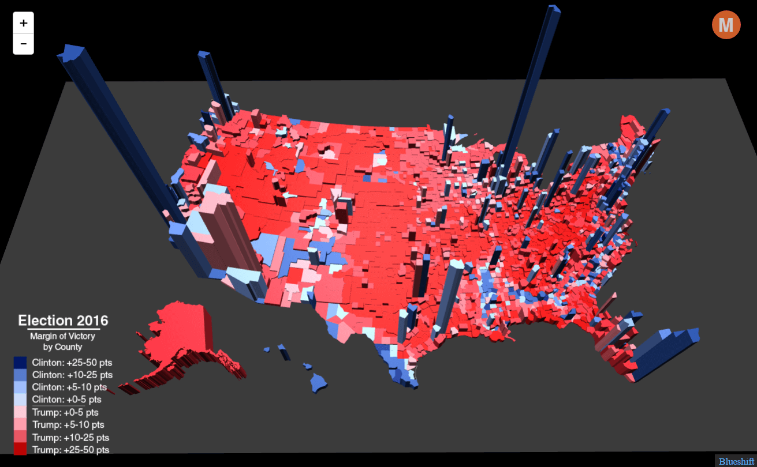
Same electoral map at larger scales
(showing similar data differently)
http://mediad.publicbroadcasting.net/p/michigan/files/styles/x_large/public/201611/2016_election_results_map_1.jpg
http://metrocosm.com/wp-content/uploads/2016/11/election-map-by-county-3d-1.png

Slide 33
Finally, one main question that can be asked is whether a cartographer is mapping the true geography of the land or simply mapping a set of data that is conveniently available. A map reader should train himself/herself to recognize the difference. It may not be an easy task, but taking the context of other geographic factors and other supporting maps or geographic information and then applying spatial thinking skills are critical in truly understanding the intended message of the map.
The 2006 publication by the U.S. National Research Council, Learning to Think Spatially: GIS as a support system in the K-12 curriculum, should be used by teachers as a reference and consultation for their efforts in developing lesson plans or for creating spatial thinking exercises.
Four lesson plans developed by a team of U.S. experienced geography teachers from maps and other materials in The National Atlas of Korea Volume I have been taught in classrooms for the past two and a half years to over 800 students in Utah, Minnesota, Tennessee, Georgia and several other states with success (Chu et.al.; 2016)
Drafts of additional lesson plans are also now being created and finalized utilizing Atlas versions II and III. These lesson plans can be downloaded by any teacher for use in their classroom since they are in the public domain (http://nationalatlas.ngii.go.kr/).
Along those lines, it is greatly encouraged that developing spatial thinking skills should begin at the middle and high school levels.
Many thanks to Dr. Gregory Chu for his work on Atlas IV which I have quoted from above ☺ And to Dr. Jongnam Choi,
and High school APHG colleagues Kelly Swanson, Michael Robinson and Doug Andersen for their continued assistance and
collegiality.

