Slide 1
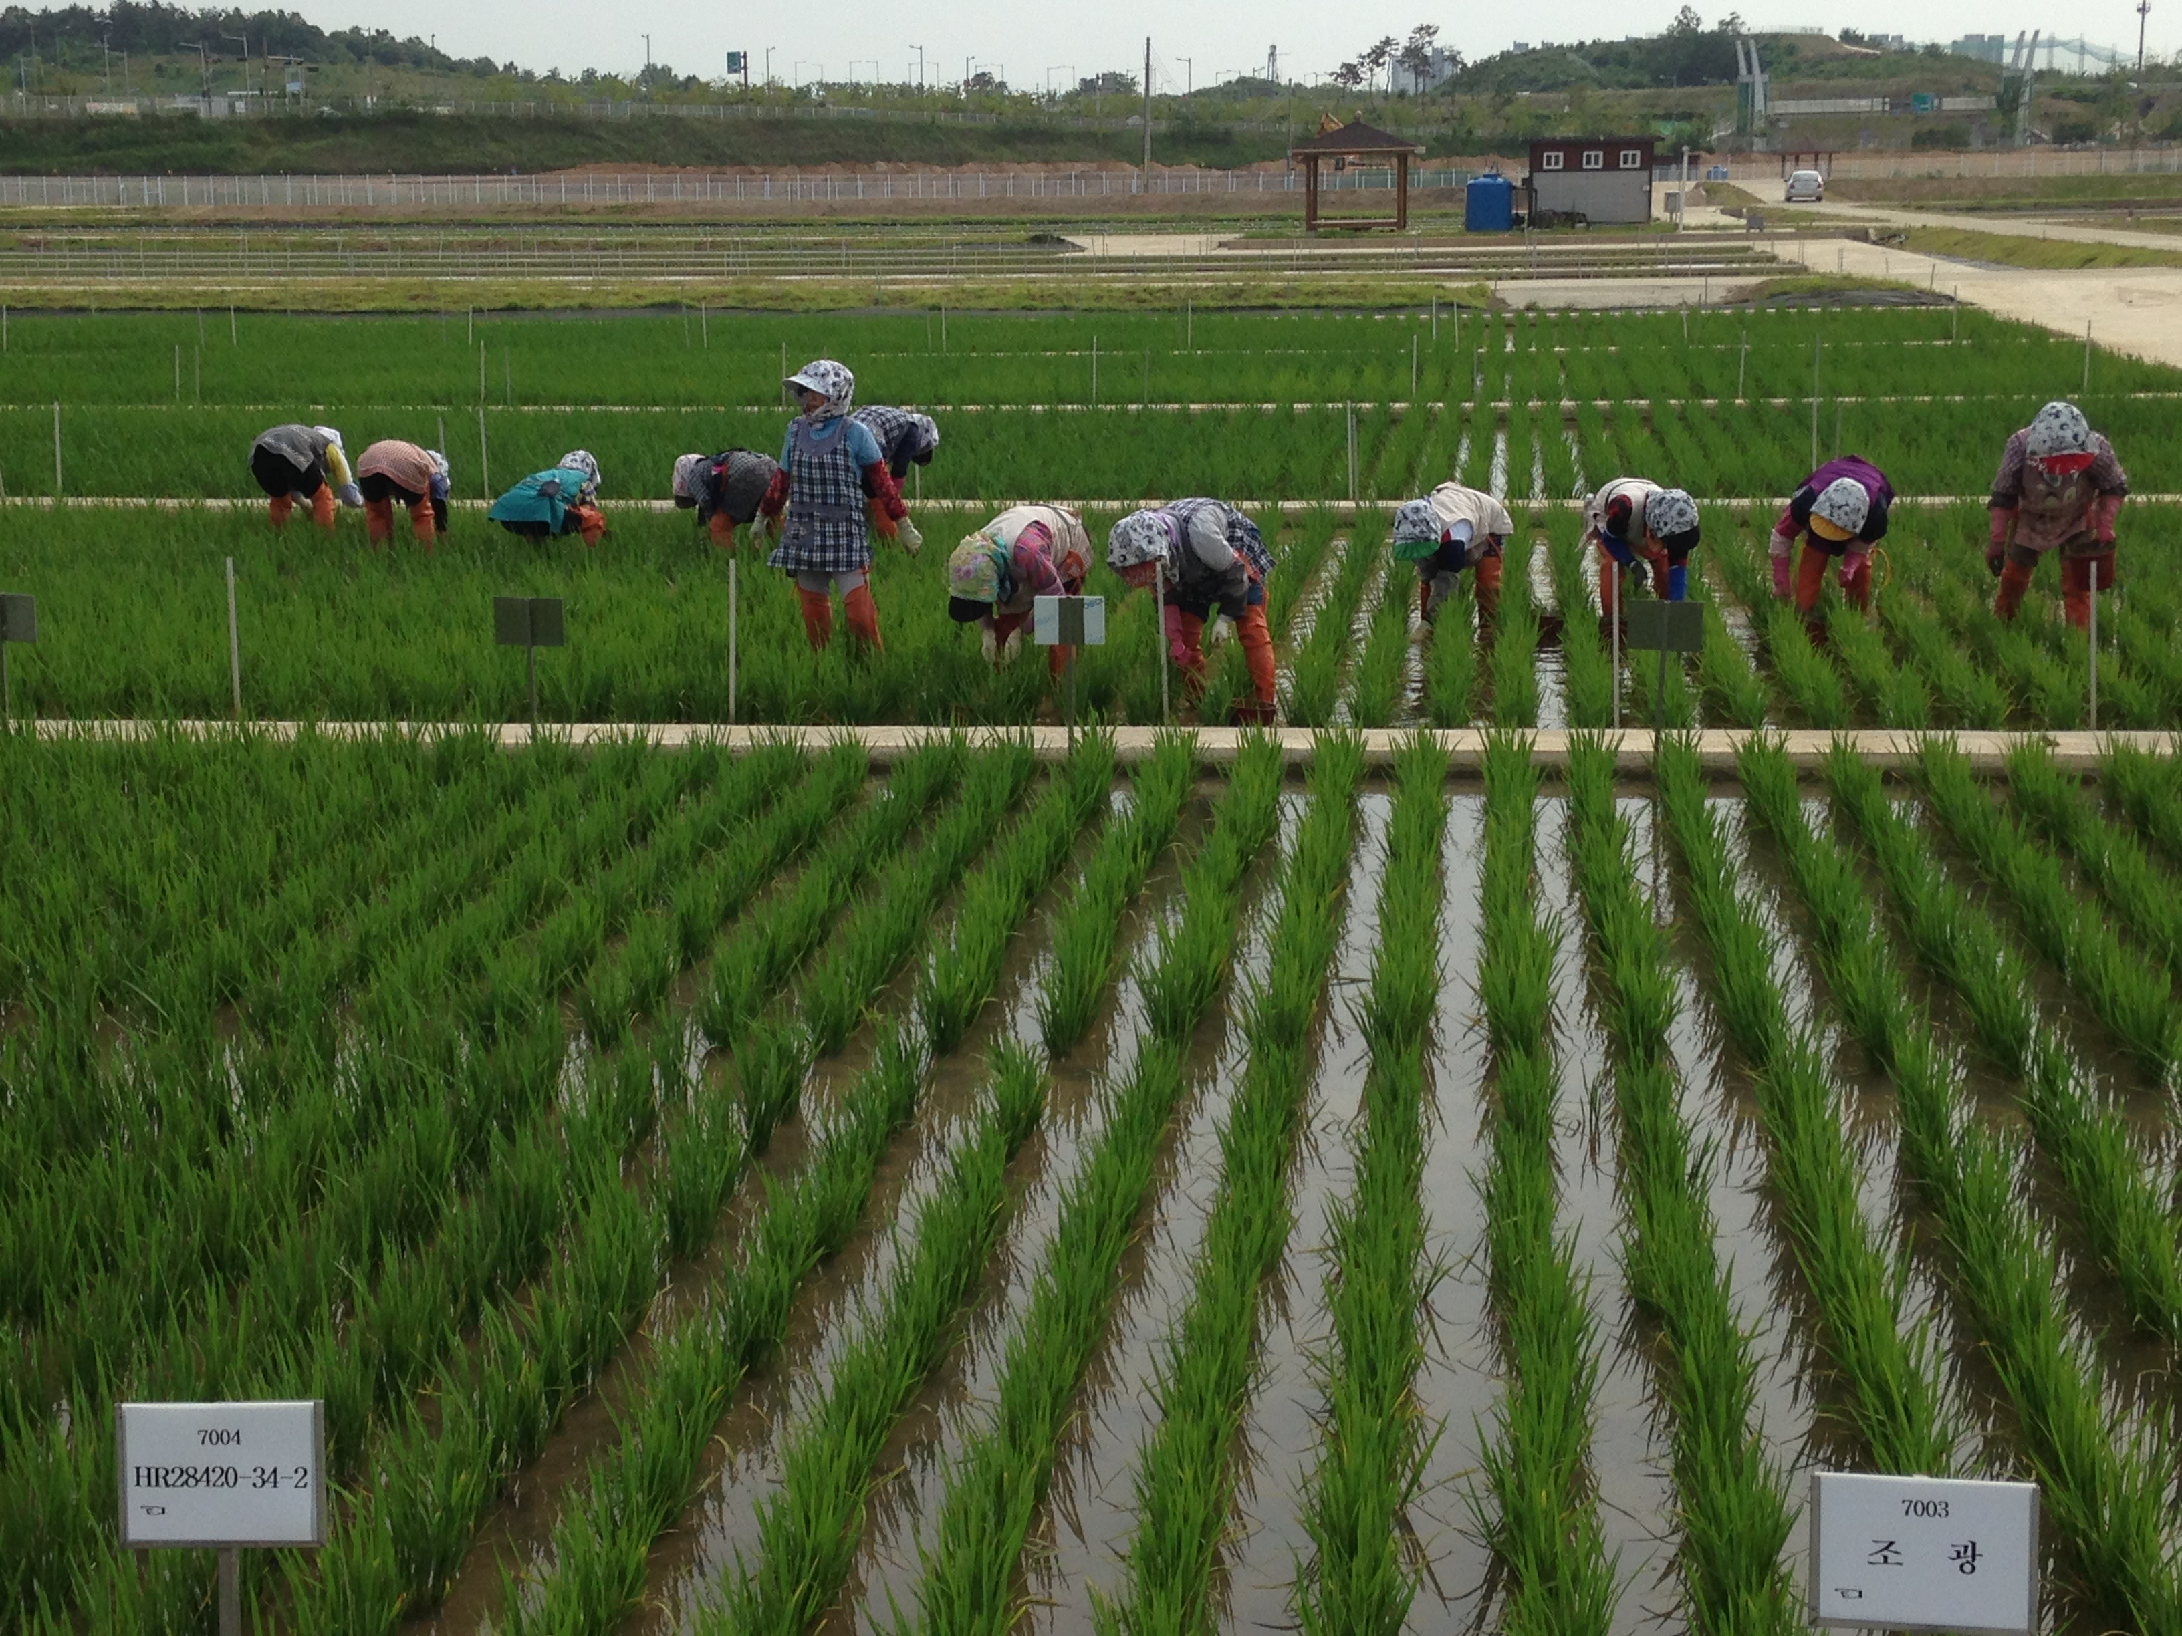
Rice is Nice! The Why of Where in Korean and US Ag.
Kelly Swanson
Metropolitan State University/ Johnson Senior High School
St. Paul, Minnesota

Slide 2
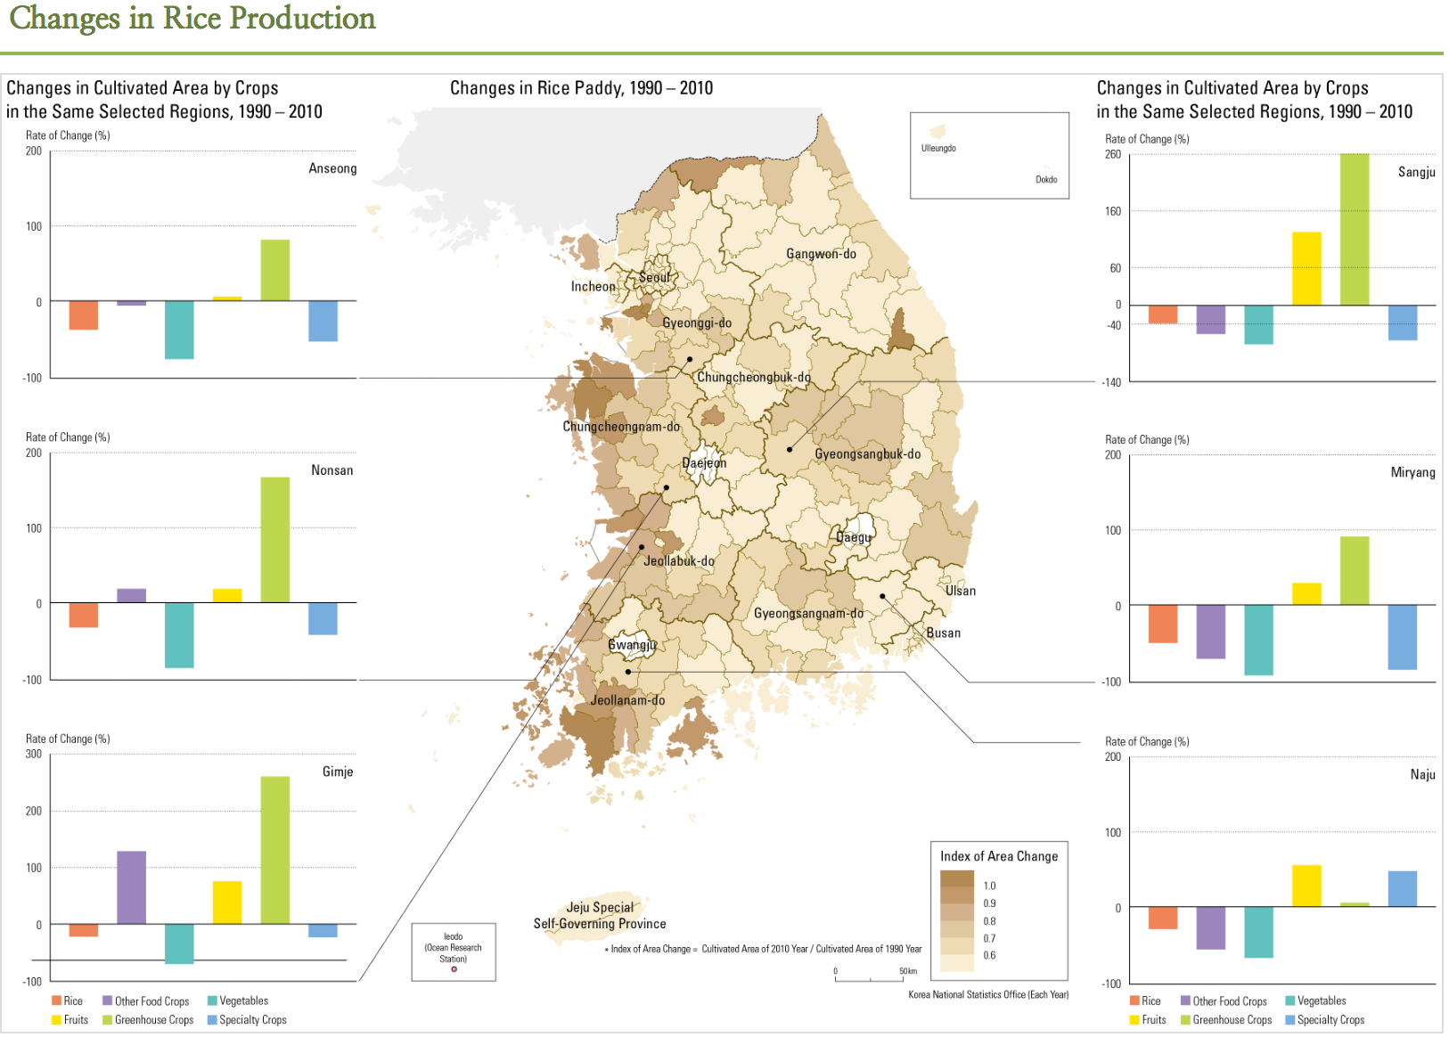
Where is Rice Grown in Korea?

Slide 3
What Explains This Trend?
Important to look at what’s on the map and what is not on the map.
Geography is the Why of Where.
What patterns are evident and seen with changes in time?

Slide 4
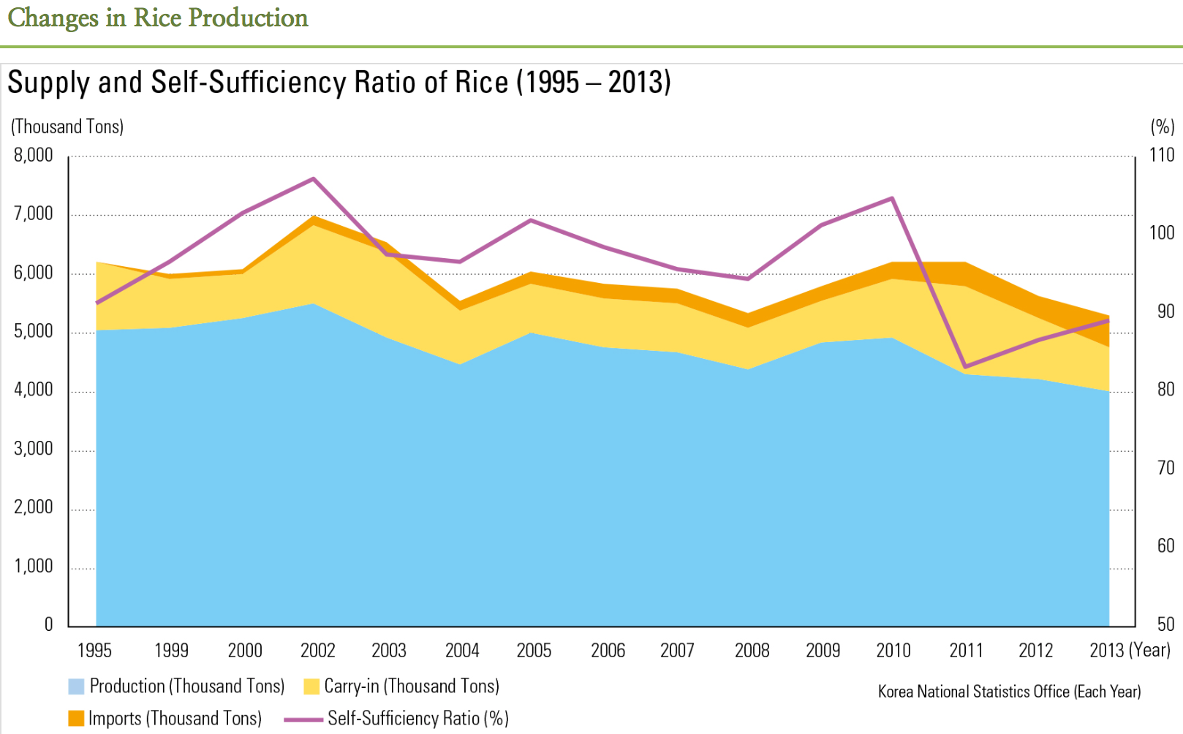
Rice Production in Korea

Slide 5
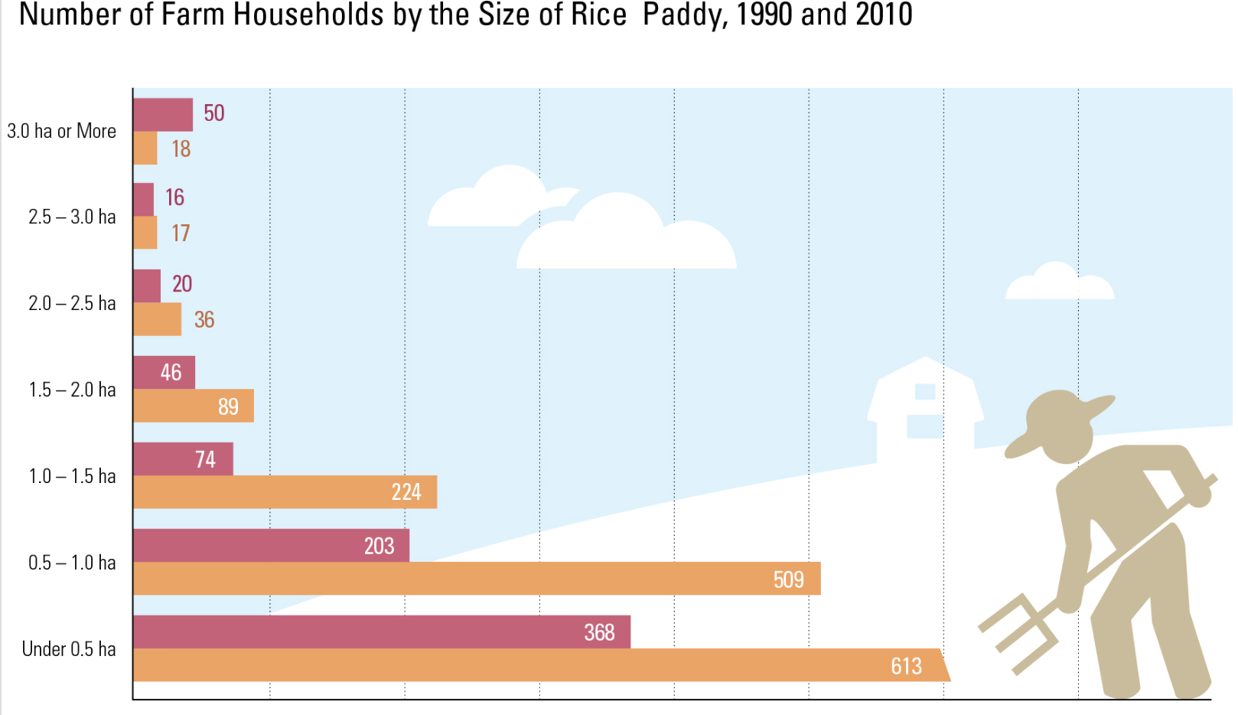
Rice Production in Korea

Slide 6
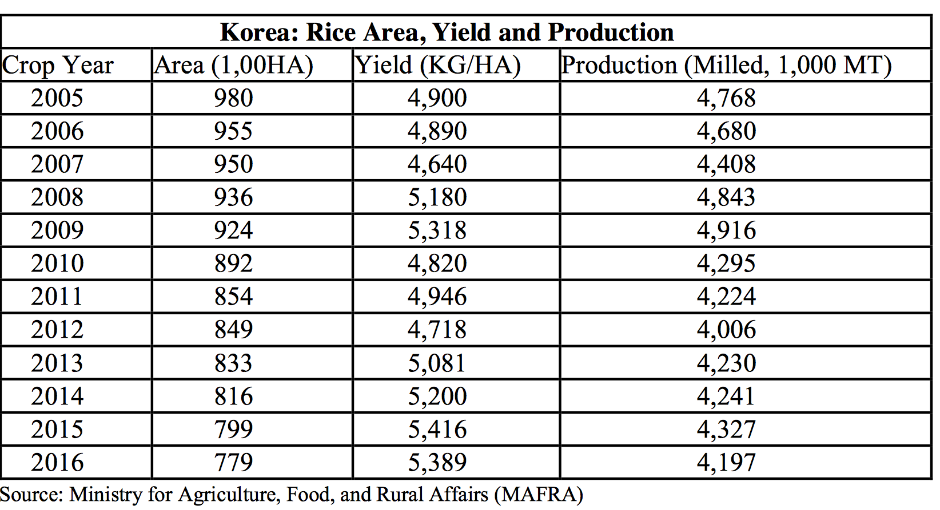
Rice Production in Korea

Slide 7
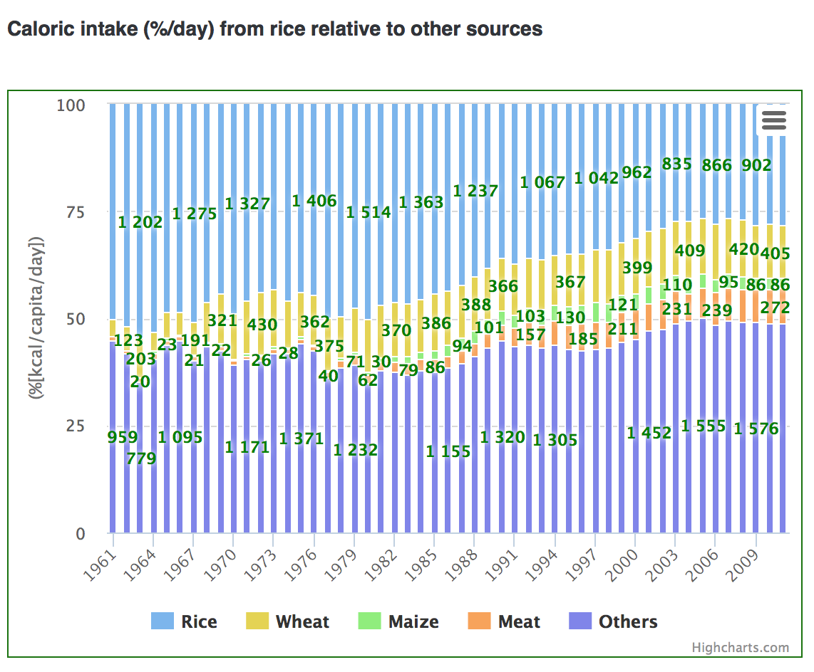
Rice as Food
Source: Ricepedia

Slide 8
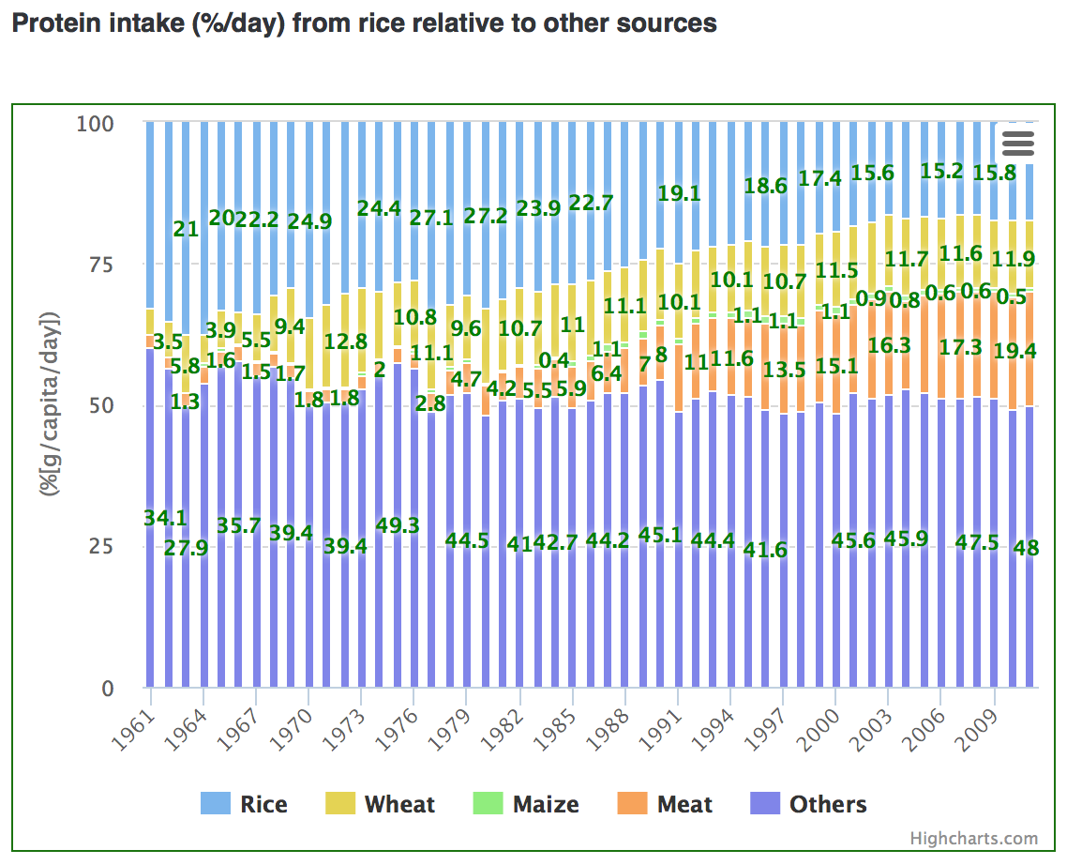
Rice as Food
Source: Ricepedia

Slide 9
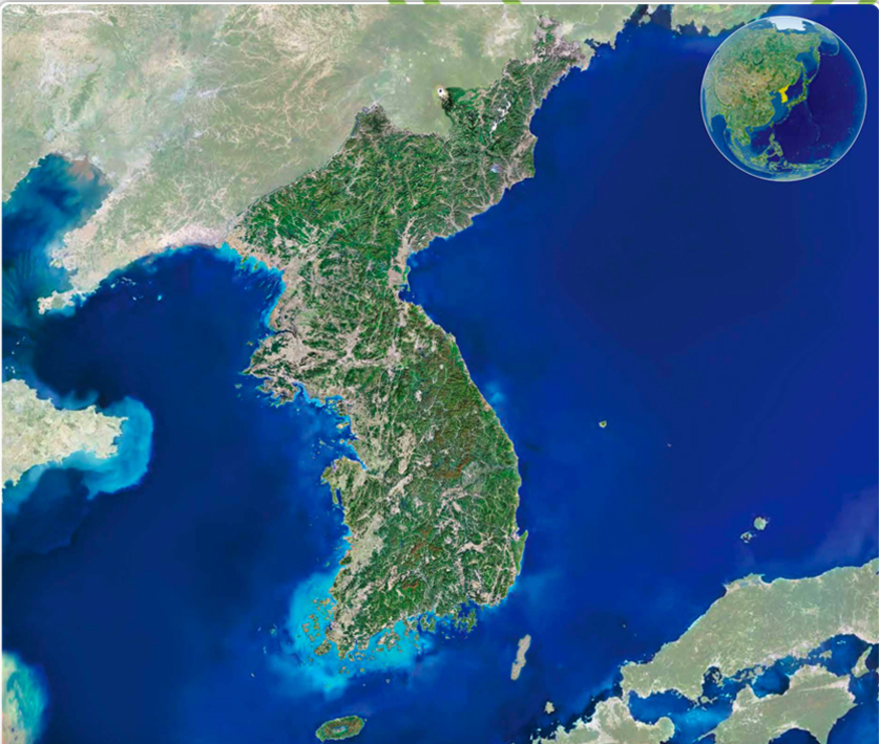
Physical Map of Korea

Slide 10
Conclusions - Rice Production in Korea
Rice consumption is decreasing as a percentage of the overall diet.
Rice production has become more efficient on less land in the previous three decades
Rice is still imported in Korea due to trade agreements with the United States and Europe.
White revolution has increased profits for farmers in Korea specifically located near urban areas – von Thunen.

Slide 11
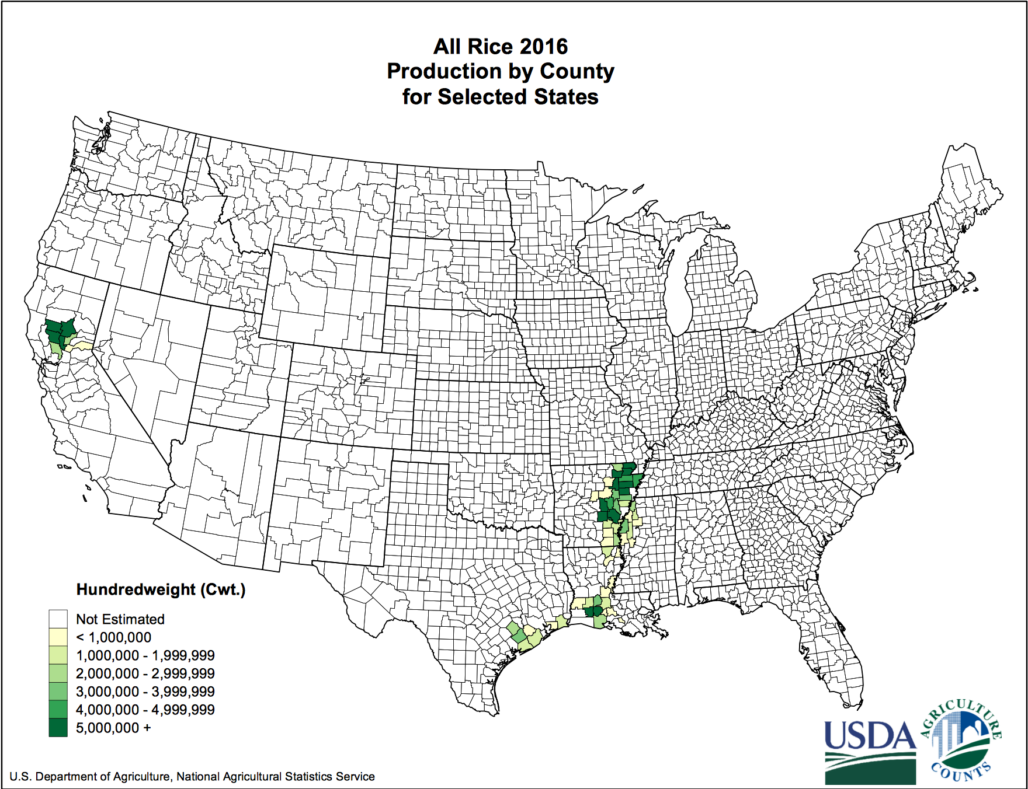
Rice Production in the United States

Slide 12
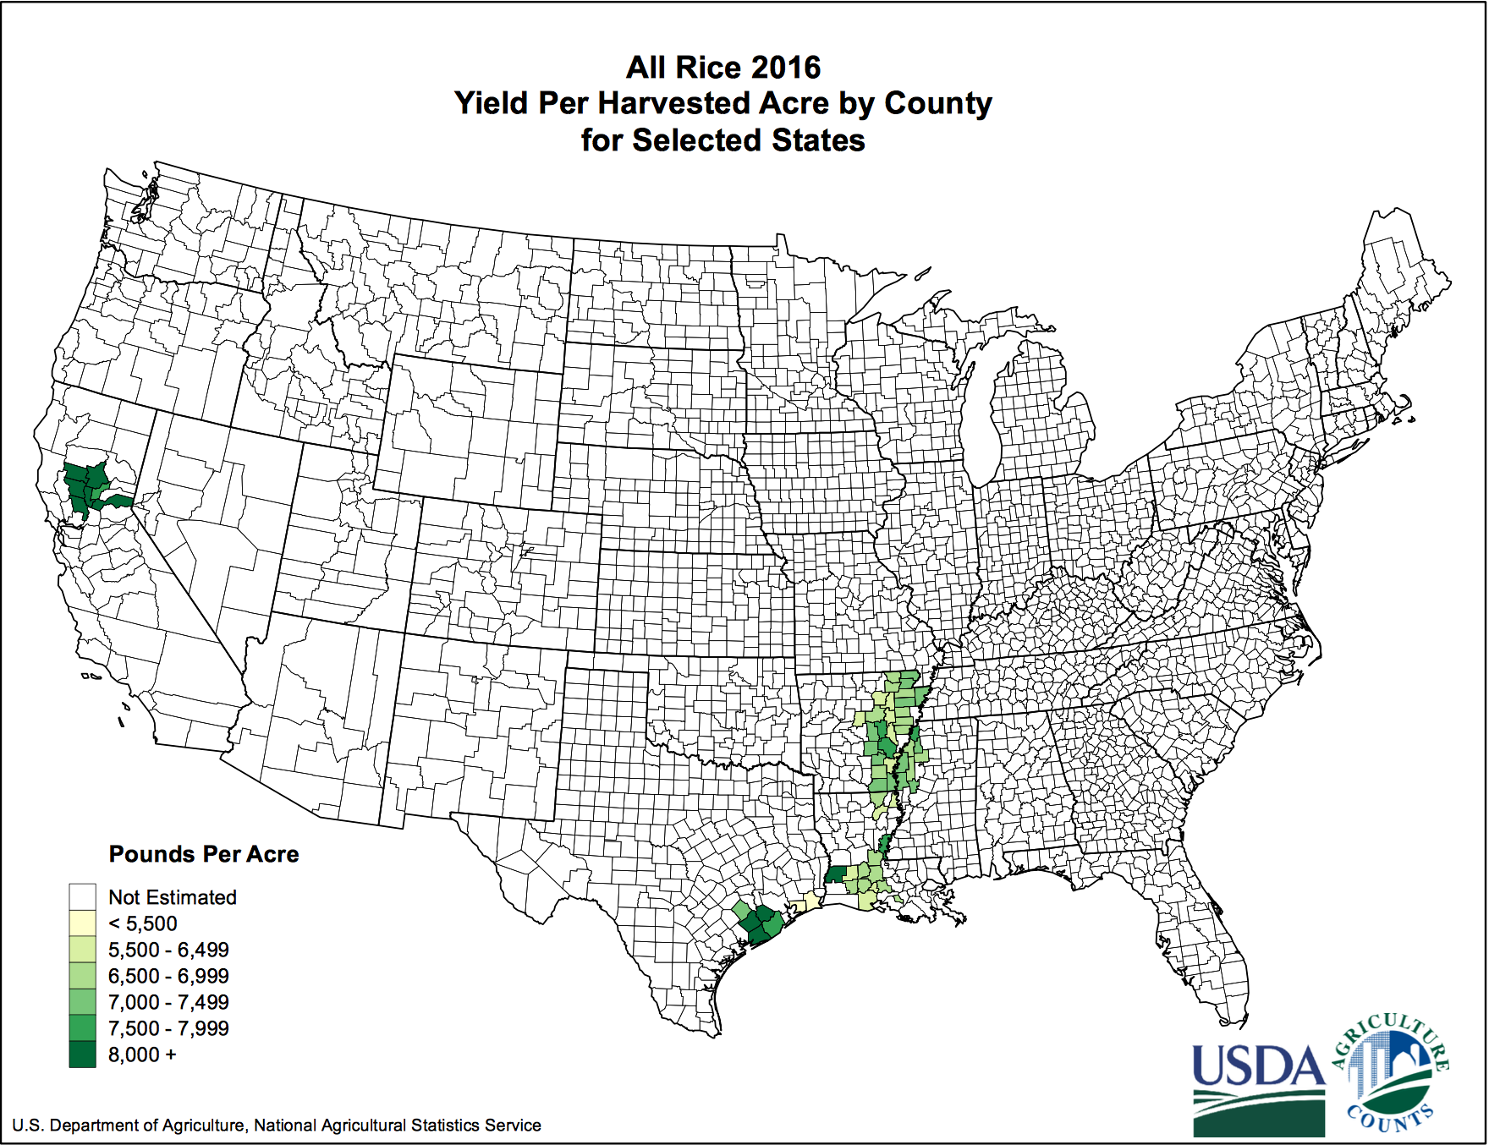
Rice Production in the United States

Slide 13
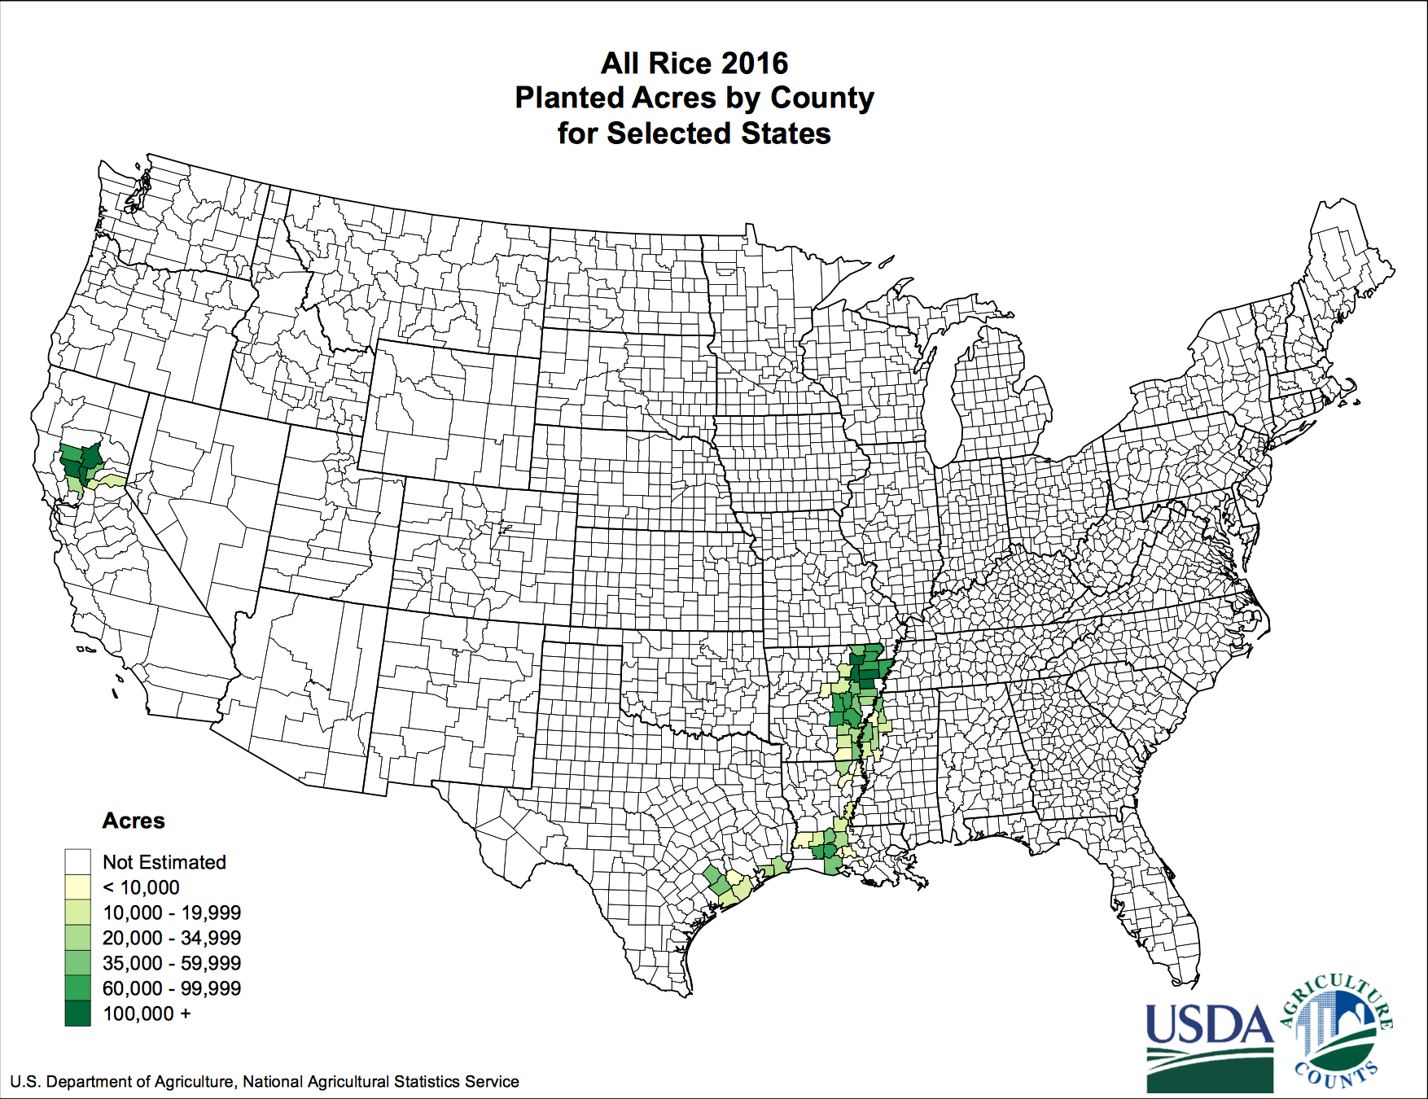
Rice Production in the United States

Slide 14
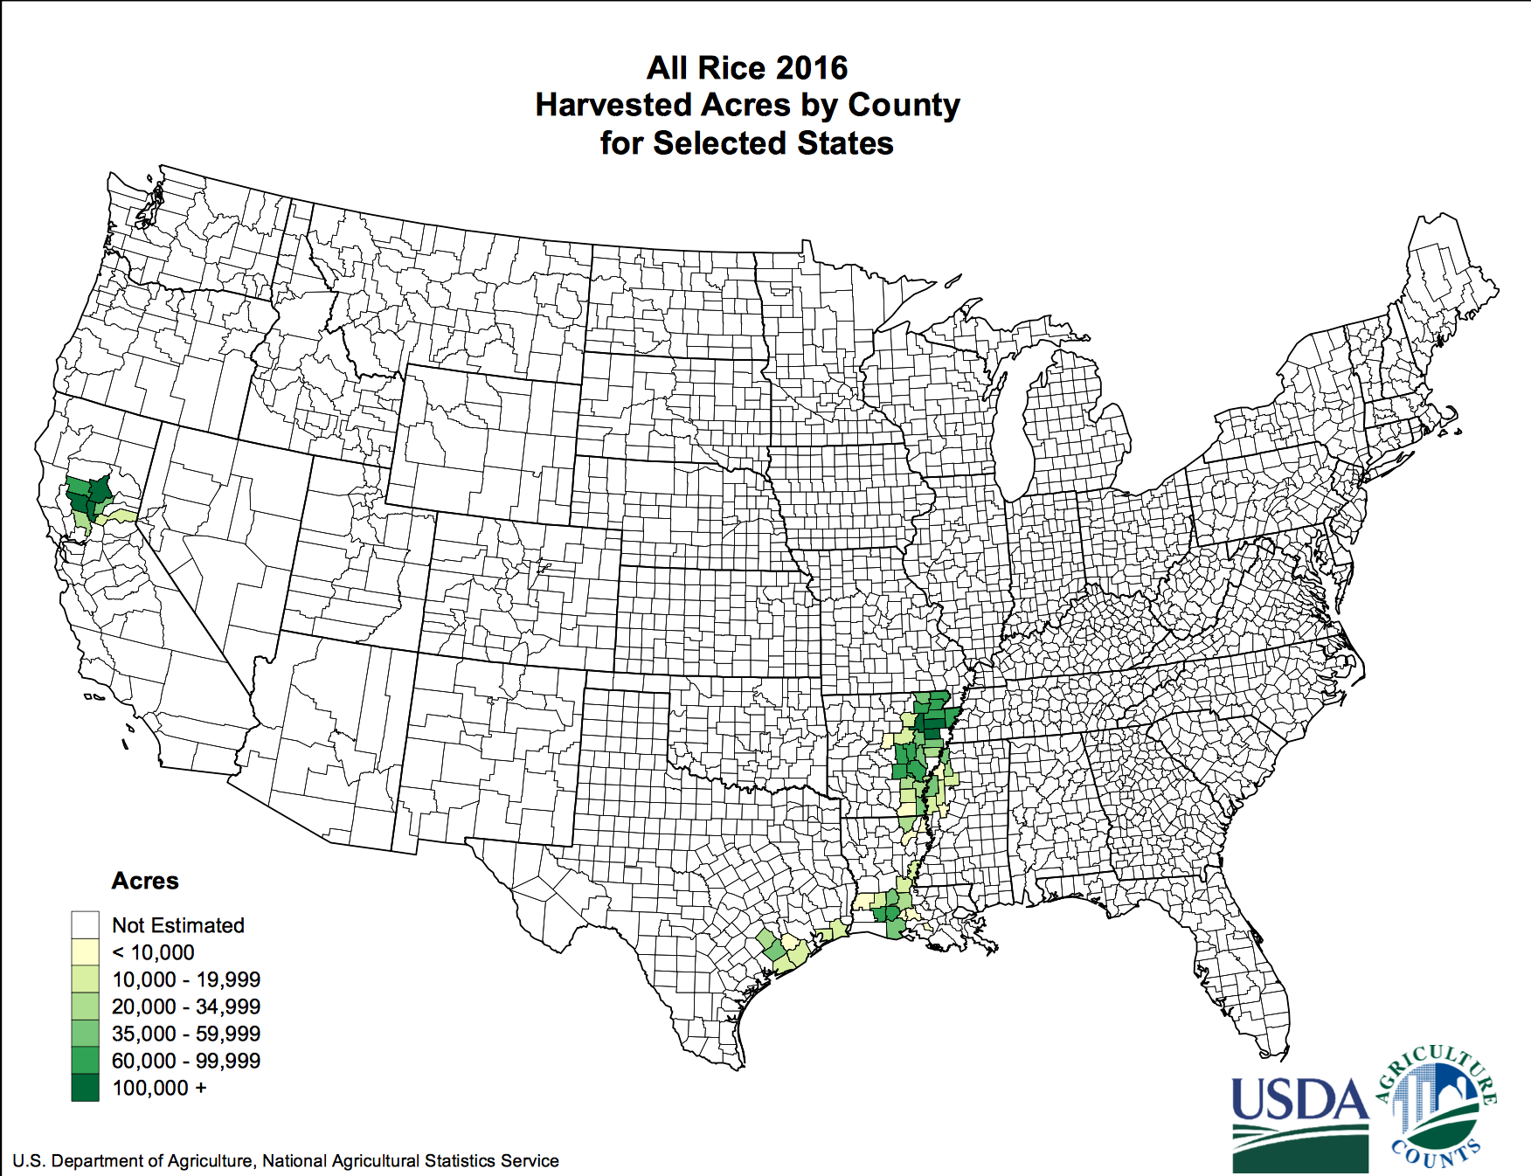
Rice Production in the United States

Slide 15
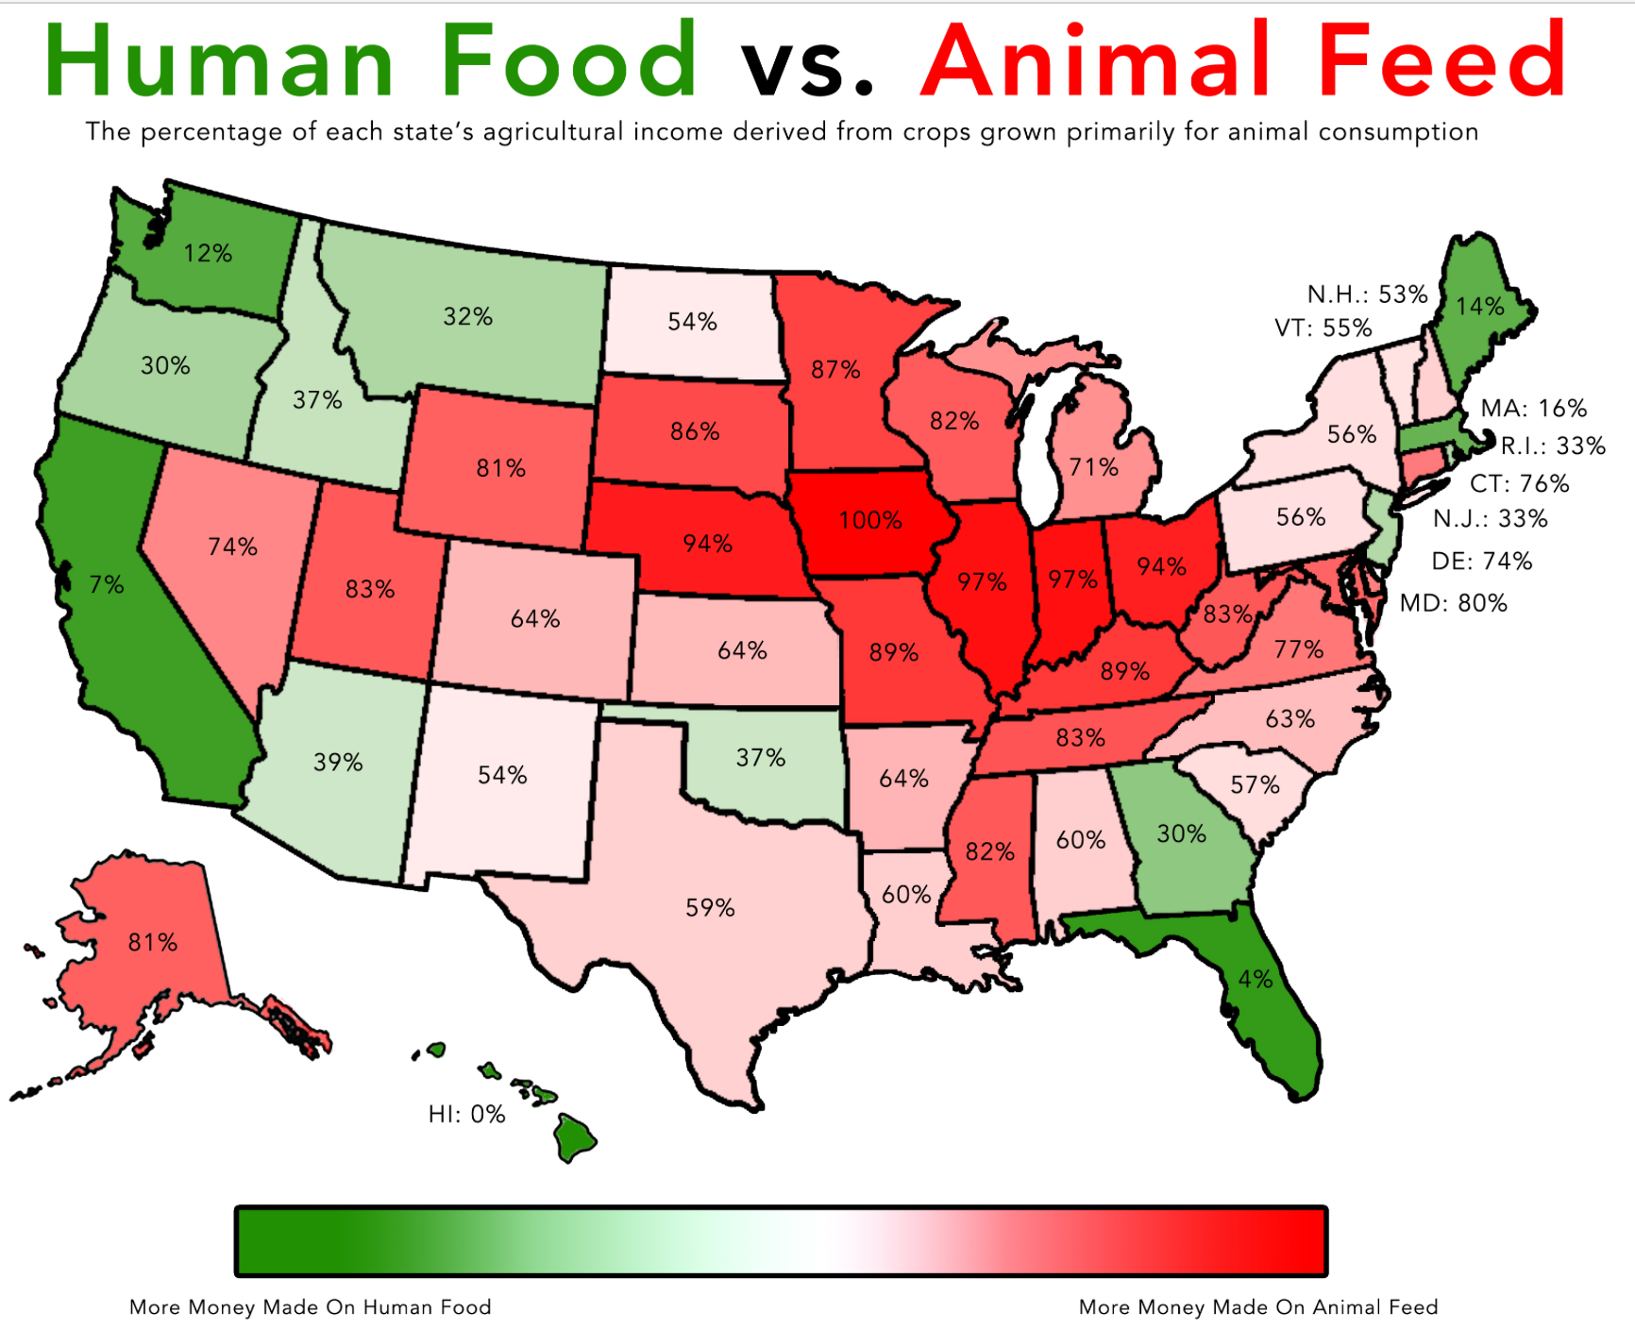
Rice Production in the United States

Slide 16
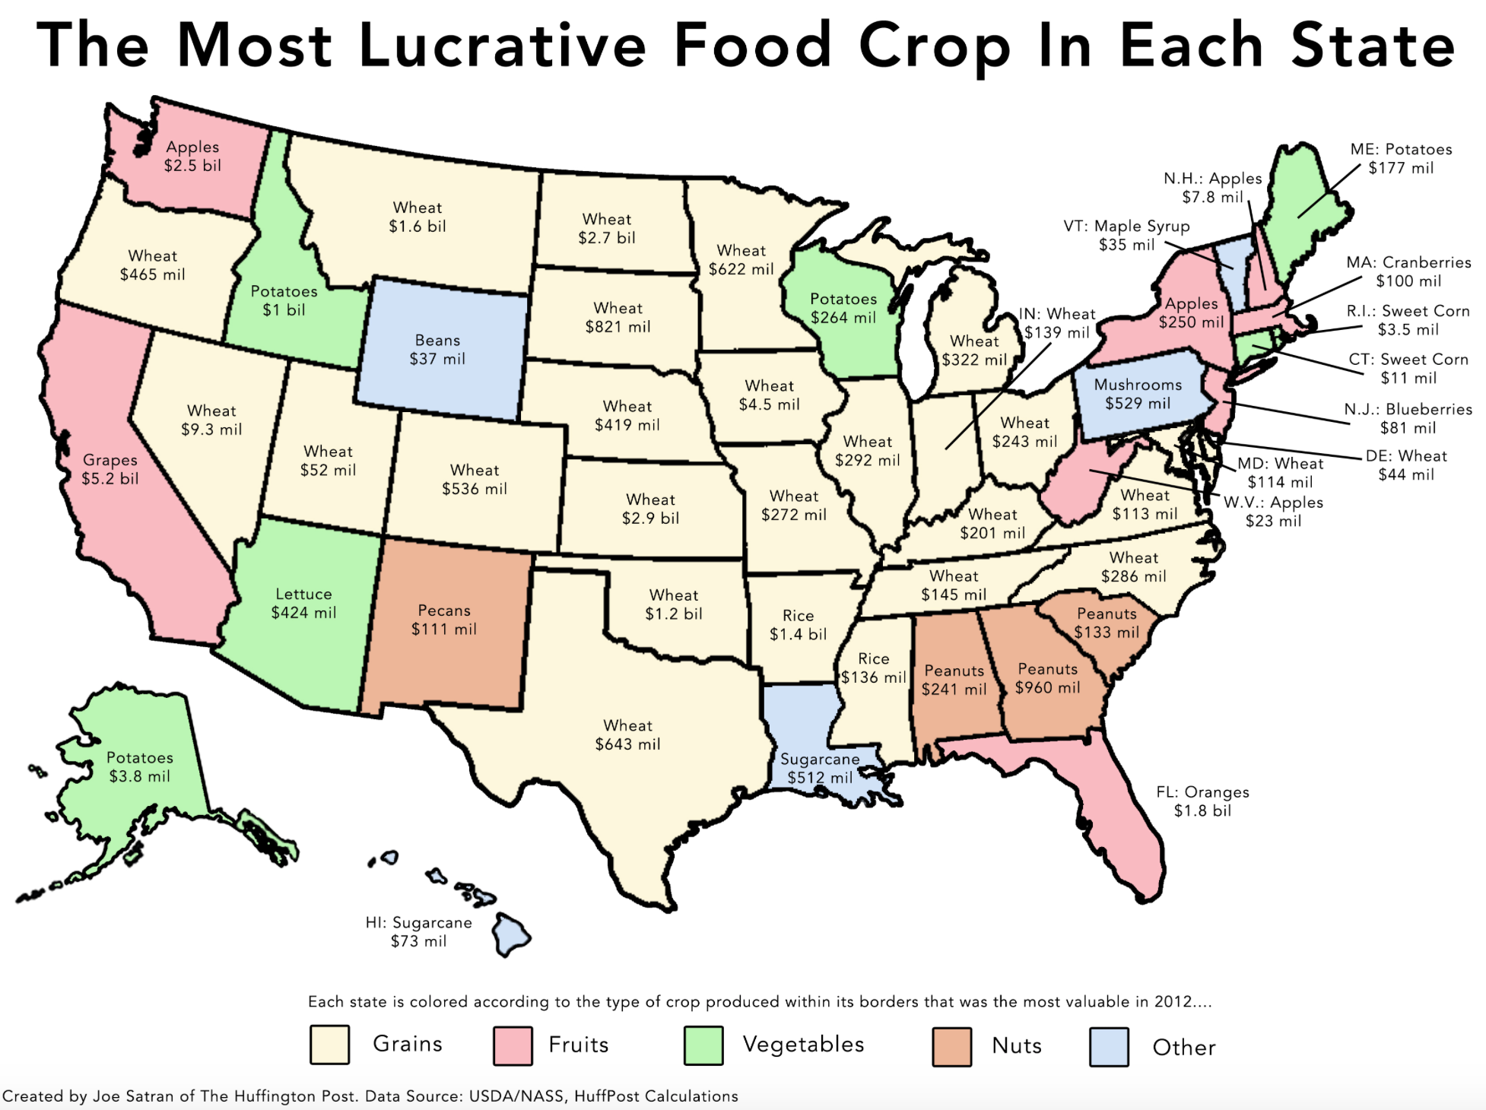
Rice Production in the United States

Slide 17
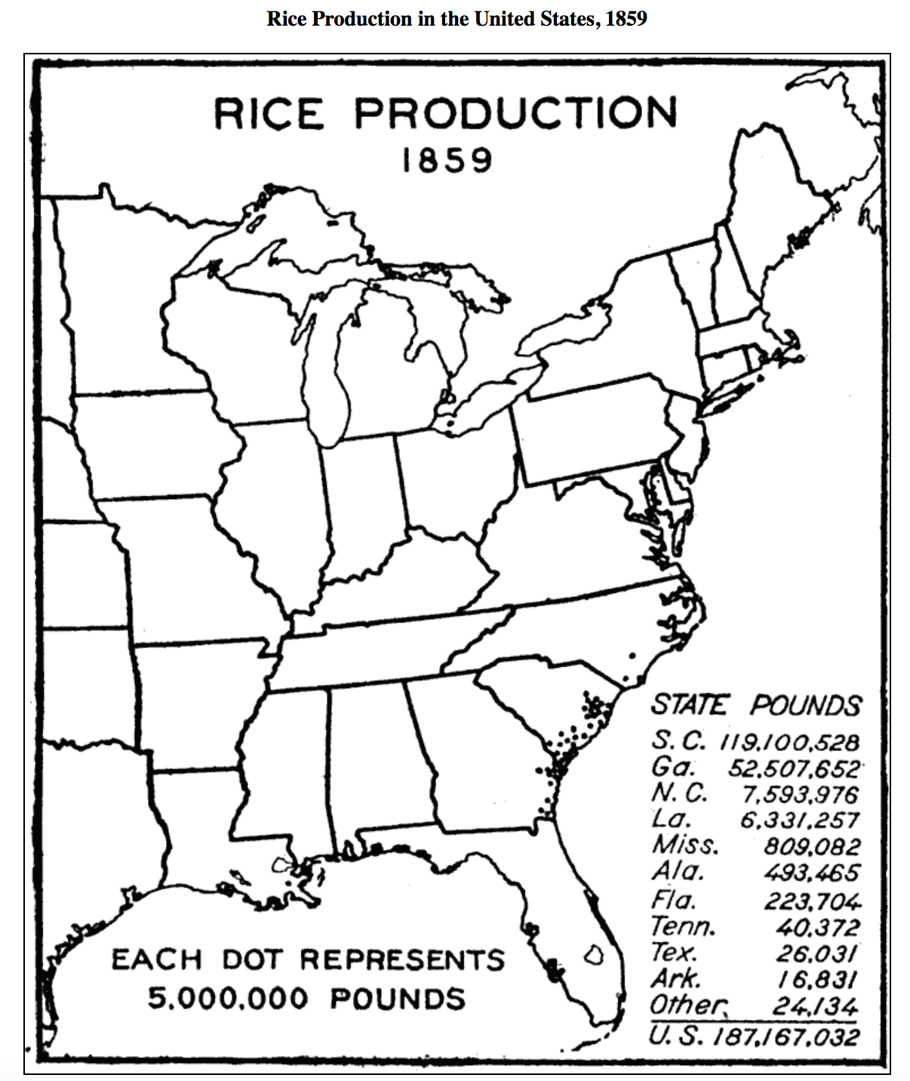
History of Rice Production

