Slide 1
The Why, Where and When of Korean Economic Development
Kelly Swanson
Metropolitan State University
Johnson Senior High School
St. Paul, Minnesota
2015 NCGE Conference
August 7th, 2015

Slide 2
National Standards
#1 – How to use maps and other geographic representations, geospatial technologies, and spatial thinking to understand and communicate information.
#11 – The patterns and networks of economic interdependence on Earth’s surface.
#18 – How to apply geography to interpret the present and plan for the future.

Slide 3
Minnesota Graduation Standards
9.3.1.1.2 – Apply geographic information from a variety of print and electronic sources to interpret the past and present and plan for the future; provide rationale for using specific technologies for each application.
9.3.2.3.1 – Make inferences and draw conclusions about the physical and human characteristics of places based on a comparison of maps and other geographic representations and geospatial technologies.
9.3.2.4.2 – Identify the primary factors influencing the regional pattern of economic activities in the United States and the world.
9.3.3.5.6 – Analyze how transportation and communication systems have affected the development of systems of cities.

Slide 4
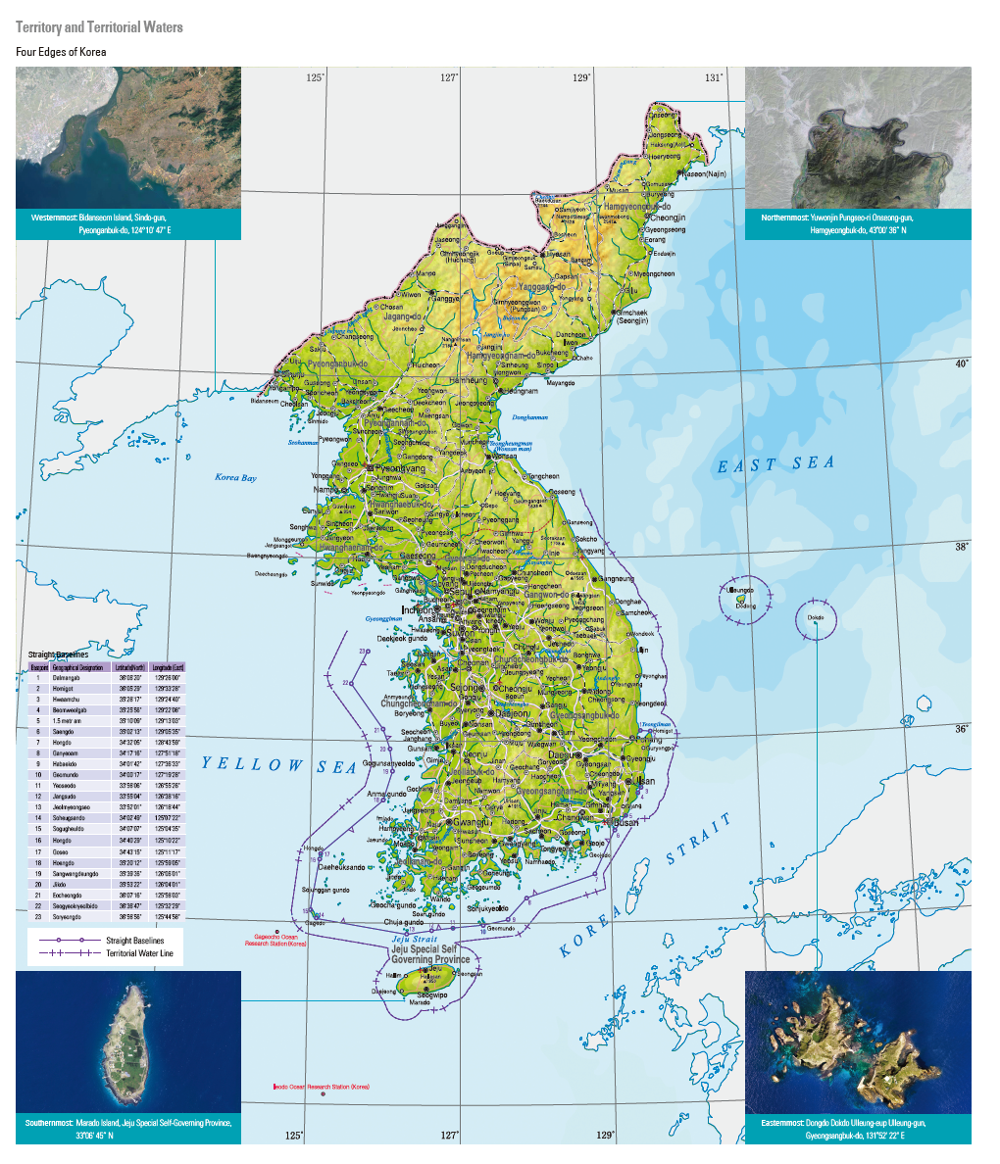
Korea and Your Classroom!

Slide 5
Forms of Development
Social Indicators
Demographic Indicators
Economic Indicators
Why is more than one indicator needed to measure development?

Slide 6
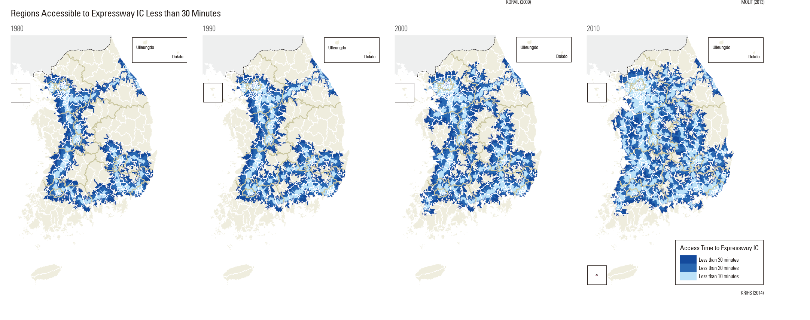
Which Form of Development?
Accessibility Maps

Slide 7
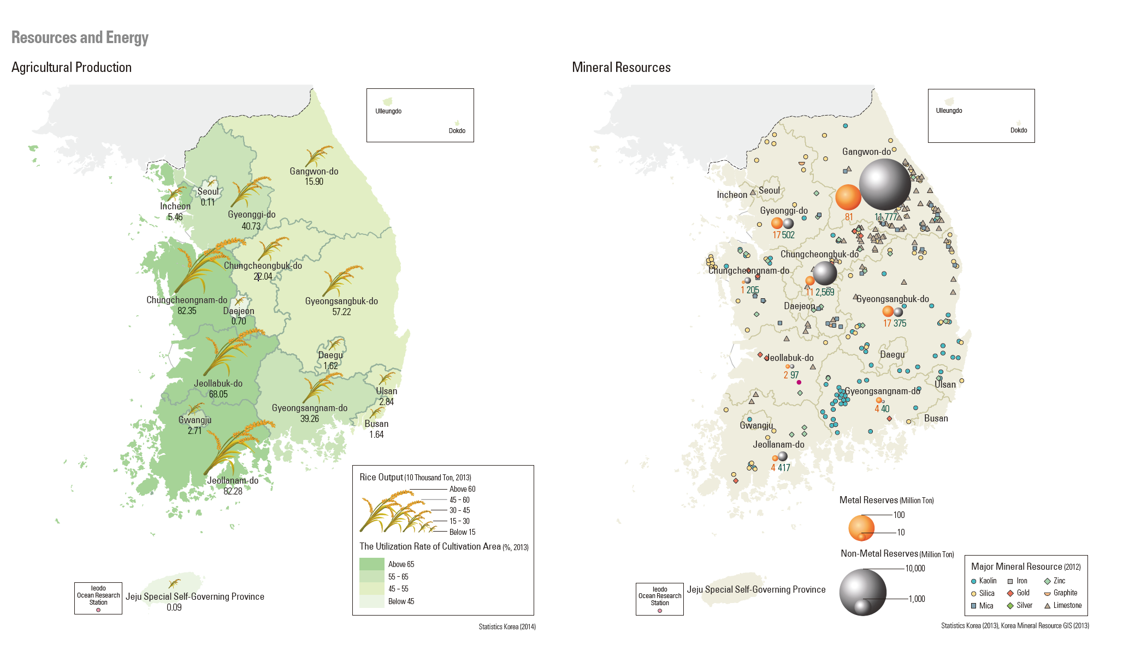
Which Form of Development?
Agricultural Production
Mineral Resources

Slide 8
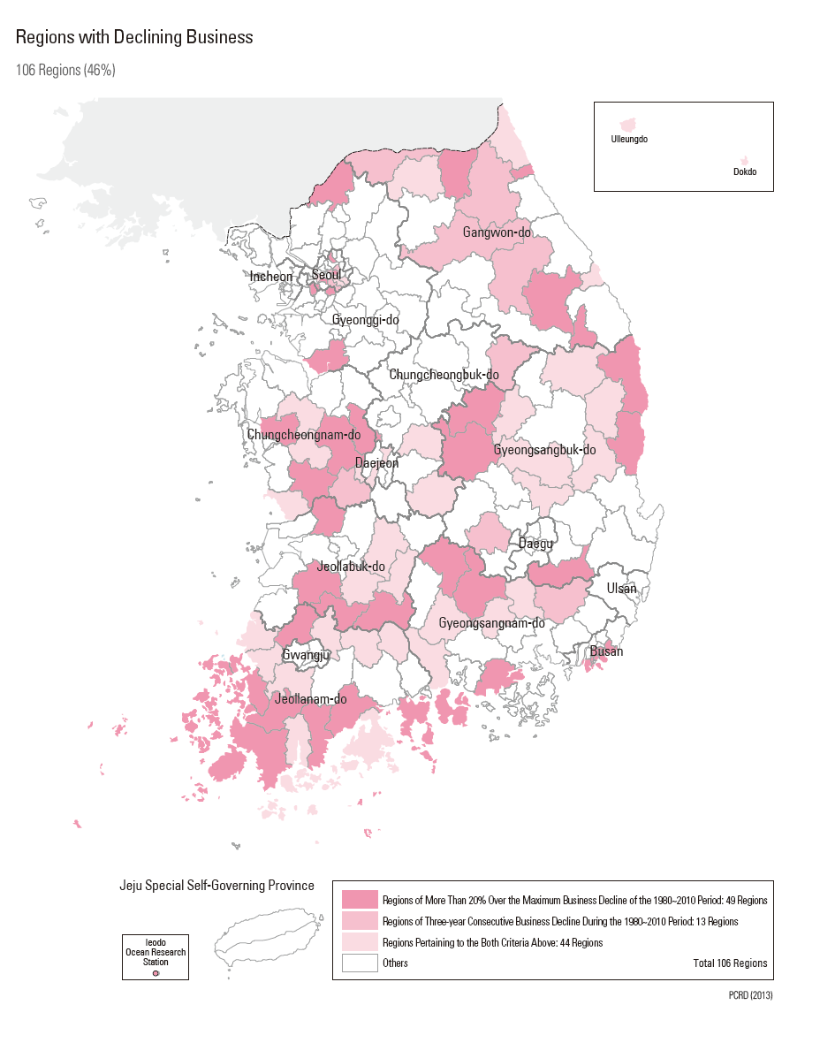
Which Form of Development?
Regions with Declining Business

Slide 9
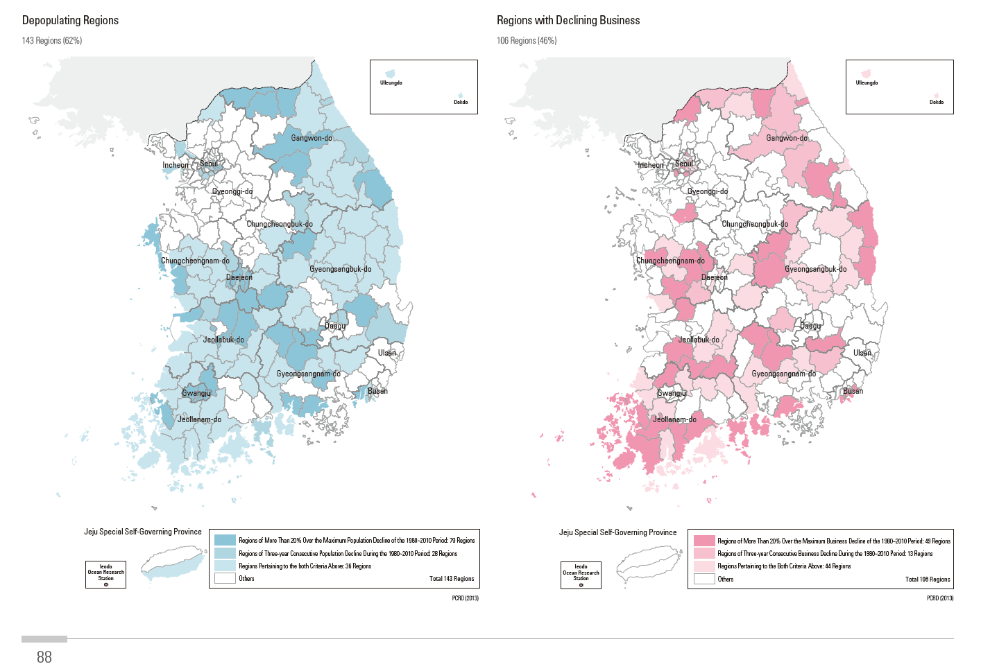
Which Form of Development?
Depopulating Regions
Regions with Declining Business

Slide 10
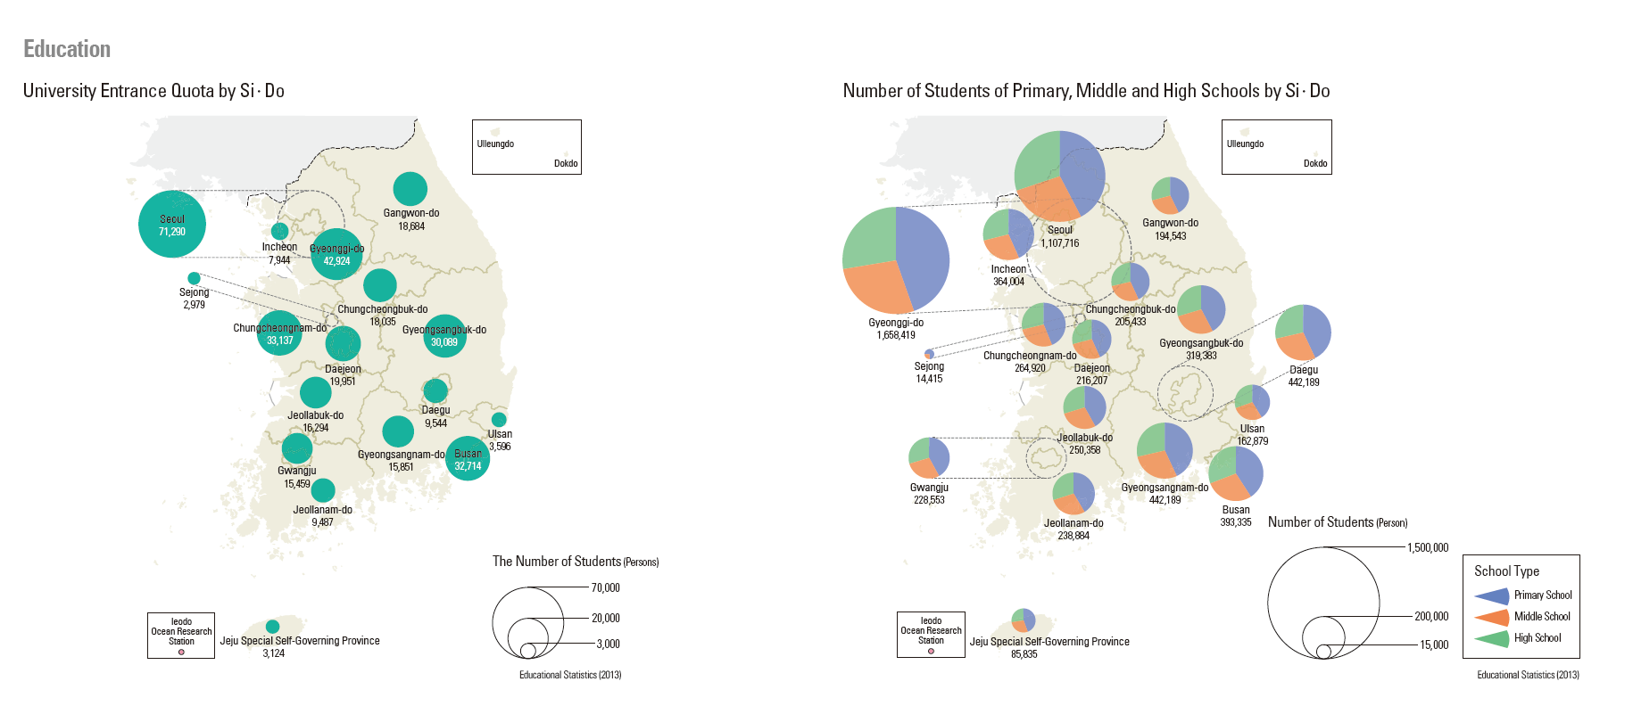
Which Form of Development?
University Entrance
Number of Students

Slide 11
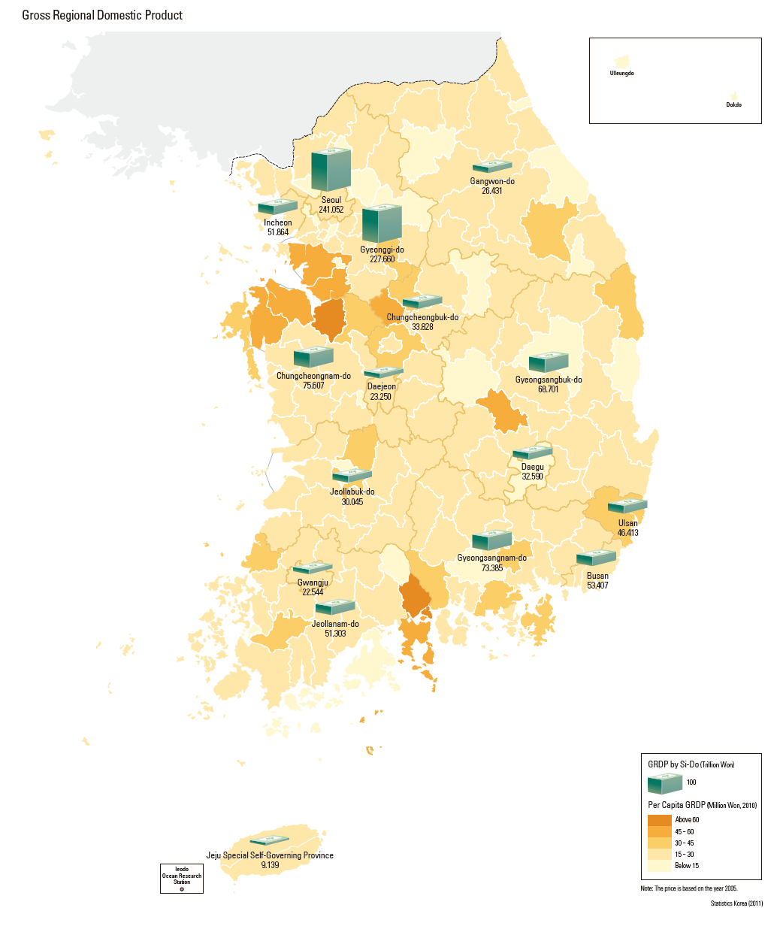
Which Form of Development?
Gross Regional Domestic Product

Slide 12
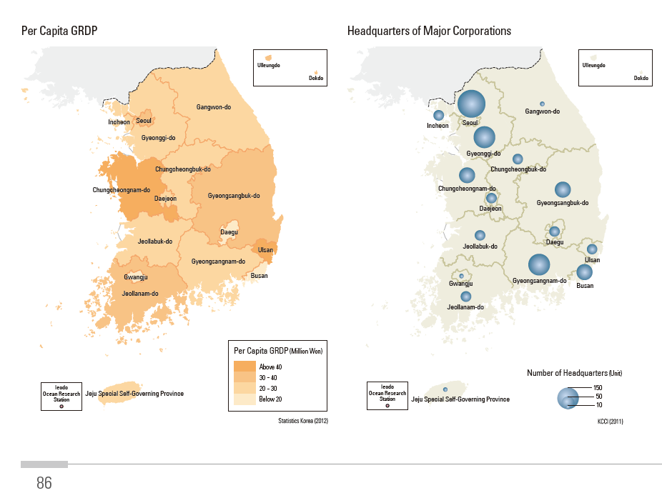
Which Form of Development?
Per Capita GRDP
Headquarters of Major Corporations

Slide 13
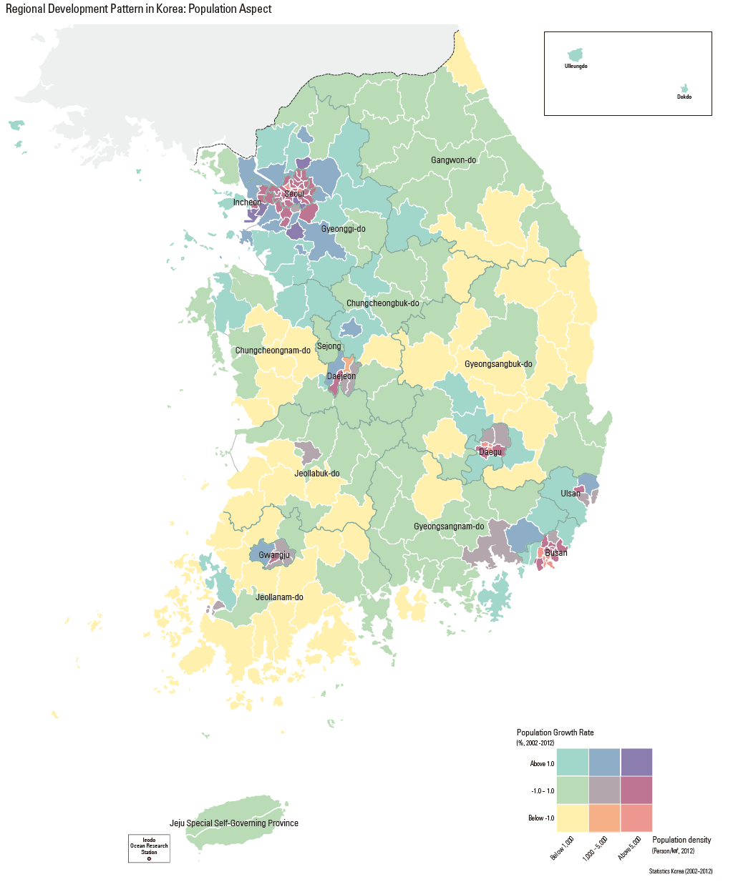
Which Form of Development?
Regional Population Growth Rates

Slide 14
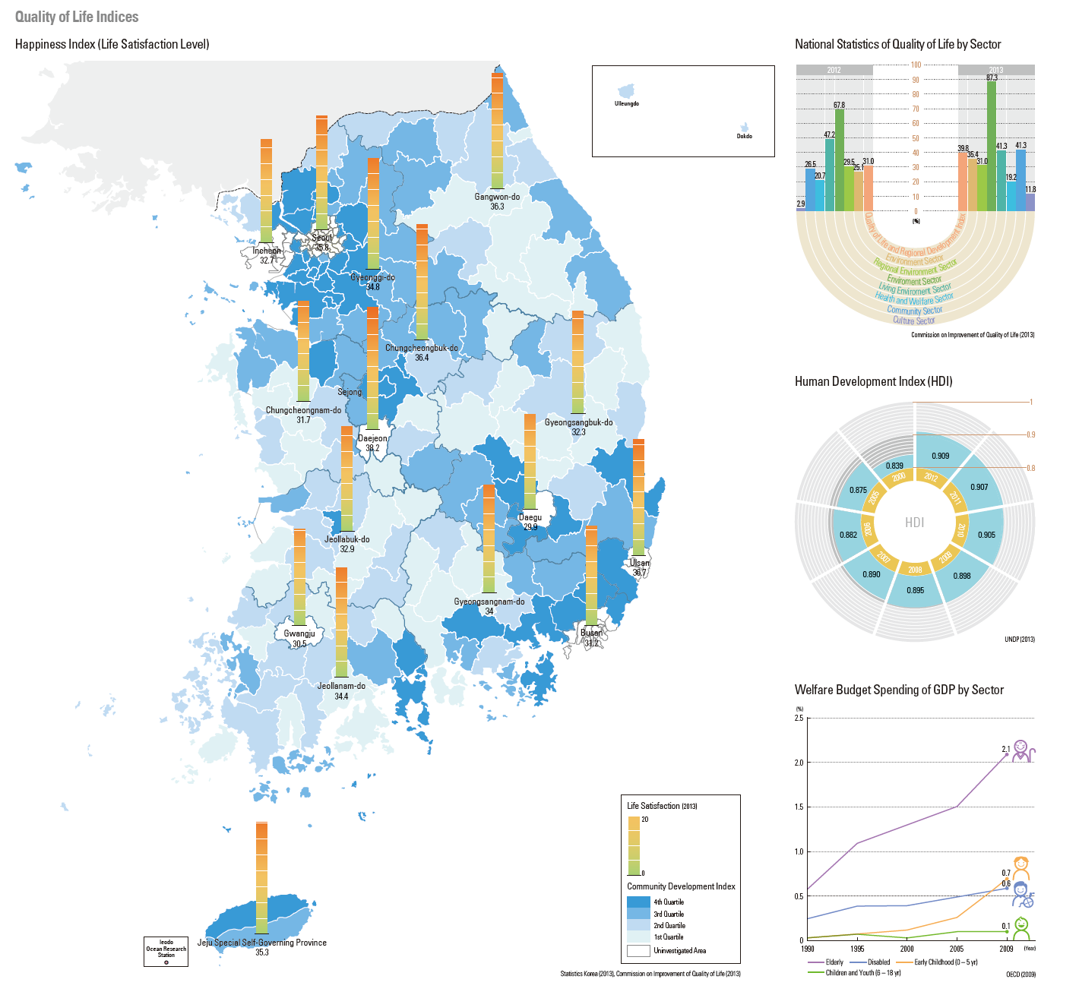
Which Form of Development?
Happiness Index

Slide 15
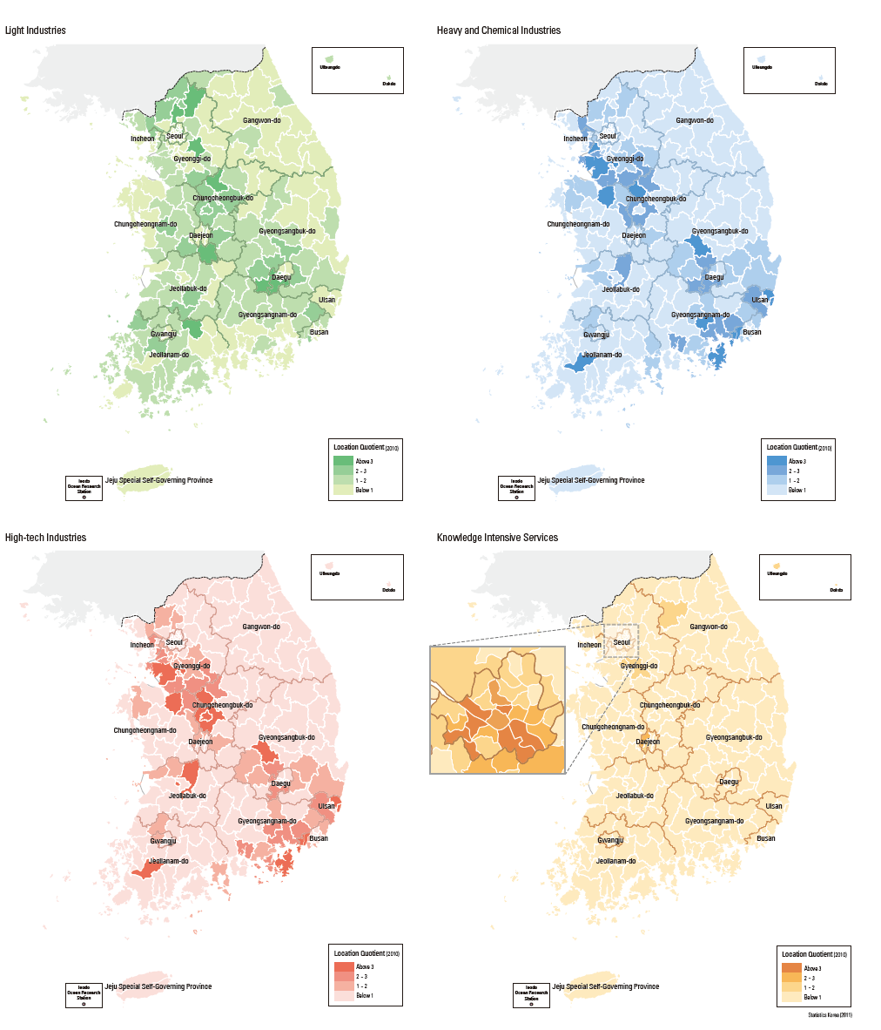
Which Form of Development?
Light Industry
Heavy and Chemical Industry.
High-tech Industry
Knowledge Intensive Industries

Slide 16
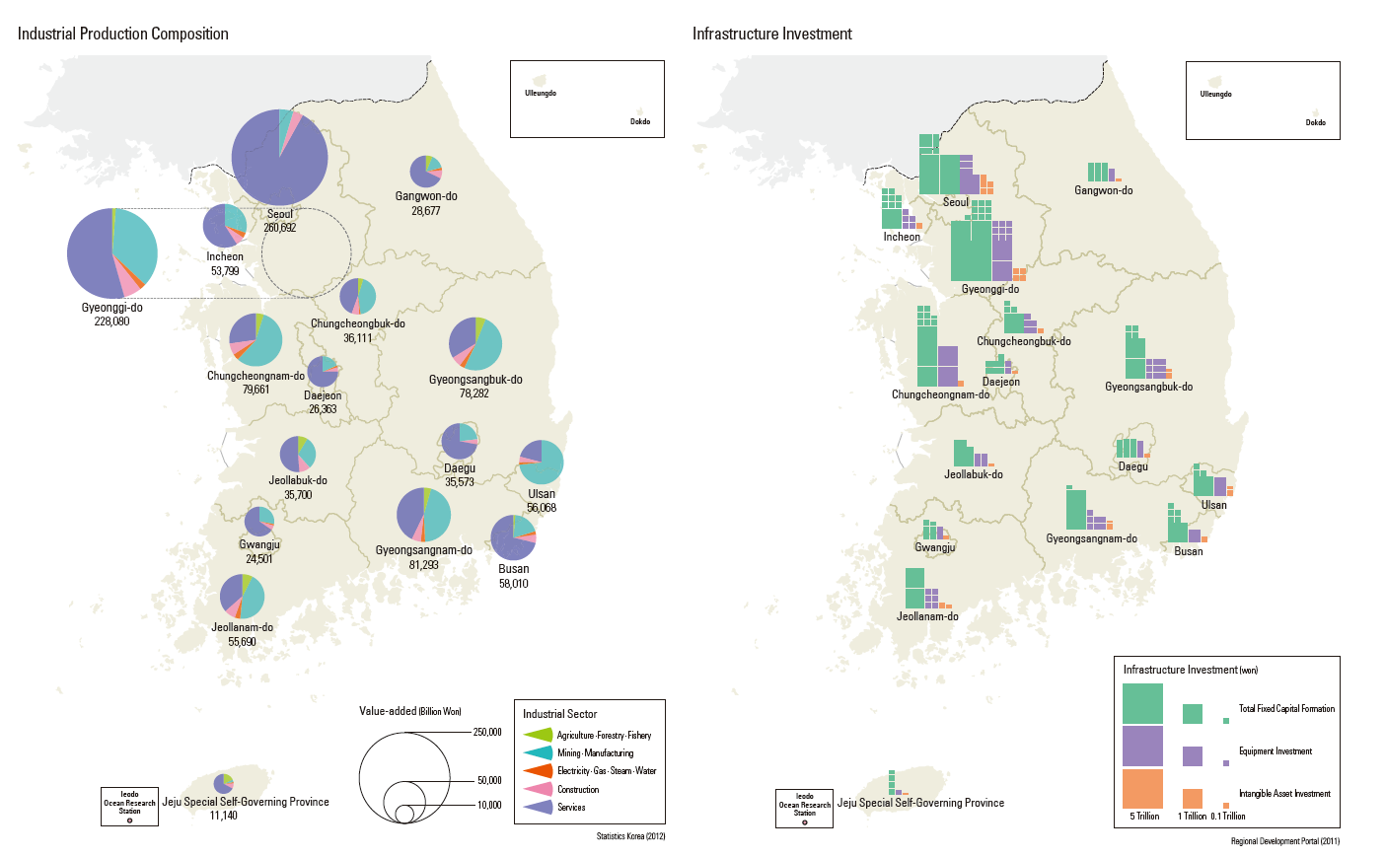
Which Form of Development?
Industrial Production Composition
Infrastructure Investment

Slide 17
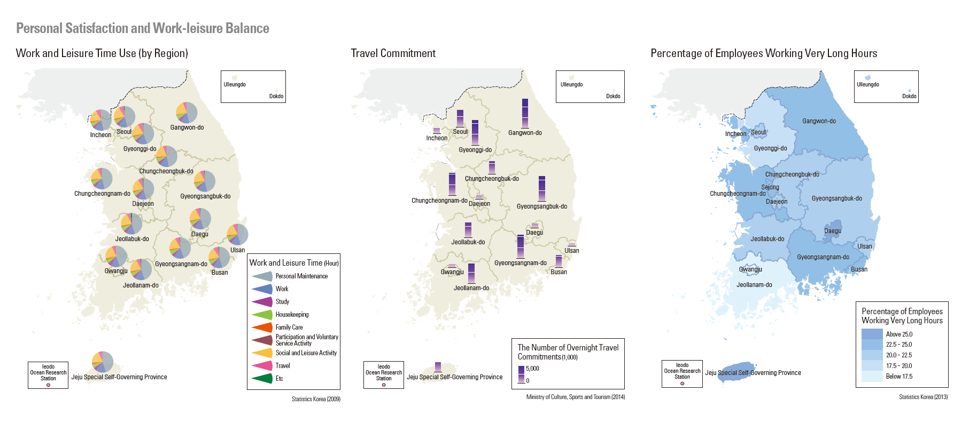
Which Form of Development?
Work and Leisure Time Travel Commitment Hours Worked

Slide 18
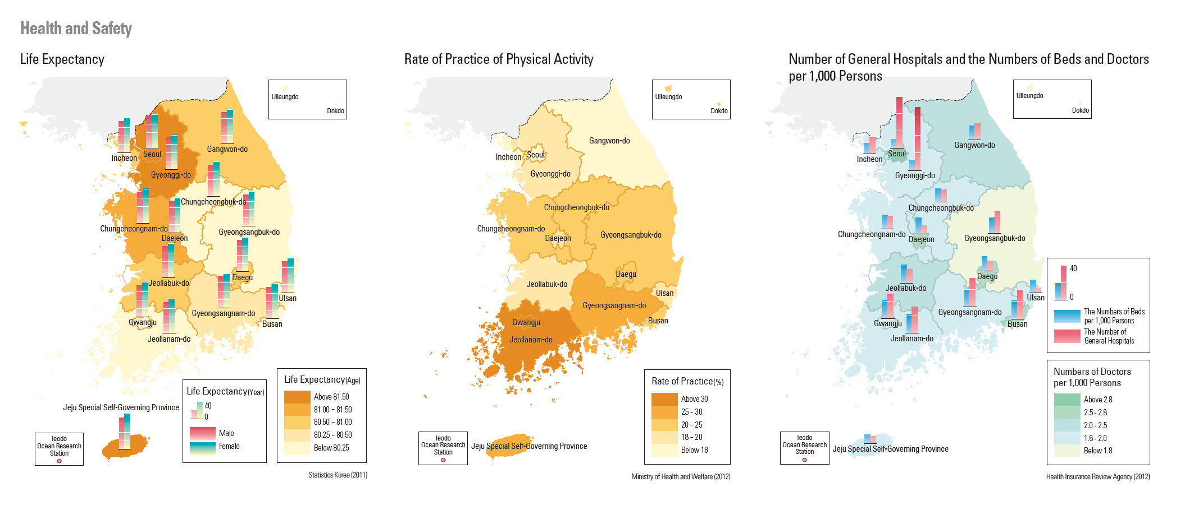
Which Form of Development?
Life Expectancy Practice of Physical Activity General Hospitals

Slide 19
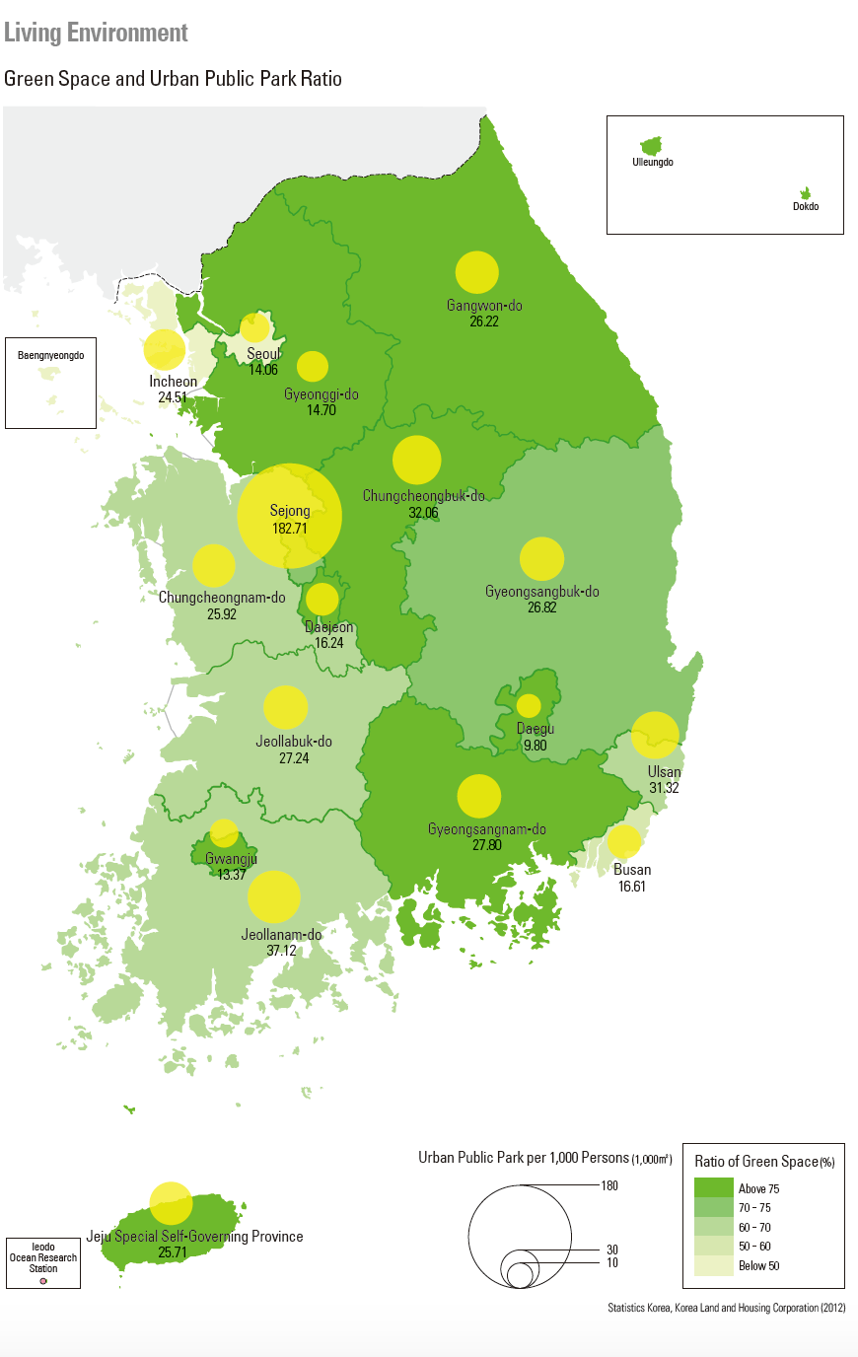
Which Form of Development?
Living Environment

Slide 20
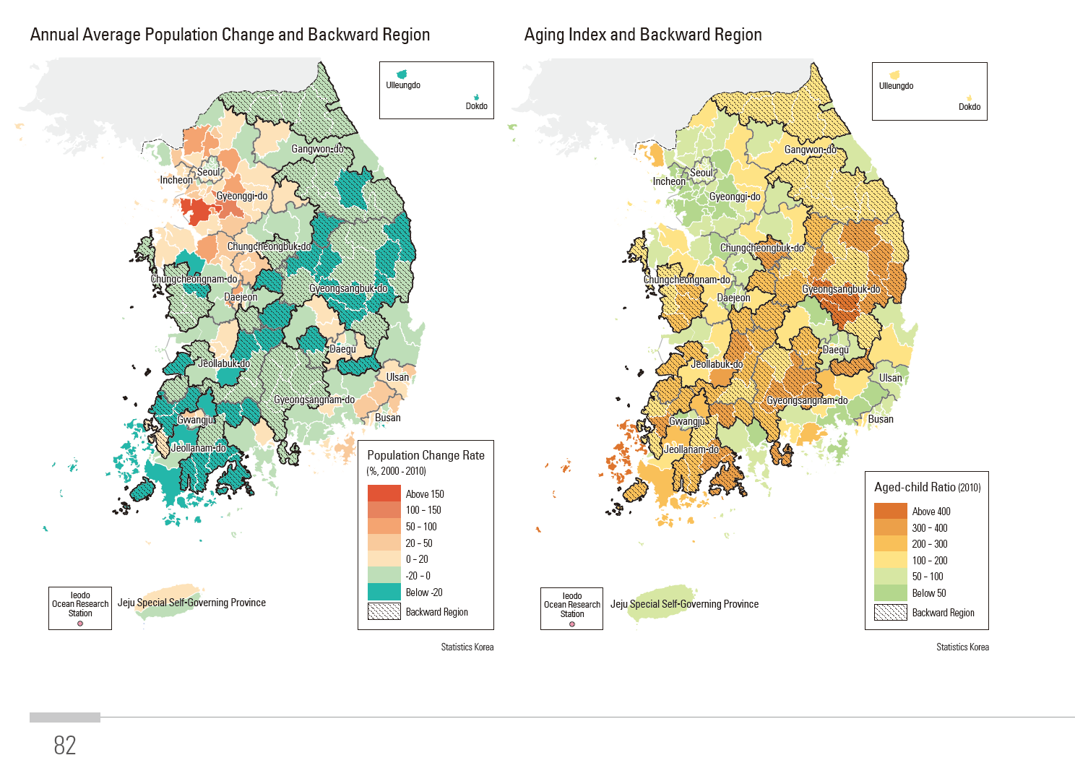
Which Form of Development?
Population Change
Aging Index

Slide 21
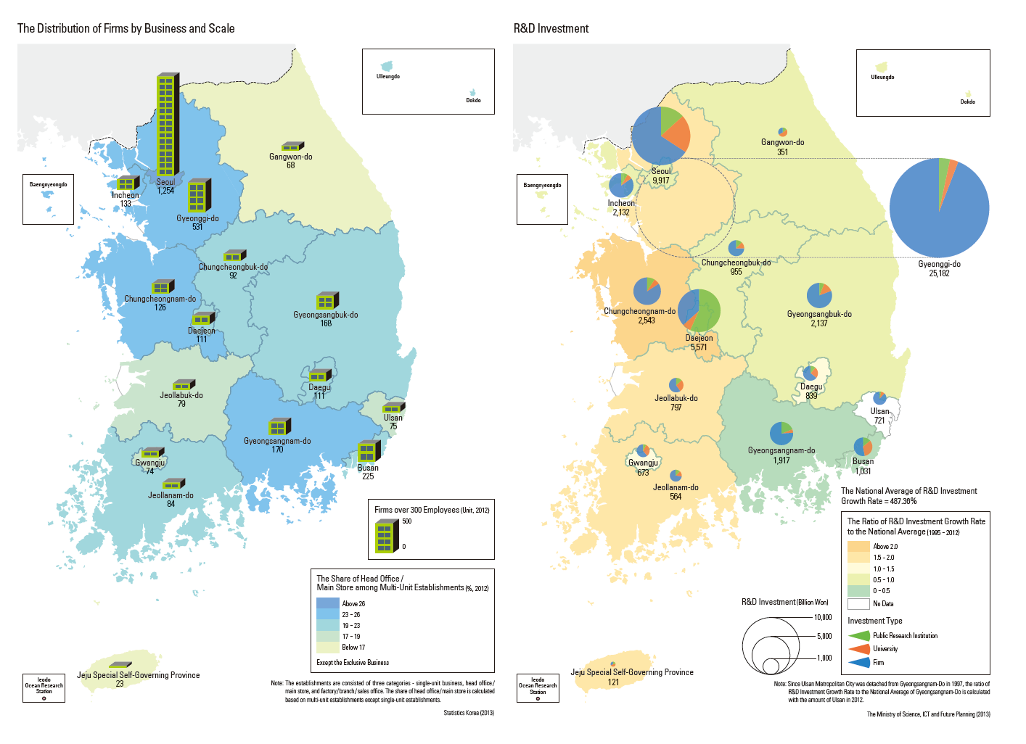
Which Form of Development?
Distribution of Firms
Research and Development Investment

Slide 22
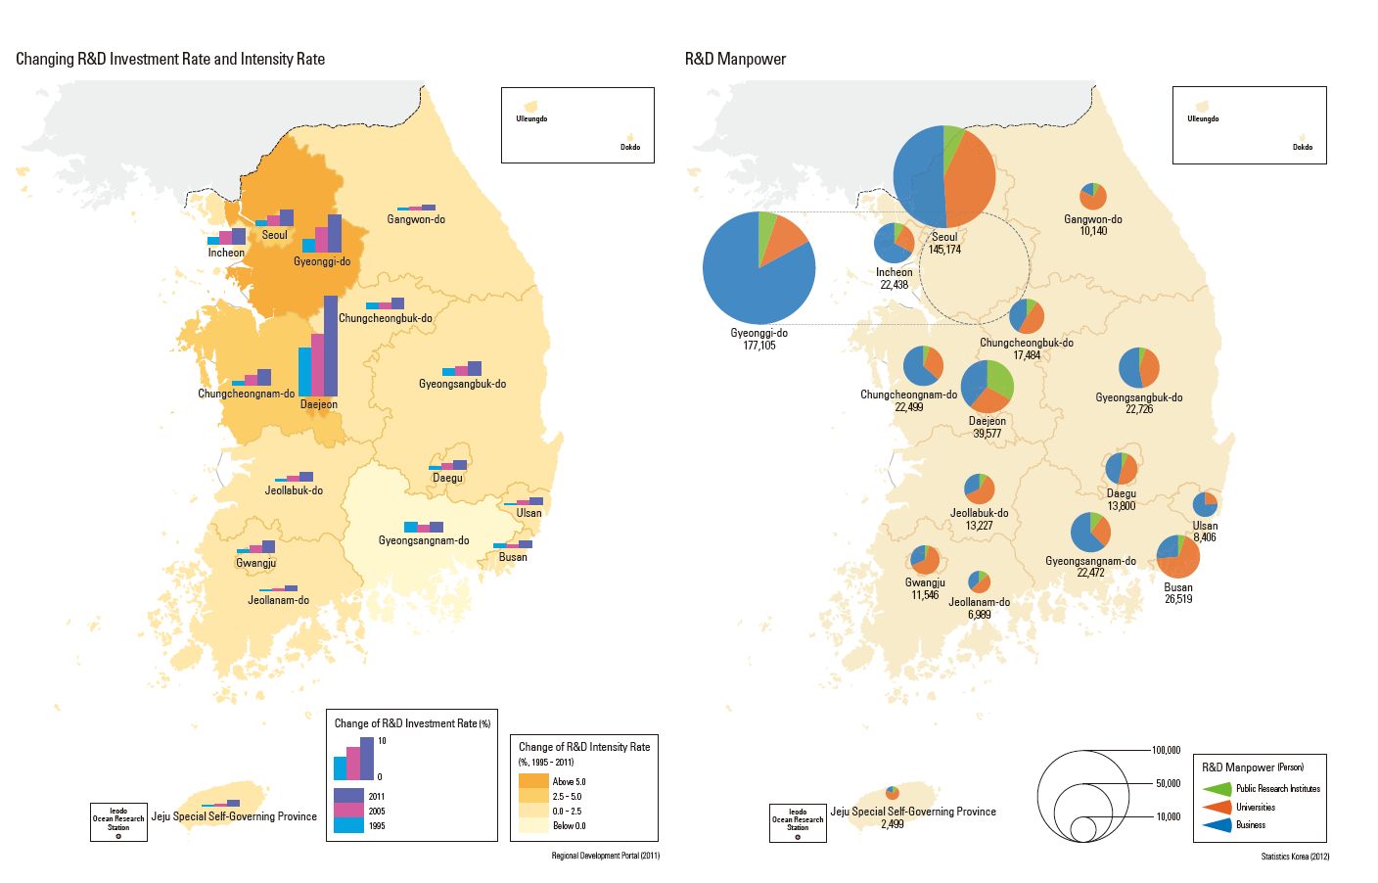
Which Form of Development?
Research and Development/Intensity
Research and Development Manpower

Slide 23
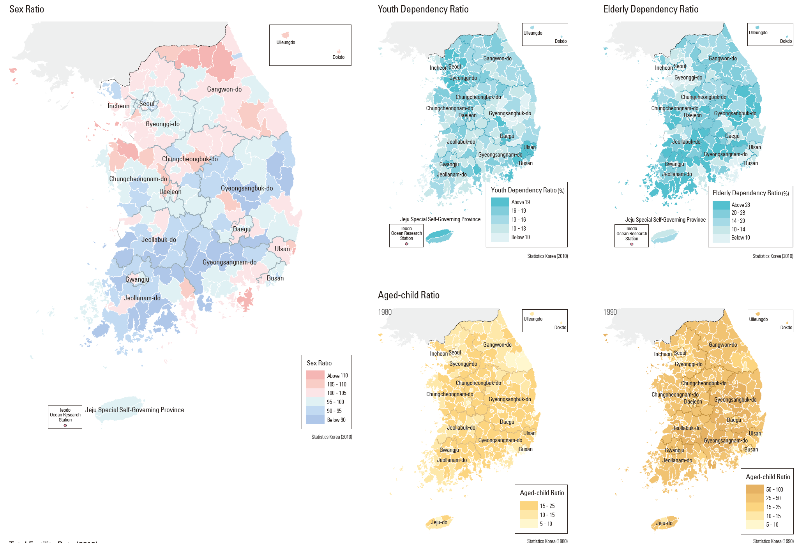
Which Form of Development?
Sex Ratio
D. Ratio

Slide 24
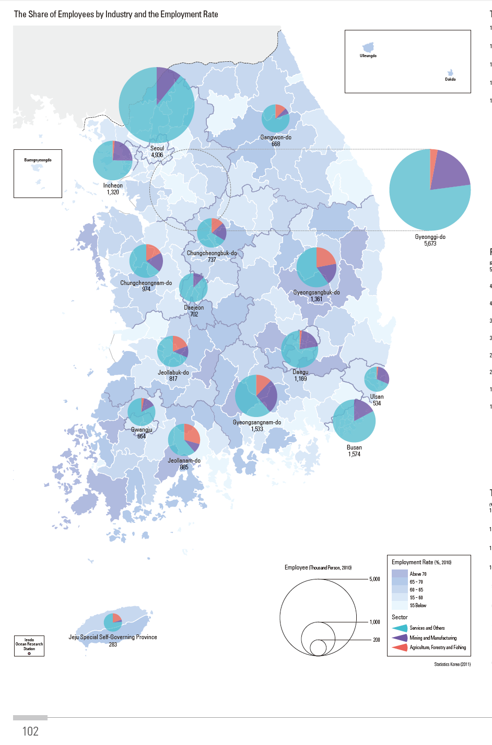
Which Form of Development?
Share of Employees by Industry and Employment Rate

Slide 25
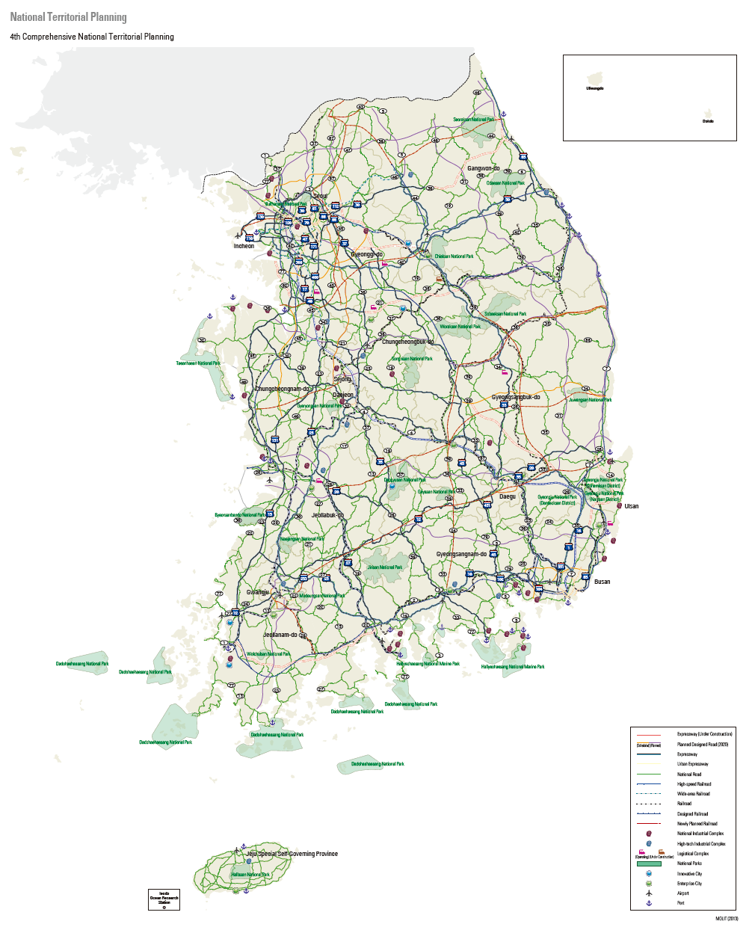
Which Form of Development?
South Korea Transportation Map

Slide 26
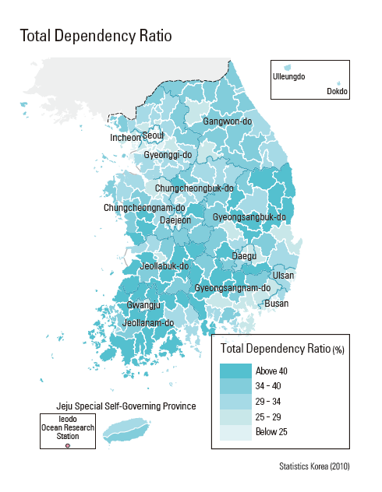
Which Form of Development?
Total Dependency Ratio

Slide 27
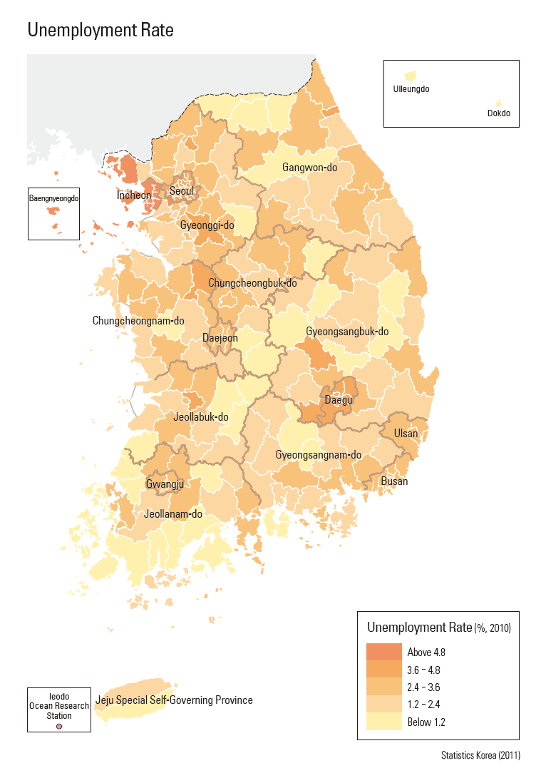
Which Form of Development?
Unemployment Rate

Slide 28
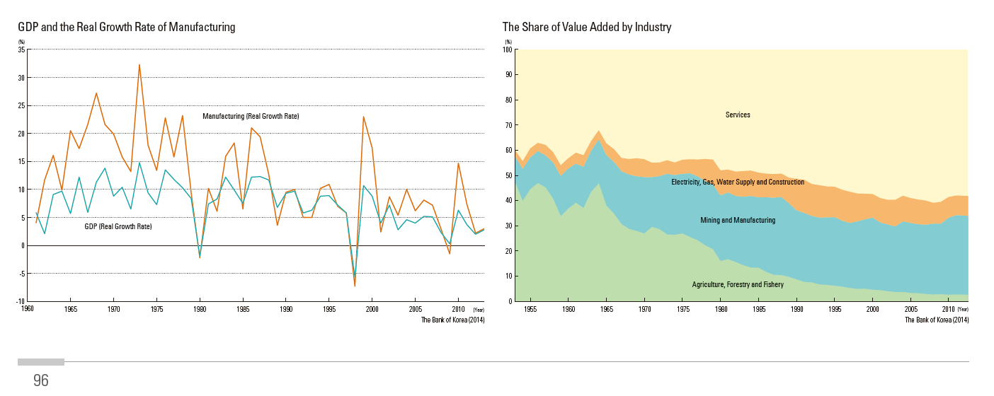
Which Form of Development?
GDP and Manufacturing Growth Rate
Value Added by Industry

Slide 29
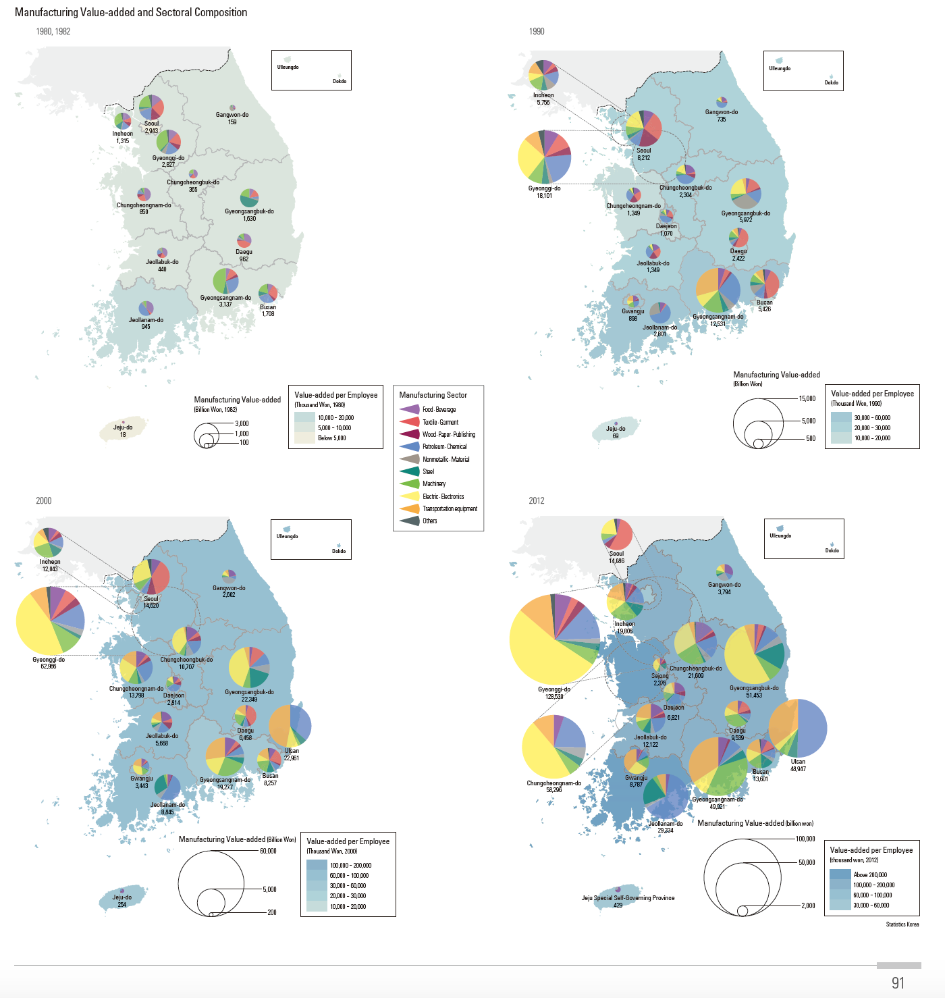
Which Form of Development?
Value Added by
Decades

Slide 30
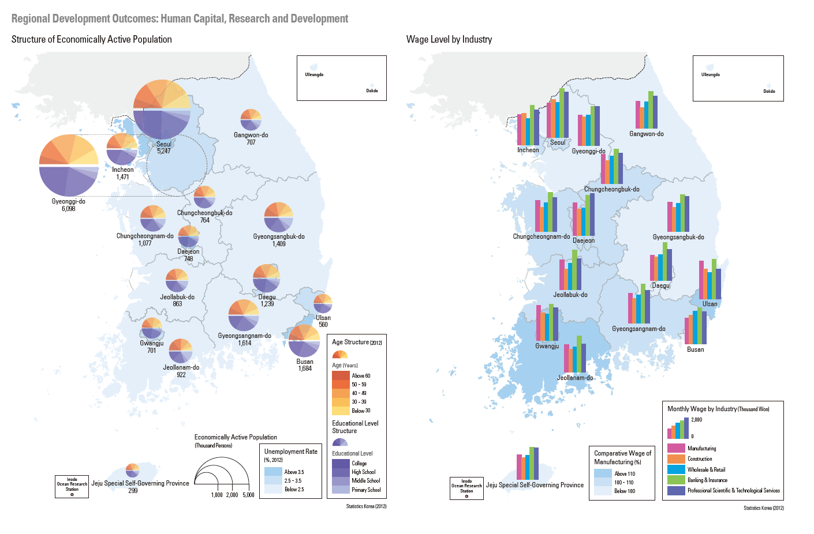
Which Form of Development?
Economically Active Population Wage Level by Industry

Slide 31
Korea Lesson – Part II
Development is not even across the country.
Scale is important in AP Human Geography.
Students should evaluate development based on scale using the afore mentioned maps.
Which maps had the most impact on them? Why?
Which indicators had the most maps associated with them?

Slide 32
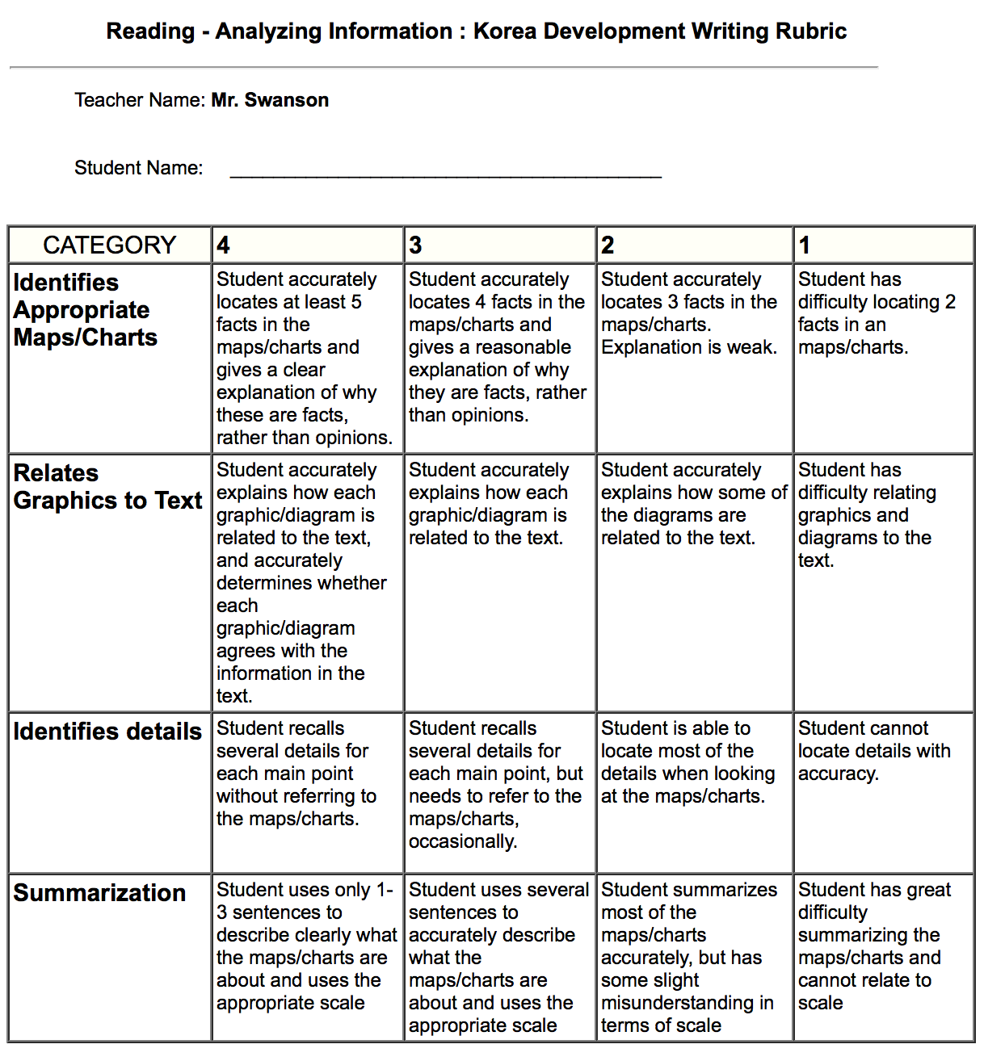
Korea Writing Rubric

Slide 33
More Information
Kelly Swanson
E-mail – kswany@hotmail.com
Twitter - @geokswanson
Website for lessons:
https://sites.google.com/a/uwlax.edu/chu/advance-placement-in-human-geography-lesson-plans-using-national-atlas-of-korea
Website for Atlas:
http://nationalatlas.ngii.go.kr

