Slide 1
Utilizing the National Atlas of Korea
Global diffusion of Korean culture and associated societal impacts
An analysis of Culture and
Quality of Life in South Korea and Beyond…
Kenneth H. Keller
George Walton Comprehensive HS
Marietta, GA

Slide 2
GRADES: High School 9-12
SUBJECT: AP/World Geography, World Cultures, Contemporary Korea
TIME REQUIRED: Two class periods, 45-55 minutes in length.

Slide 3
OBJECTIVES
Students will be able to analyze different segments of the National Atlas of Korea and critically evaluate the role of Korean culture in various regions of the world.
Students will be able to compare and contrast Korean cultural and lifestyle attributes with those of other globalized regions in relation to quality of life characteristics.
Students will determine their own quality of life in relation to the characteristics identified by the National Atlas of Korea along with others of their own choosing.

Slide 4
NATIONAL GEOGRAPHY STANDARDS
4. Places and Regions: The student will understand physical and human characteristics of places.
6. Places and Regions: People can view places and regions from multiple perspectives.
10. Human Systems: The student will understand characteristics, distribution, and complexity of Earth's cultural mosaics.
http://education.nationalgeographic.com/standards/national-geography-standards/?ar_a=1

Slide 5
COMMON CORE STANDARDS
(is a requirement in some states)
RH1. Cite specific textual evidence to support analysis of primary and secondary sources, attending to such features as the date and origin of the information.
RI By the end of grade 9 and 10, read and comprehend literary nonfiction at the high end of the grades 9-10 text complexity band independently and proficiently.

Slide 6
STATE OF GEORGIA SOCIAL STUDIES WORLD GEOGRAPHY STANDARDS
SSWG1 The student will explain the physical aspects of geography.
SSWG2 The student will explain the cultural aspects of geography.
SSWG5 The student will describe the interaction of physical and human systems
that have shaped contemporary South Asia, Southeastern Asia, and Eastern Asia.
INFORMATION PROCESSING SKILL:
The student will be able to locate, analyze, and synthesize information related to social studies topics and apply this information to solve problems/make decisions.

Slide 7
MATERIALS REQUIRED
Copies of maps provided by the National Atlas of Korea (print in color if at all possible as not to lose important contrast in thematic elements)
Access to a computer lab or use of student’s personal devices to access articles and associated websites
Articles from various publications related to: Globalization and Pop Culture.

Slide 8
Questions students should be able to answer based on their research…
How do local populations around the world relate to `foreignness' presented to them in the form of pop culture?
What role does pop culture play with respect to globalization?
More importantly, how does pop culture help us to understand globalization?

Slide 9
Also, articles which students can evaluate in relation to the quality of life for South Korean citizens and how it has changed in relation to globalization and associated foreign influences.
Instructors/teachers should note that both of these above topics for students to critically evaluate should be connected to an analysis of the maps provided from the National Atlas of Korea.

Slide 10
Some sample article websites. See WORD document for complete list of these resources
1. The Korean Wave
http://www.aaanet.org/sections/seaa/2014/07/the-korean-wave-hallyu/
2. The Journey of Cultural Globalization in Korean Pop Music
http://www.e-ir.info/2011/08/17/the-journey-of-cultural-globalization-in-korean-pop-music/
3. The Journey of Cultural Globalization in Korean Pop Music
http://www.e-ir.info/2011/08/17/the-journey-of-cultural-globalization-in-korean-pop-music/

Slide 11
Background/Introduction to lesson
Cultural or spatial diffusion is the process of the spread of an idea or innovation from one culture to another. This process is more likely to occur from cultural hearths (origins of culture traits), or centers of culture that are closer in proximity to each other. With the rise of globalization and technology the spread of culture most significantly through the geographic process of space-time compression is more prevalent than ever before. As noted, barriers to cultural diffusion may include the time and distance it takes for the ideas to travel, known as time distance decay or space-time compression, as well as the prevailing attitudes and taboos which might hinder the adoption of new culture. South Korea is an ideal case study to examine both elements of unique culture and cultural diffusion. As a dominant economic power/tiger in Asia, South Korea is no stranger to the forces of foreign influence and cultural diffusion. Yet as a modern industrialized country who has embraced globalization, they have also begun to export many elements of their vibrant and unique culture to other parts of the world. In examining South Korean culture, both the rise of global influences within their borders as well as their own influence in foreign lands can be readily observed.

Slide 12
KEY TERMS
Pop culture
Globalization
Hallyu (Korean Wave)
Cultural diffusion
Quality of life
Ethnic enclave

Slide 13
VIDEO RESOURCES/ANCILLARIES
The Great Transformation of Korean Wave Part 1
https://www.youtube.com/watch?v=lnmvHf9kIv4
The Great Transformation of Korean Wave Part 2
https://www.youtube.com/watch?v=_ZNFB58rTkU
Anthony Bourdain: No Reservations - Korea
https://www.youtube.com/watch?v=7uCIUW-cRvY

Slide 14
PROCEDURE
The teacher will break their students into nine small groups of approximately two and/or three students each. Working collaboratively, students will critically analyze the following portions of the National Atlas of Korea. Students will begin by participating in a think, pair, share activity where they think about and then discuss with their partner their definitions and application of the key terms noted in the following list taken from specific sections of the National Atlas of Korea.

Slide 15
Korea in the World

Slide 16
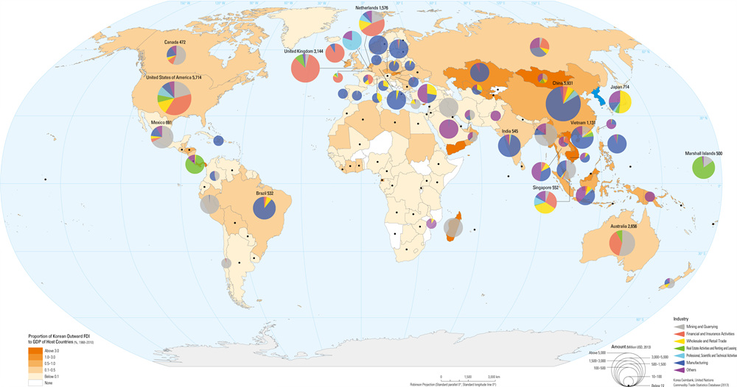
Page 122-123 Long term staying foreigners and no visa agreement nations

Slide 17
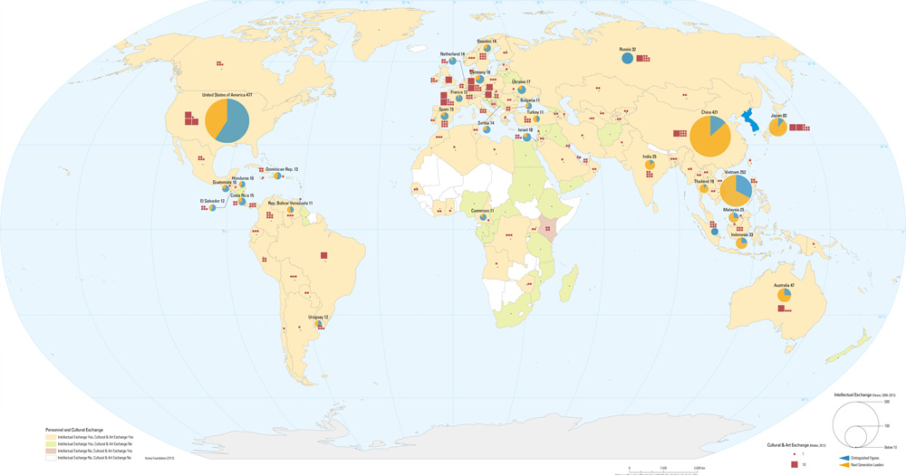
Page 130-131 Personal and Cultural exchange

Slide 18
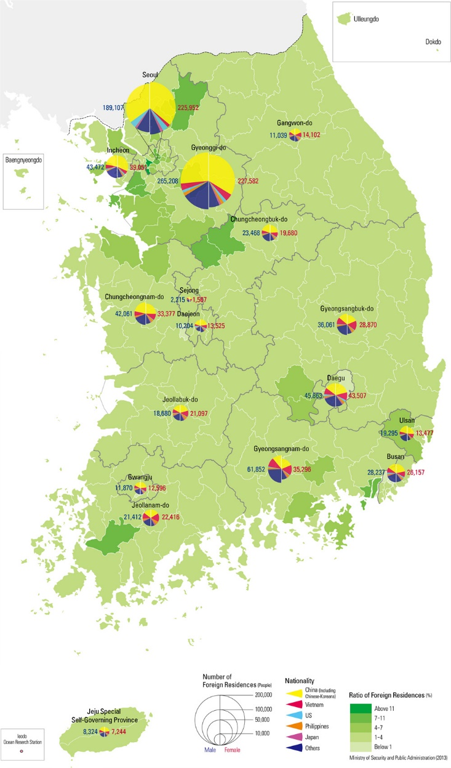
Page 152-157 Living with Diversity
Sample map showing foreign residences

Slide 19
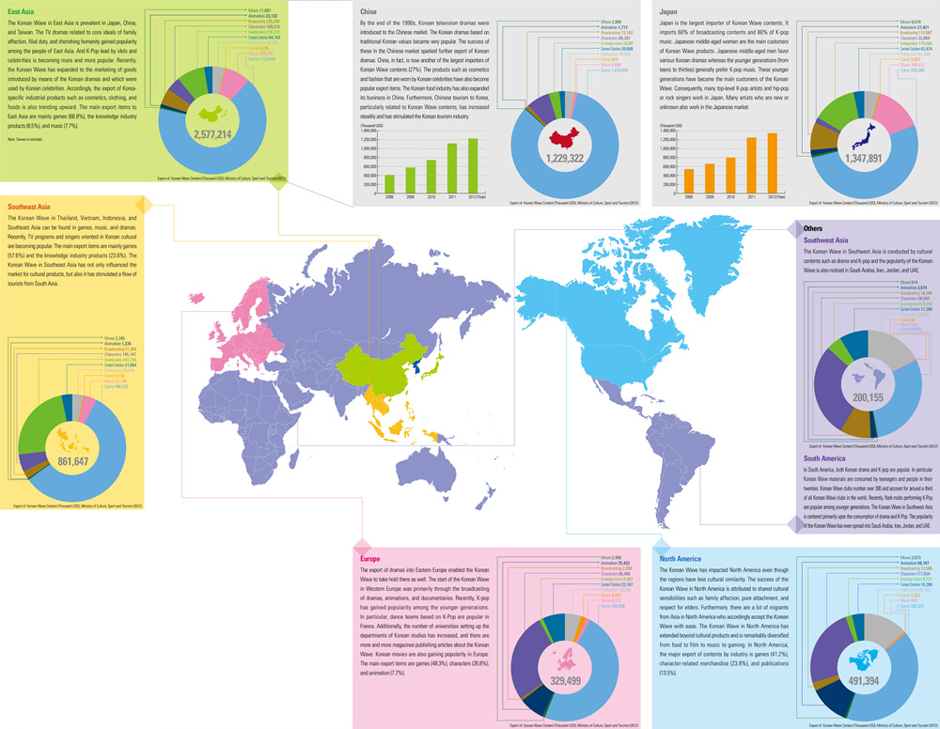
Page 158-159 The Korean Wave

Slide 20
Transformation and development of the land
Quality of life indices

Slide 21
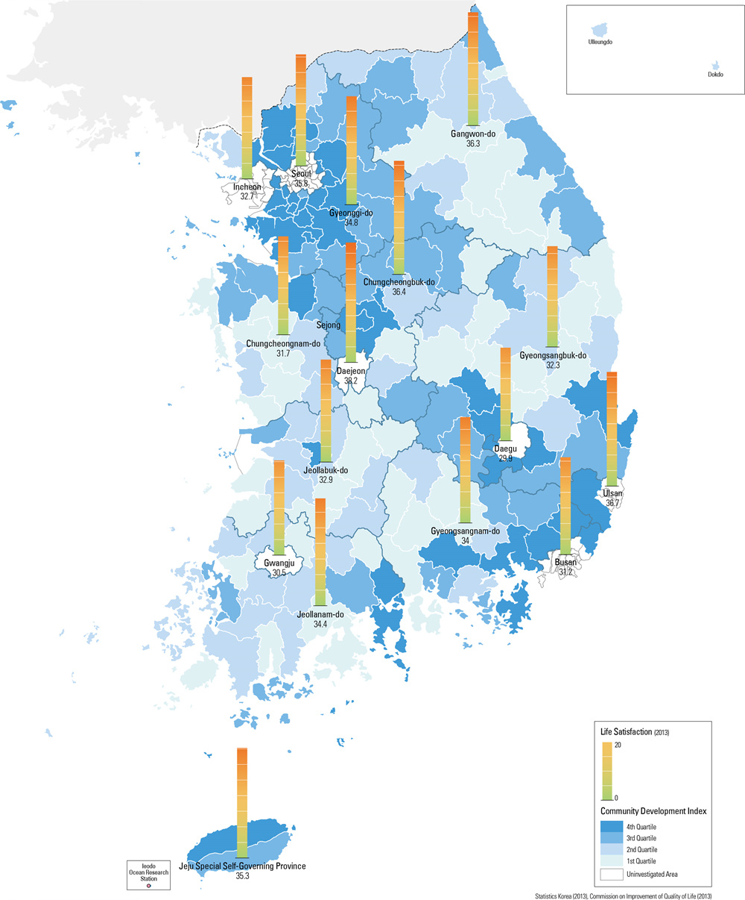
Page 105- Happiness Index

Slide 22
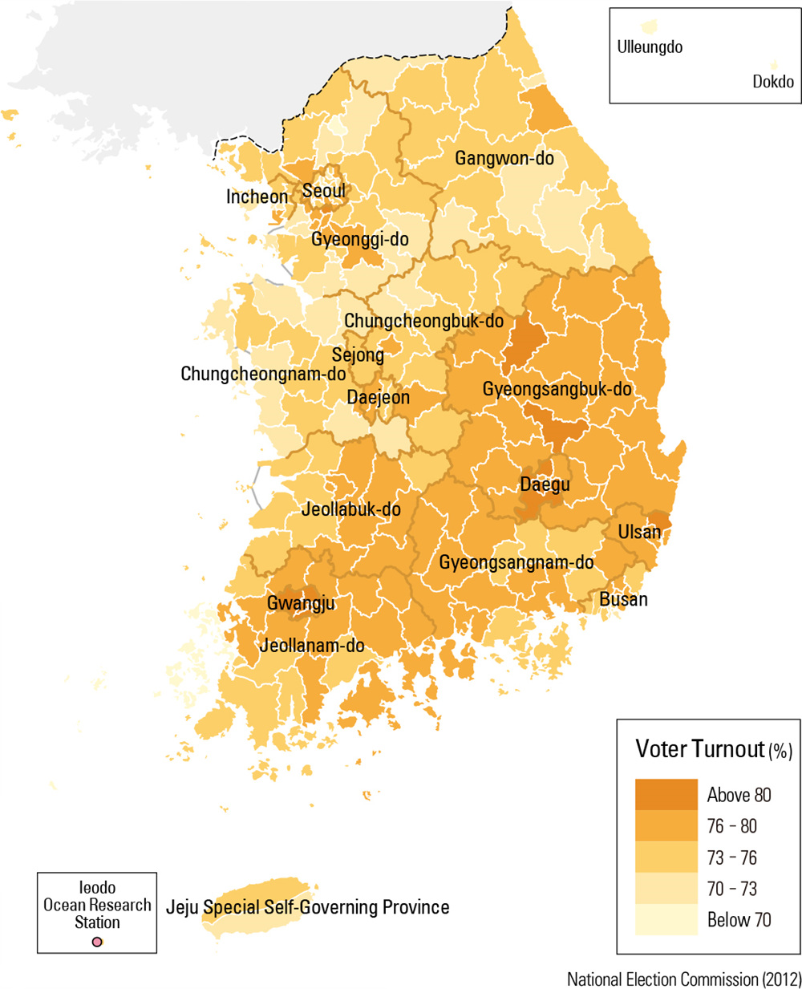
Page 106- Public participation

Slide 23
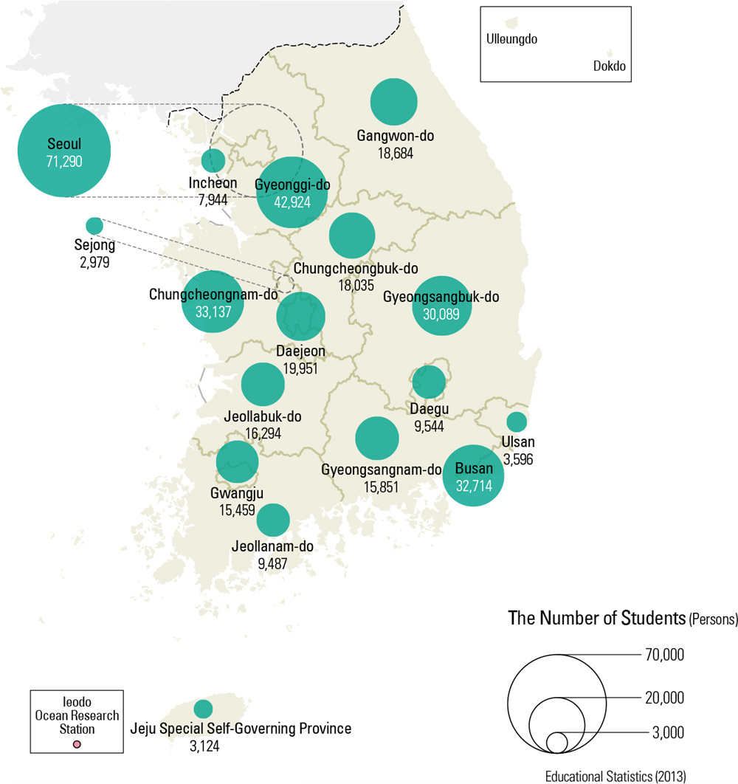
Page 107- Education

Slide 24
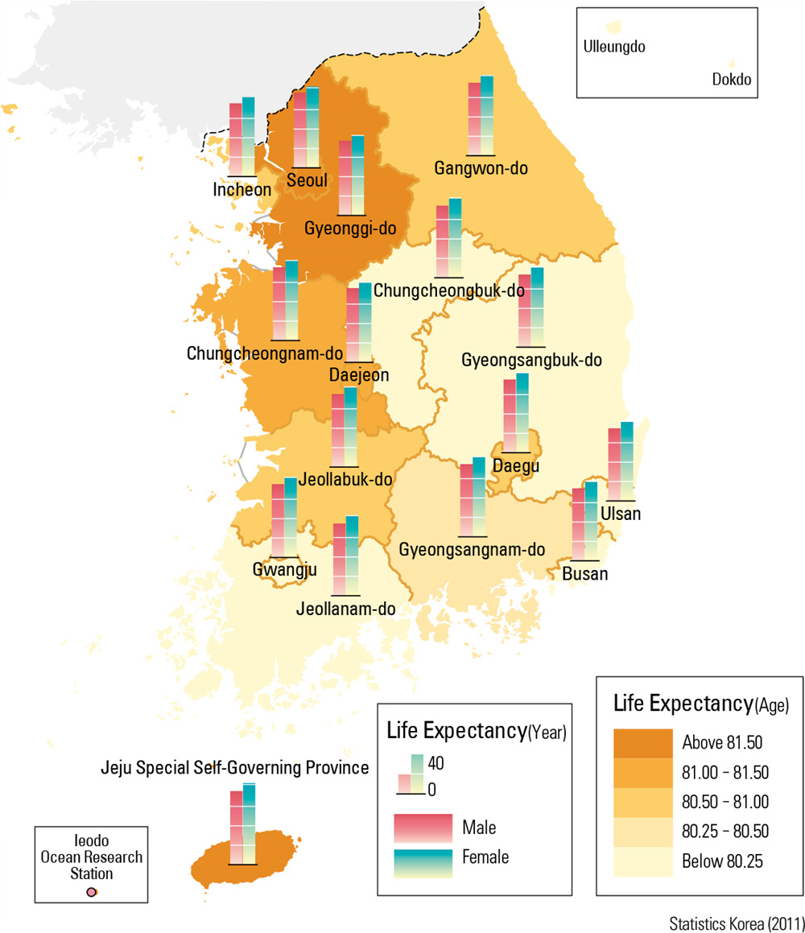
Page 108- Health and Safety

Slide 25
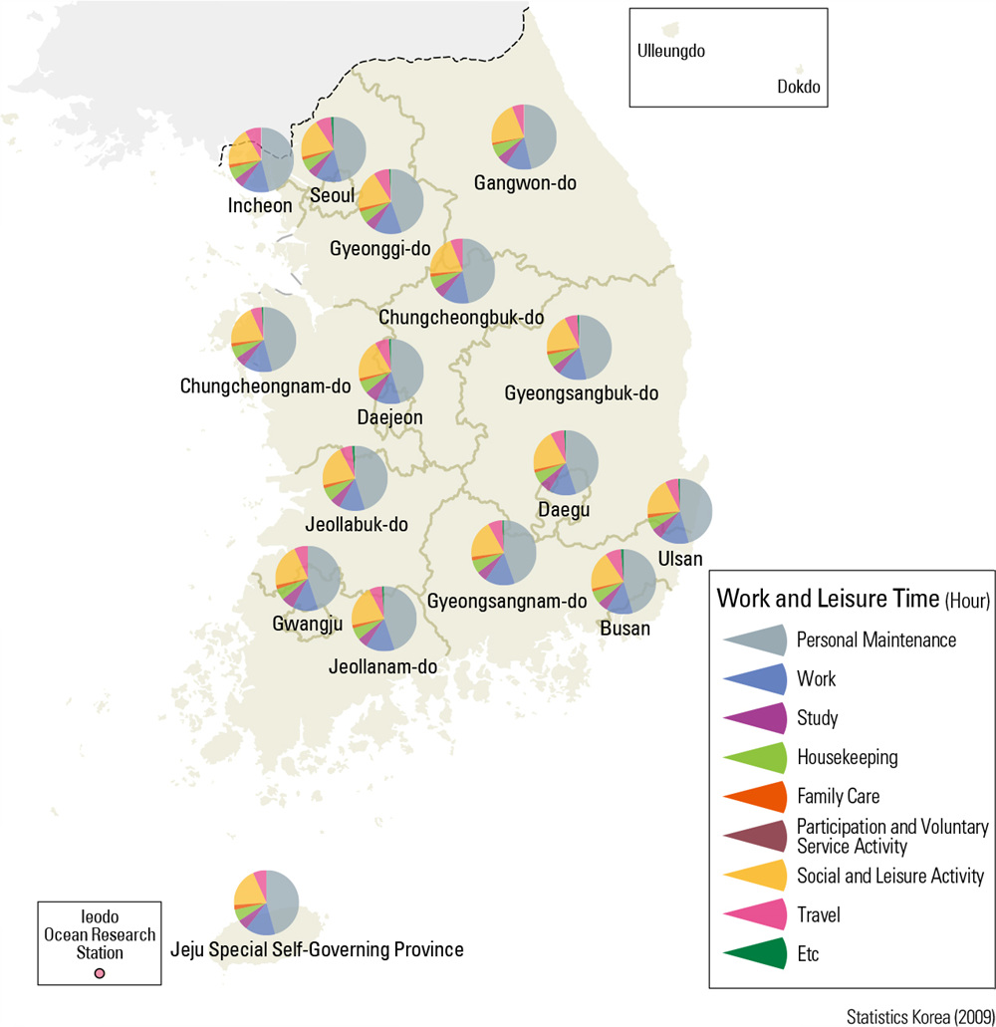
Page 109- Work and Leisure time use

Slide 26
Strategies to organize information
Students should incorporate the use of ESPeN or SPEED analysis to complete their evaluation of the resources.
See separate handouts related to these strategies for students to utilize when completing this assignment.

Slide 27
Students will then be asked in their specific groups to analyze their specific section of the atlas in relation to answering the following questions

Slide 28
For groups looking at maps related to the Korea and the World section of the Atlas:
How does their section of the atlas reflect South Korea’s influence on their neighboring countries and other countries and regions around the world? Students should come up with at least TWO examples from the section of the atlas they are responsible for.
From reading through the articles provided by their instructor, come up with two examples from the literature which reflect the influence discussed in question a above.
Students will draw/create an artistic representation of Korea and the World based on their own perceptions which have been formed by their own experiences, analysis of the atlas and associated articles.
Finally, how has the student’s impression and feelings about the globalization of Korean pop culture and its relationship with the rest of the world changed based on their evaluation of the information provided by the National Atlas of Korea.

Slide 29
For groups looking at maps related to Transformation and development of the land with respect to Quality of life indices:
How does their section of the atlas reflect the quality of life within South Korea? Students should come up with at least TWO examples from the section of the atlas they are responsible for.
From reading through the articles provided by their instructor, come up with two examples from the literature which reflect the influence discussed in question a above.
Students will draw/create an artistic representation of quality of life based on the specific section of the atlas they are examining. This drawing should be based on their own perceptions which have been formed by their own experiences, analysis of the atlas and associated articles.

Slide 30
For groups looking at maps related to Transformation and development of the land with respect to Quality of life indices:
Finally, how the student’s impression and feelings about life in South Korea has changed based on their evaluation of the information provided by the National Atlas of Korea.
Students will critically analyze the OECD Better Life Index in relation to South Korea and compare their findings to that which can be concluded by an analysis of the data from the atlas.
http://www.oecdbetterlifeindex.org/countries/korea/
Students will compare conclusions of the article from the Korea Times titled “Korea lags in quality of life” to their own impressions and evaluation of the data; both from the index and from the atlas. http://www.koreatimes.co.kr/www/news/biz/2011/08/123_93198.html

Slide 31
ENRICHMENT/EXTRA CREDIT
Have students research and find examples of Korean cultural diffusion (both aspects of
Korean culture that have spread to other areas and ideas/innovations that have come into Korean society).
2. Have students create a map showing what elements of American society are examples of Korean cultural diffusion and examine the influence this diffusion has had on American society.
3. Have students create a map showing what elements of Korean society are examples of cultural diffusion and from what countries they are influenced.
4. (In relation to #2 above) Have students do a compare/contrast with American culture in relation to Korean culture.
For example, brainstorm other aspects of American culture that they can compare to Korean culture. For example, amateur and professional sports, pop music, fashion, etc.…

Slide 32
EVALUATION AND ASSESSMENT
Students will work collaboratively to complete the following:
Students will answer the imbedded questions within the assignment.
Students will create a gallery walk/poster session related to their findings.
Students will be assessed and evaluated based on their findings in relation to describing the connection between Korean culture and globalization.
Further, to assess the impact of Korean culture in relation to the general level of happiness of the Korean people.

Slide 33
Ken Keller’s contact information:
E-mail:
kkeller1976@Comcast.net
Kenneth.keller@cobbk12.org
George Walton Comprehensive HS
1590 Bill Murdock Road
Marietta, GA 30062

