Slide 1

The National Atlas of Korea:
Broad Resources for Content
Presenters:
Gregory Chu, Univ. of Wisconsin-La Crosse
Doug Andersen, Oak Canyon Jr. High School, Linden, Utah
Kelly Swanson, St. Paul Johnson Sr. High School, St. Paul, MN
NCGE Conference, August 5-10, 2015, Washington, D.C.

Slide 2
Abstract
The new National Atlas of Korea is a well-designed atlas with abundance of maps depicting physical, socioeconomic, political patterns, government organizations, and major infrastructures. It is an enormous and valuable set of resources for geographic content for teachers and researchers alike. The Atlas is available in print and digital versions.

Slide 3
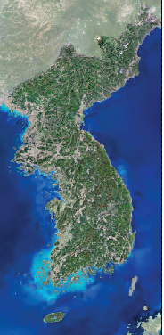

To obtain a free digital version of the National Atlas of Korea, please go to:
(URL address)

Slide 4
The National Atlas of Korea is organized into six distinct chapters, namely:
  0. Introduction
  1. Territory
  2. Government and Local Autonomy
  3. Transformation and Development of the Land
  4. Korea in the World
  5. Maps of Korea (with Index)

Slide 5
While the chapter titles are distinct, each chapter incorporates a wealth of individual informative themes and thematic maps, statistics, graphs, and photographs.
It is truly a treasure trove of content information for those who do research on or teach about Korea.

Slide 6
The wide range of themes include (but are not limited to) population, history, culture, urban/rural settings, environmental concerns, the economy and its associated social affects, quality of life, agriculture, manufacturing, landscape engineering, transportation, political organizations, and Korea’s place in the world.

Slide 7
Chapter 1
The first chapter on Territory (p1-51) details the entire confines of Korea (both the Republic of Korea [South] and the Democratic People’s Republic of Korea [North]), their provinces and administrative cities, as well as island territories, and small oceanic scientific monitoring stations in the Korean Strait and East Sea.

Slide 8
While 95% of the National Atlas centers on available information from South Korea, this first chapter does include some of the rarely found statistics and geographic information on North Korea (p 46-51).
It is a rare glimpse into some of the geographic aspects of a closed regime.
Notes:
I wanted to briefly go through this part about N Korea first before concentrating on the rest of the Atlas that has much more data for South Korea.

Slide 9
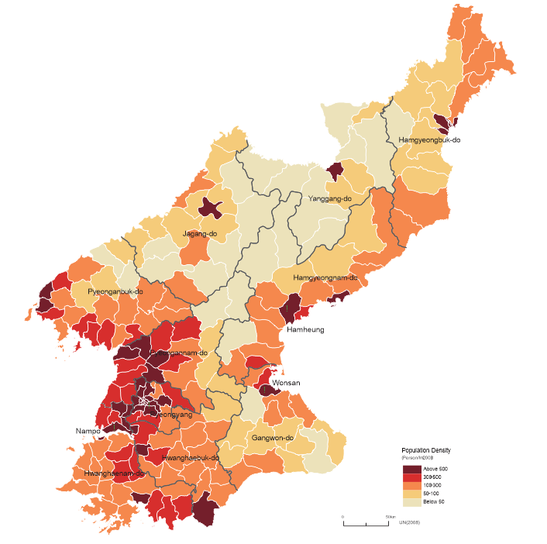
Example: Map of Population Density of North Korea

Slide 10
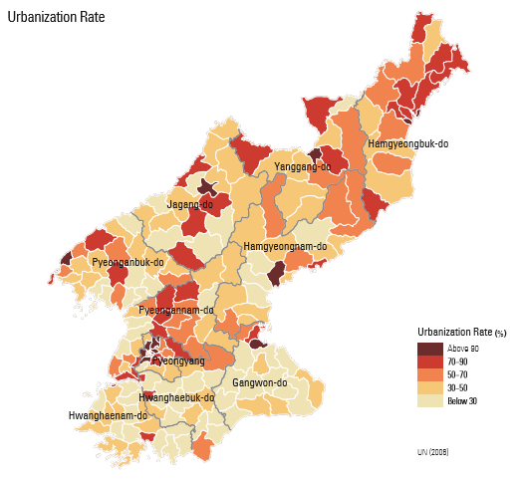
Example: Map of Urbanization Rate of North Korea

Slide 11
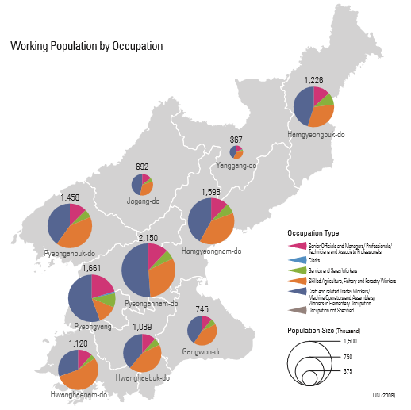
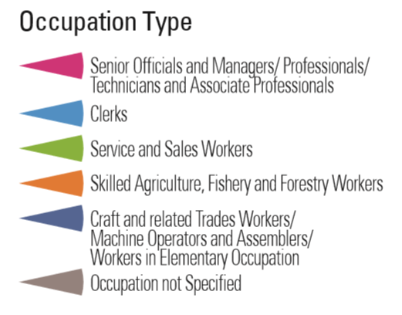
Example: Map of Working Population of North Korea by Occupation

Slide 12
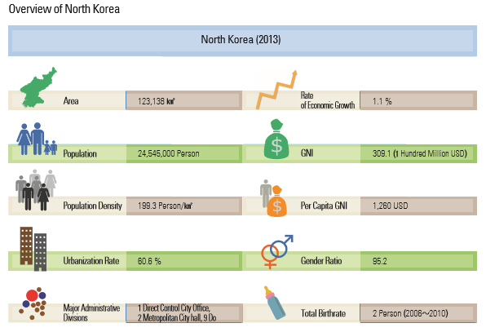

Slide 13
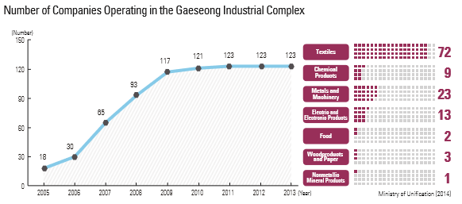
…and some insight into trade and cooperation of businesses between North and South
The Gaeseong Industrial complex is located just north of the DMZ where South Korean workers commute to work alongside N Korean workers.

Slide 14
While the talk of unification between North and South goes on and off at times, both sides have had a lot of dialogue through their respective Ministry of Unification.

Slide 15
As mentioned earlier, the majority of data for this Atlas are derived from statistics, records, and government documents from South Korea.

Slide 16
The Administrative Regions of South Korea consist of:
1 Special City (Seoul) and 6 Metropolitan Cities (Incheon, Daejeon, Gwangju, Daegu, Busan, and Ulsan)
1 Metropolitan Autonomous City (Sejong)
8 Provinces (Gyeonggi-do, Gangwon-do, Chungcheongbuk-do, Chungcheongnam-do, Jeollabuk-do, Jeollanam-do, Gyeongsangbuk-do, and Gyeongsangnam-do)
1 Special Self-governing Province (Jeju-do)

Slide 17
Included in these Administrative Regions are:
  the island of Ulleungdo and Dokdo, which are part of Gyeongsangbuk-do (Province).
  two scientific Oceanic Research Stations, Gageocho Station and Ieodo Station, which monitor hydrographic, atmospheric and ocean current conditions.
  other tidal stations, ocean buoys, surface current stations, and ocean stations as operated by various government institutes.

Slide 18
Chapter 2
The chapter on Government and Local Autonomy presents a complete organization of government branches in detail (p52-67).
This includes its
  National Assembly
  Executive Government
  Judiciary
  Local Autonomy and Decentralization

Slide 19
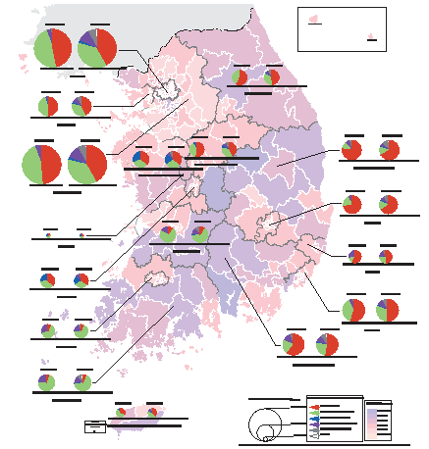
There are some unique maps on the geography of its voting patterns. This map is on Voter Turnout by Political Party.

Slide 20
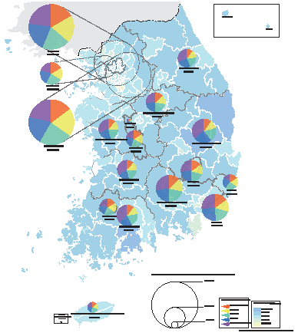
This one is on Voter Turnout by Age.

Slide 21
Chapter 3
The chapter on Transformation and Development of the Land is really the major core of the Atlas (p68-117).
It captures the post-Korean War (even though the War is not officially declared over) re-building of South Korea from a war-torn state to its current status as global economic powerhouse in merely 60 years.

Slide 22
This chapter is predicated on the following spatial topics:
  Transformation of the Land
  Spatial Planning (on a national scale)
  Regional Development
  Economy and Industry
  Quality of Life
  Population and Human Settlement
Numerous maps and charts were produced to illustrate these major attributes

Slide 23
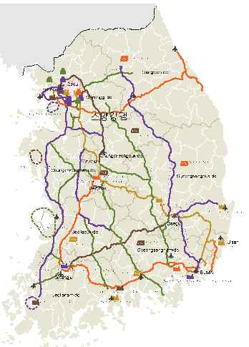
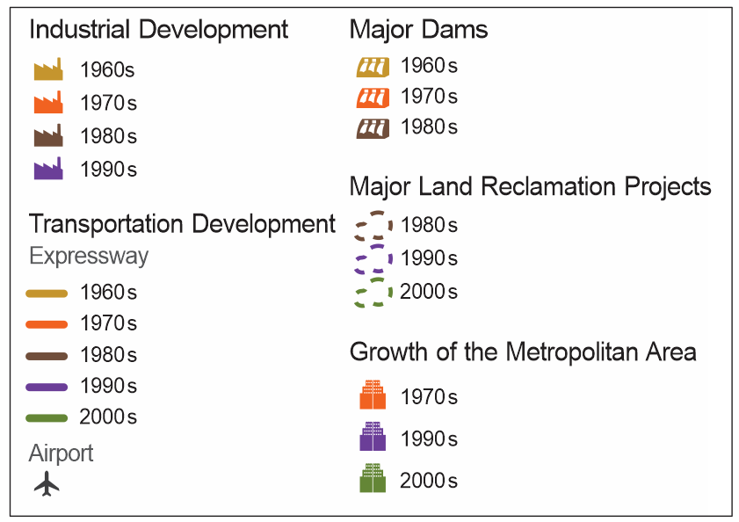
Map showing major development projects
Note: original map in Atlas has much higher resolution

Slide 24
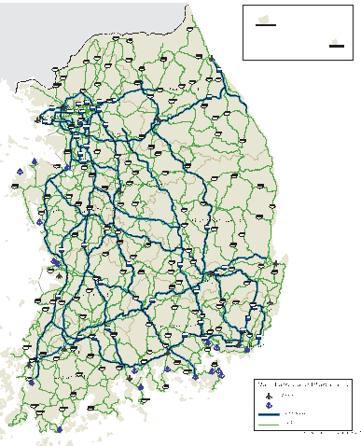
Map showing major transportation infrastructures
Note: original map in Atlas has much higher resolution

Slide 25
Many other maps show such unique themes as
  national spatial planning schemes
  expressway developments thro’ decades
  Railroad extensions
  Regional development plans
  Urban development plans
  Plans to improve quality of life (Map of happiness index, p.105)
  Human settlement plans and communities
  Economic growth plans
  In- and out- migration patterns

Slide 26
Chapter 4
The chapter on Korea in the World (p118-159) highlights South Korea’s global activities on:
  Diplomacy
  International Development & Cooperation
  International Trade and Investment
  Research and Expedition (Dasan Station on Svalbard Is., King Sejong Station and Jang Bogo Station in Antarctica)
  World Heritage (cultural)
  Living with Diversity

Slide 27
Many world maps show such themes as
  Major treaties with the world
  Personnel and cultural exchanges
  Free Trade agreements
  Korea’s foreign direct investments
  Korea’s overseas resource developments

Slide 28


In addition, there are multiple photographs showing Korea’s culture, heritage and diversity.

Slide 29
Chapter 5
This chapter on Maps of Korea showcases five well-executed topographic maps that covers all of North and South Korea at a scale of 1:1,200,000, complete with index of all place names.

Slide 30
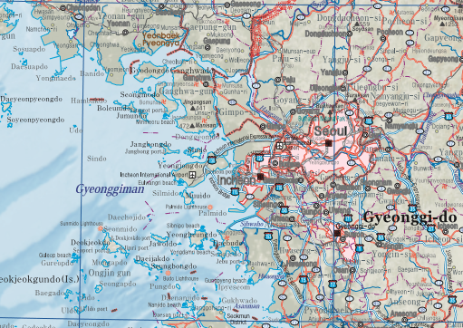
Note: original map in Atlas has much higher resolution

Slide 31
Pages of the National Atlas of Korea can be downloaded from:
http://nationalatlas.ngii.go.kr
when this webpage goes live in the near future

Slide 32
Thank you for your attention!

