Slide 1

The National Atlas of Korea:
Opportunities for Spatial Thinking Lesson Plans
Presenters:
Gregory Chu, Univ. of Wisconsin-La Crosse
Michael Robinson, Houston High School, Germantown, TN
Kenneth Keller, Walton High School, Marietta, GA
NCGE Conference, August 5-10, 2015, Washington, D.C.

Slide 2
Maps, tables, photographs and drawings of this Atlas provide innovatively designed graphics to stimulate spatial thinking visually and statistically. Teachers can take advantage of thematic maps such as population change, infrastructure development of transportation corridors, or urban fringe housing developments and create their own spatial thinking lesson plans.

Slide 3
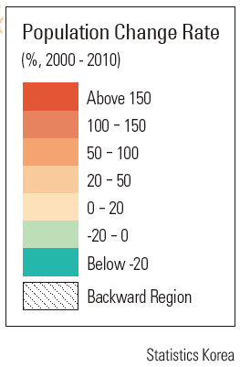
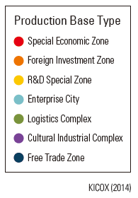
The following are two seemingly unrelated maps from the Korean National Atlas.
one shows the Annual Average Population Change and Backward Regions
the other shows New Industrial Production Bases
Their respective legends
Notice

Slide 4
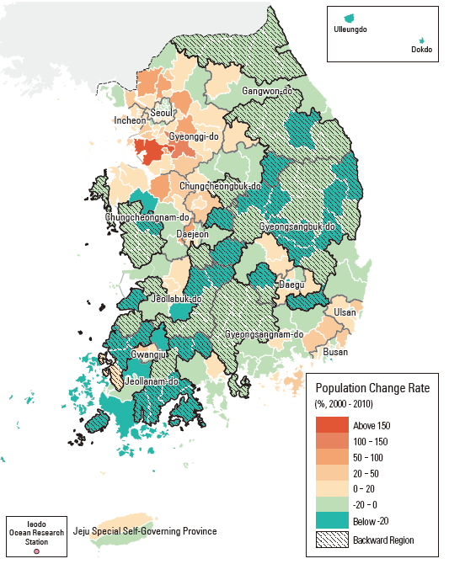
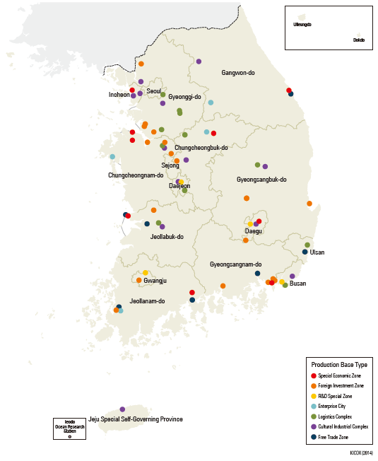
p.82
p.93

Slide 5
Although these two maps do not show a definitive causal effect, but one can certainly make a very strong argument that the absence of industrial production bases may contribute to why the region was backward and the decline of population in this region.
The power of spatial association often review significant underlying factors. This is the value and power of geographic analysis.

Slide 6
Spatial thinking questions for the previous maps:
  How many dots (or new industrial production bases are within the Backward Region?
  Look at the map legend and identify what these dots represent?
  Are they likely to be the type of industrial production bases that will boost economic growth of the Backward Region?
  If you are the director of a national economic planning agency, will you add new industrial production bases inside the Backward Region to try to stimulate its economy?
  If you do add new bases, where would you put them?
  Do they need to be near an adequate labor force?
  Do they need to be near resource materials?
  Do they need to be in an area with sufficient energy supply?
  Will they create more jobs?
  Will these bases exist in harmony with the environment?
  How many other questions that you can think of that may affect your decision in locating new bases in the Backward Region?

Slide 7
The rest of this powerpoint presentation will be a survey of some of the most representative thematic maps that are important in the continued development of South Korea.
Each slide immediately following the slides of maps will post critical and spatial thinking questions to suggest the core of new lesson plans based on the maps.

Slide 8
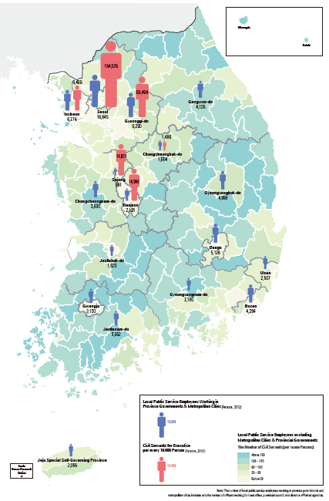
P. 57
Civil Servants of the Central and Local Governments.
Notice the growth of civil servants in the Sejong and Daejeon areas.

Slide 9
Spatial thinking questions for the previous map:
  Where is the highest concentration of civil servants?
  Where is the second highest concentration of civil servants?
  How far away is the second highest concentration from the highest concentration?
  Is the second highest concentration closer to or further away from North Korea?
  Do you think that the location of the second highest concentration purposely planned?
  If so, what geographic advantage (s) do you see for the location of the second highest concentration? (Answers: diversifying government offices; further protection in case of a North Korean invasion; decreasing the density of civil servants in the capital; further away from capital but yet close enough for effectiveness)
  Is there any evidence of careful planning for Sejong where the second highest concentration occurs?
  Are there other factors that you can think of?

Slide 10
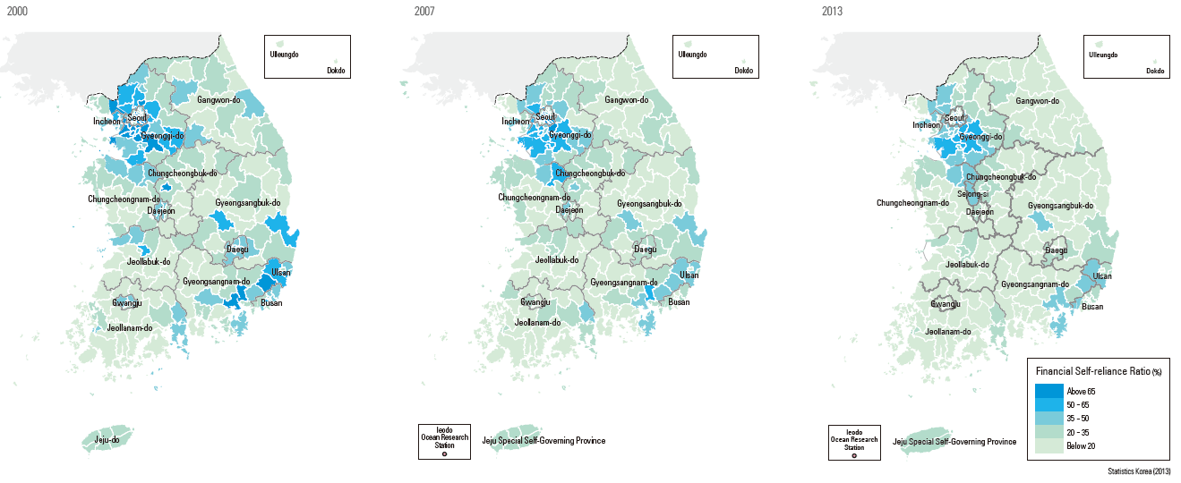
P. 66
Changes of financial self-reliance.

Slide 11
Spatial thinking questions for the previous maps:
  Are there drastic changes in the spatial pattern of self-reliance?
  How do you interpret these particular time-sequence maps?
  How do you interpret the colors? (Answers: the darker the blue means the more the county will rely on itself, the lighter the blue shade means the more that county depends on Central Government for support)
  Do you notice some subtle changes in the color scheme?
  Pick a particular county and assess whether there was any change in self-reliance from 2000 to 2007 to 2013?
  Are the more self-reliant county associated more with urban settings or with rural settings?
  Why is this so?
  What factors contribute to a county’s reliance on Central Government? Is it distance? Is it infrastructure?
  Are there other factors that you can think of?

Slide 12
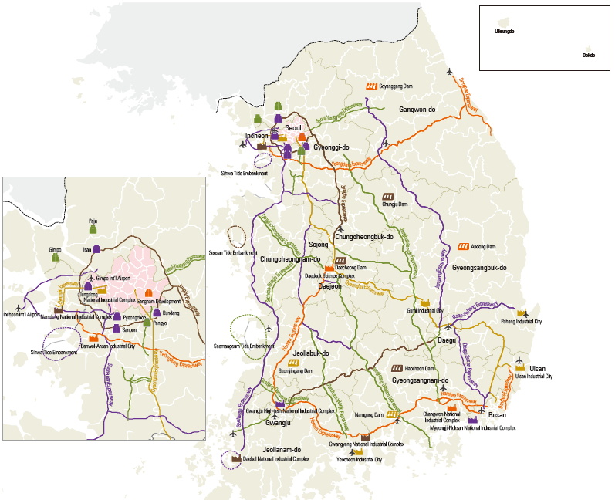
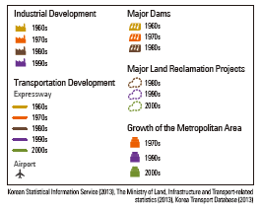

P. 69 – Major development projects.

Slide 13
Spatial thinking questions for the previous maps:
  Look at the map legend and list the five types of development projects?
  Why are transportation projects important?
  Why are building dams important to a nation? (Answers: they provide water supply for various purposes such as drinking, recreation, industrial use, and agriculture; they also can generate electricity; a reservoir may moderate extreme weather conditions)
  What are some negative environmental impacts of dams? (Answers: they starve water supply for the lower course of the river; dams create a barrier to water flow and is a cause for silt and sand build-up; they lessen the amount of nutrients to the lower course; they may prevent some fish species from migrating upstream to spawning grounds; they may submerge any archaeologic sites; and they may displace people who have homes in the watershed).

Slide 14
Spatial thinking questions continued:
  What is a reclamation project?
  Are reclaimed lands safe to build on? (yes if done properly)
  Can reclaimed lands sustain tall building? (yes, many examples exists in other cities where land is scarce and population high)
  Can reclaimed lands sustain agriculture? (yes)
  What are some of the other uses of reclaimed land? (for building infrastructures such as airports and transportation networks, or severe weather resistant dykes; many examples from Hong Kong)
  Why must a nation address the growth of metropolitan areas? (to alleviate pressures from population growth, housing demands, added sewage and sanitary demands, transportation congestions, water supplies, air pollution from added transportation vehicles, higher demand for medical services, food supply and food security, as well as social and community needs such as police and fire-fighter, green spaces, personal well beings and quality of life, amongst many other living conditions.)

Slide 15
Spatial thinking questions continued:
  From looking at the maps, there are obvious swaths of land that the South Korean Central Government did not plan any major development projects, where are these swaths of land?
  Why would the government not build projects here? (For the north swath of land: it is too close to N Korea; for the east swath, look at the next map from this powerpoint or p.70 of the Atlas [answers: much less efficient transportation network and very rugged terrain])
  What will adequate infrastructure mean for a nation? (that it has the right tools to succeed in manufacturing and conduct global trade)
  Can you think of other issues that relate to a nation’s need to develop major projects?

Slide 16
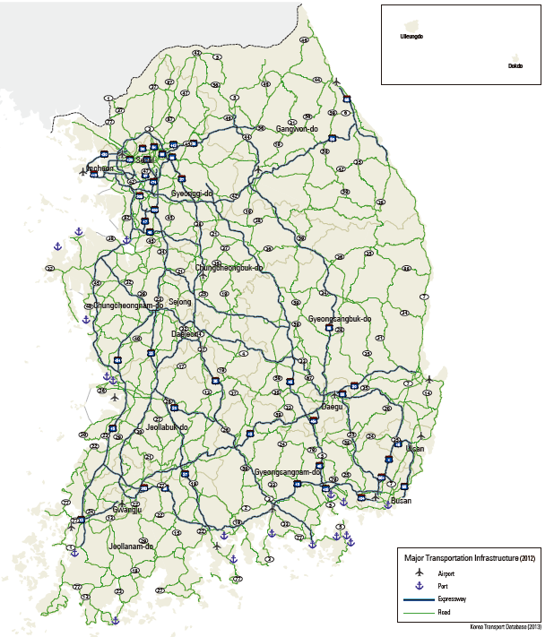
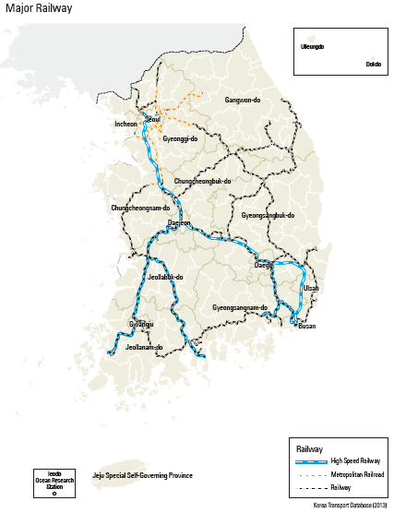
P. 70 – Major Transportation Infrastructure.

Slide 17
Spatial thinking questions for the previous maps:
  What is the general direction of the pattern of major highways?
  What part of South Korea has the densest transportation network?
  What part of South Korea has the most sparse transportation network and why? (Look at a physical map of the country)
  On the maps, the networks of airports and port facilities are less obvious than roads and railroads, can you suggest why and how would you solve this problem? (Answers: airports and port facilities are represented by point symbols on the map and therefore less obvious; create a separate map that is not cluttered with linework).
  What other transportation networks are not obvious on this map and why? (Answer: urban transportation networks cannot be included in a national map because of a big difference in map scale requirements. Urban transportation maps need to have a large scale (meaning smaller land area, but more local details).

Slide 18
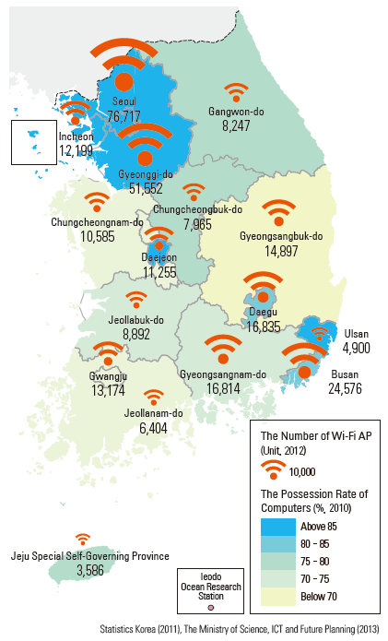

P. 71 – The Possession Rate of Computers and the Number of Wi-Fi.

Slide 19
Spatial thinking questions for the previous maps:
  What can you conclude about the location of concentrations of computer possessions and wi-fi availability?
  Are they associated with urban or rural settings?
  Which part of South Korea has the least amount of computers and wi-fi connectivity? Why? (Answers: the NE part; rugged terrain and much less development.)
  What can you conclude about the status of high tech activities in South Korea? (Answer: Cannot conclude much from this map, must need other resources. They major conclusion is that there is an imbalance of high-tech [computer and wi-fi] users between urban and rural settings. A statistical map that indicates the number of cell-phone users will be much more helpful since most cell phones can access the Internet today.)

Slide 20
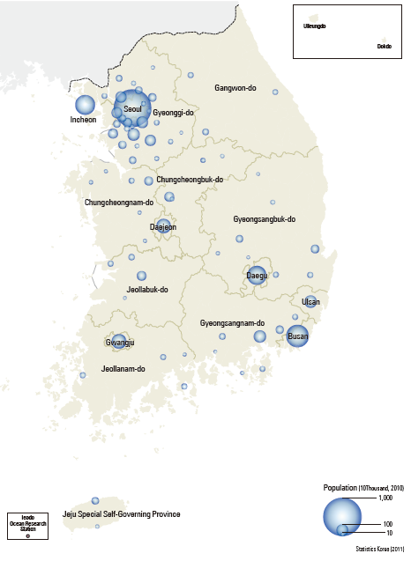
P. 72 – The Spatial Pattern of Cities by Population Size

Slide 21
Spatial thinking questions for the previous maps:
  What can you conclude about the location of concentrations of cities in South Korea?
  Which part of South Korea has the least number of cities with a substantial population? Why? (Answers: the NE part; rugged terrain and much less development.)
  If you were to build one transportation line to connect the most number of cities in South Korea, where will you draw this line on the map?

Slide 22
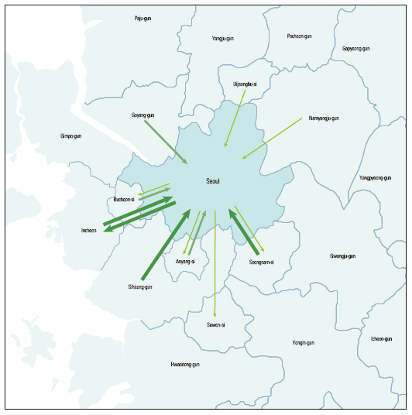
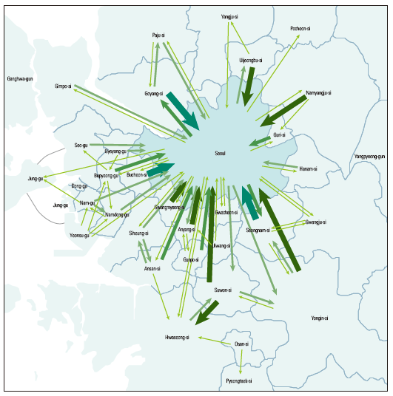
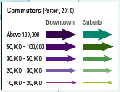
P. 73 – The Growth of Commuters into the Capital Region. (green arrows are commuters from suburbs)
1980
2010

Slide 23
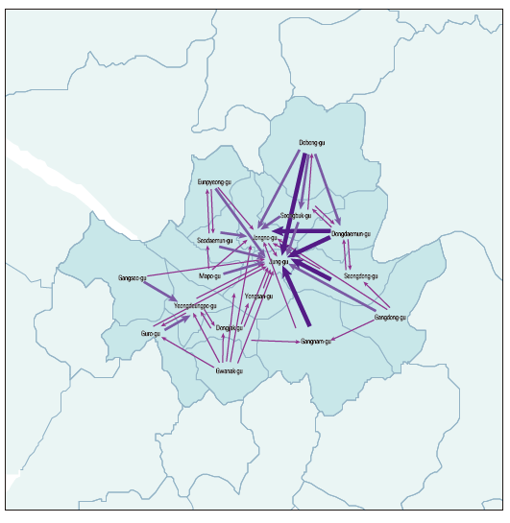
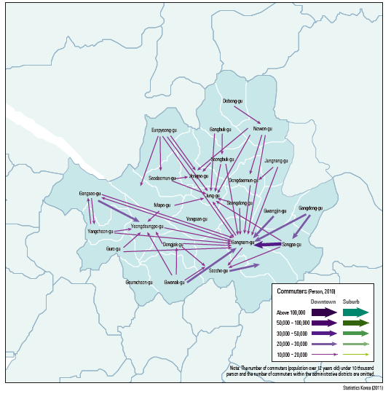
P. 73 – The Growth of Commuters within the Capital Region. (blue arrows are commuters from downtown commuting within the Capital Region)
1980
2010

Slide 24
Spatial thinking questions for the previous maps:
  What can you conclude about the volume of commuters coming into the region between 1980 and 2010?
  What is the major direction from which commuters enter the Capital Region in 1980?
  Has that direction changed in 2010?
  From what major directions do suburb commuters come in 2010?
  Can you suggest why this is happening? (Answers: Perhaps an increase in developments in the North, South, and Southeast of the Capital Region; perhaps an increase in population from these areas; perhaps from inadequate housing facilities inside the Capital Region)
  What is the major destination of downtown commuters within the Capital Region (blue arrows) in 1980 and what is their major destination in 2010? (Answers: 1980 – Jung-gu; 2010 – Gangnam-gu). Why is there a shift? (Newer developments)

Slide 25
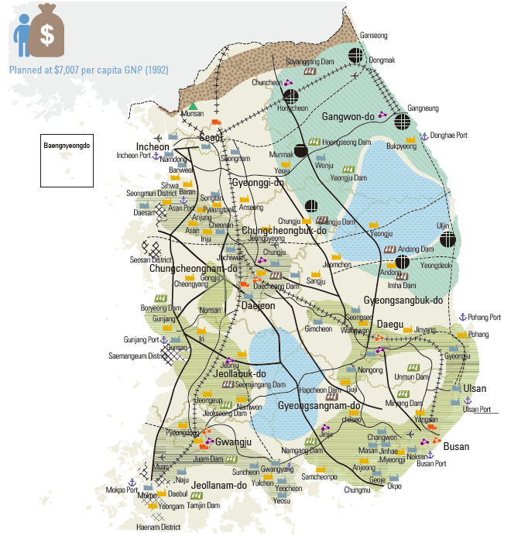
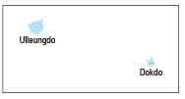
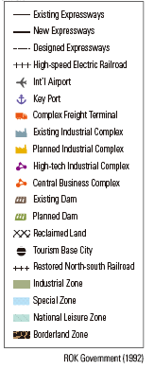

P. 78 – Third Comprehensive National Territorial Planning (1992-2001.

Slide 26
Spatial thinking questions for the previous maps:
  In your own words, how would you describe South Korea’s overall Comprehensive National Territorial Planning? (complex, aggressive, spatial, methodical, costly, worthwhile, sensible, a reflection of Korea’s wealth)
  Where are the reclamation projects? Why are they on one side of the coast and not the other coast? (protected from the open ocean, closer to major cities and economic activities, more need to relieve space congestion here than the other coast)
  How well does the shape of the industrial zone correlate with the railroad? Why is this so?
  How many dams are planned for construction?
  What is the overall plan for the Northeast and East Central areas of South Korea? (Answer: tourism and leisure space, as evidenced by the abundance of tourism symbols)

Slide 27
Spatial thinking questions continued:
  Why is the Northeast and East Central areas of South Korea not planned for industrial development? (rugged terrain, not sufficient transportation network, being too close to North Korea, need to preserve open and leisure space)
  Why is there nothing planned for the Borderland Zone? (may lose all constructions if war is to break out with North Korea)
  Where do you expect to find key port facilities? (near major industrial complexes along the coast and at the end of railroad lines, namely Busan, Ulsan, Incheon, and Pohang)

Slide 28
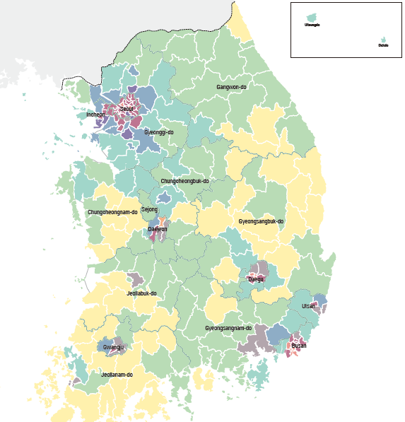
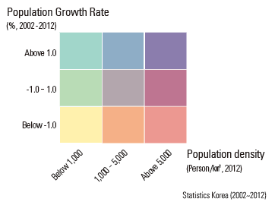
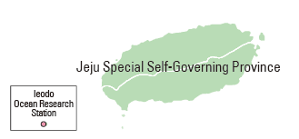
P. 87 – Regional Development Pattern in Korea: Population Aspect.
Note that this is a bivariate map (mapping 2 variables simultaneously).

Slide 29
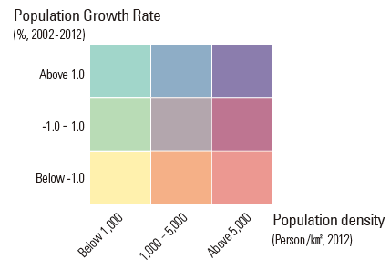
Spatial thinking questions for the previous maps:
  This is a bivariate map (meaning that it maps two variables simultaneously). Although bivariate maps are more difficult to interpret, they also show close associations between the two variables.
Looking at the upper left corner of the 3x3 legend box colors, the dark green color represents an area that has a population growth rate of above 1.0 and a population density of below 1,000. This means that all areas represented by this green color on the map have the ability
to sustain a higher growth rate since its density is relatively low compared to other areas. On the other hand, the box on the lower right has a high population density but a low growth rate, meaning that it has little room to grow.

Slide 30
Spatial thinking questions continued:
  Now, study the map again and determine where would you ideally develop new housing communities if South Korea were to have a rapid increase in population. (answer: in the light tan color associated with the lower left box of the 3x3 legend where both population growth rate and density are low).
  But is this so simple a solution? What other concerns will come into play? (Answers: Are there enough jobs to sustain this sudden increase in population in tan color areas? Are there industries or economic activities to provide jobs to sustain such new additions of population? Are there enough infrastructures to facilitate their daily lives?
  All these are major geographical questions that must be answered.
  Can you think of other related geographic questions?

Slide 31
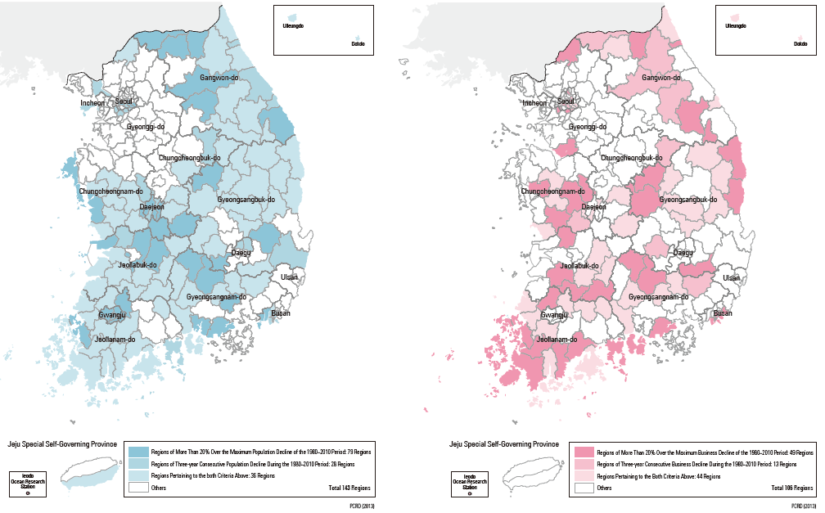
P. 88 – Depopulating Regions (left) and Regions with Declining Businesses (right)

Slide 32
Spatial thinking questions for the previous maps:
  Do the two patterns (depopulation and declining businesses) resemble or correlate with each other?
  What does that suggest to you as possible spatial relationships?
  Do these patterns suggest one causes the other? (No! There are obviously other factors that contribute to such declines.)
  Do these declines relate to urban areas or rural areas? (Use other maps from the Atlas to draw your conclusions.)
  Caveat: Strong spatial correlations do not scientifically constitute causal relationships; however, arguments can be made that strong spatial correlations can be attributed to some underlying factors that define the reasons for the concentration of spatial patterns. Such reasons do command merits in analysis or decision-making (spatial correlation is a powerful tool for epidemiologists who may struggle with causal relationships but successful in finding solutions to controlling some diseases).

Slide 33
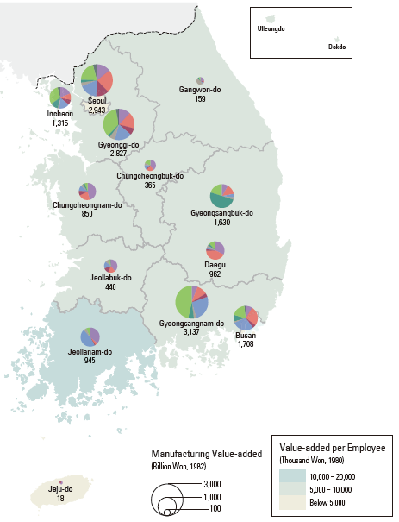
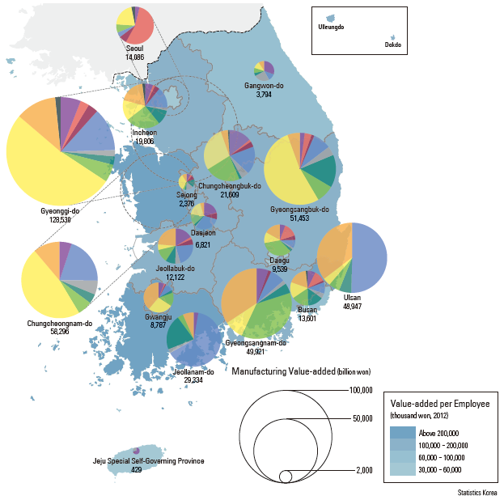
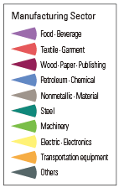
P. 91 – Manufacturing Value-added and Sectoral Composition (Note: 2 more maps, 1990 and 2000, are in the Atlas but not shown here).
1980-82
2012

Slide 34
Spatial thinking questions for the previous maps:
  What can you conclude about the magnitude of increase in value-added manufacturing between 1980 and 2012?
  What are the two major Sectors that are in 2012 and not in 1980? (Answers: Electronics and Transportation Equipment)
  Can you characterize the number of value-added manufacturing employees between 1980 and 2010.
  If you have to pick one part of South Korea where such increase is not very dramatic, which part would you pick and what is your evidence for picking this part?

Slide 35
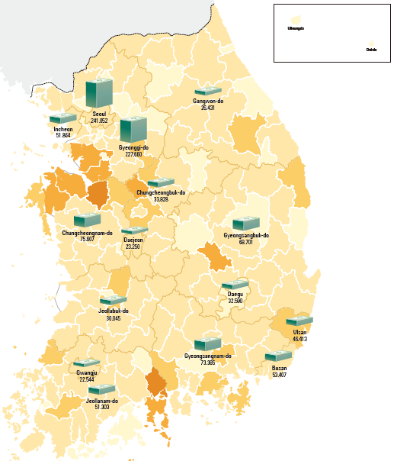
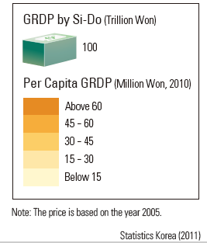

P. 97 – Gross Regional Domestic Product

Slide 36
Spatial thinking questions for the previous maps:
  Where are the high concentrations of Per capital gross regional domestic product?
  Are they associated with urban centers or rural communities?
  What is the advantage of computing a per capital gross regional domestic product rather than a national per capital domestic product index? (Answer: so that you can see a more localized breakdown of details about variations in the per capital domestic product, meaning that you can identify which local areas are doing better economically than other areas. It is a finer spatial resolution.)

Slide 37
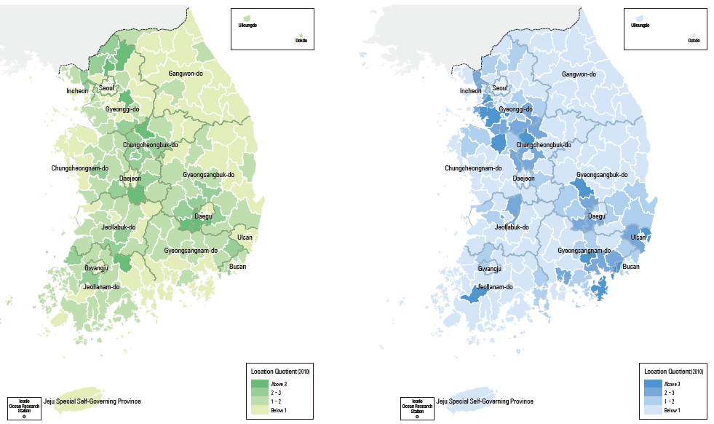
P. 99

Slide 38
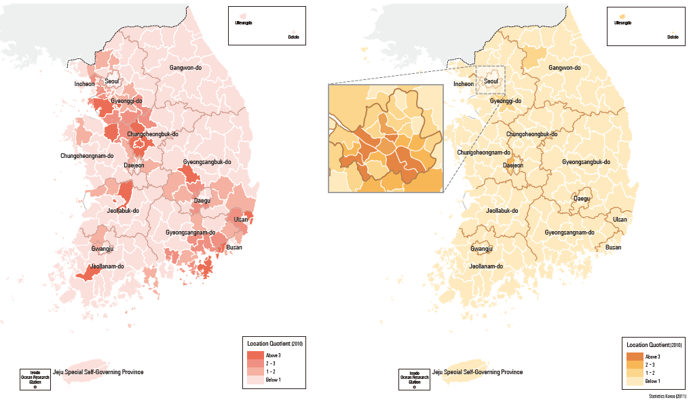
P. 99

Slide 39
Spatial thinking questions for the previous maps:
  Which of the four previous maps stand out totally different than the other three? (Answer: the Knowledge Intensive Services)
  Are the spatial patterns similar among the light industries, heavy and chemical industries, and high-tech industries?
  Are these spatial patterns similar to the knowledge intensive services?
  Why is there a lack of spatial pattern for the knowledge intensive services but almost entirely concentrated in Seoul? (these services can be conducted from anywhere without dependence on transportation or raw material supplies; even from homes with Internet access)

Slide 40
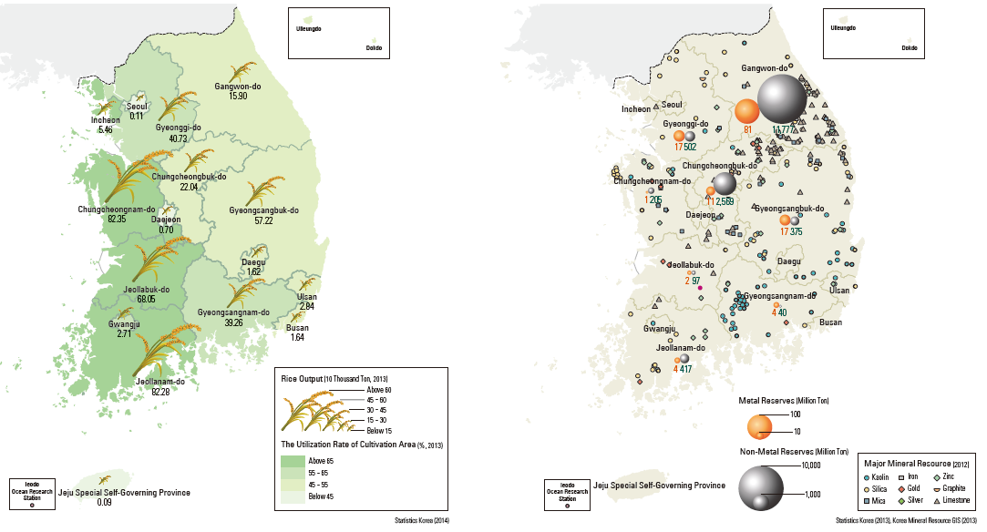
P. 101 – Agricultural Production (left) and Mineral Resources(right)

Slide 41
Spatial thinking questions for the previous maps:
  Which half of South Korea is more suitable for agriculture?
  Where are the concentrations of mineral resources?
  Do they compete for land? (Answer: not likely)
  Do they affect each other environmentally? (Not likely)

Slide 42
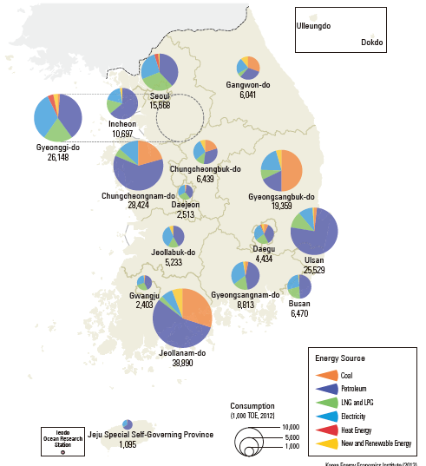
P. 101 – Final Energy Consumption by Source

Slide 43
Spatial thinking questions for the previous maps:
  The map legend lists LNG and LPG which are less popular in the US, what are LNG and LPG? (Liquidified natural gas and liquified petroleum gas)
  Maps are made to convey spatial information; when reading or interpreting a map, one must also be aware of how accurate the information may be and should arouse our curiosity and raise questions when something may not look right. Can you spot something that may not look right to you on this map and raise a question? (Hint: look at the largest graduated circle and compare it to the circle that represents Seoul. The question that I raise is why is there a higher consumption of energy in the Province of Jeollanam-do than all of Seoul? What is there that require such a high energy consumption in Jeollanam-do?) (Unfortunately, I was not able to find the answer from the Atlas, but that may be a good lesson for students.)

Slide 44
Spatial thinking questions for the previous maps:
  Another curiosity: If Seoul consumes less energy than Jeollanam-do Province, what does it say about the efficiency of energy use in the generation of national wealth? How should valuable resources be assigned?
  A parallel scenario: Large amounts of water are used for the sugar cane industry on Oahu (Hawaii) while not enough water go into the tourist industry even though tourism brings in much more income to Oahu. Again, how should valuable resources be assigned?

Slide 45
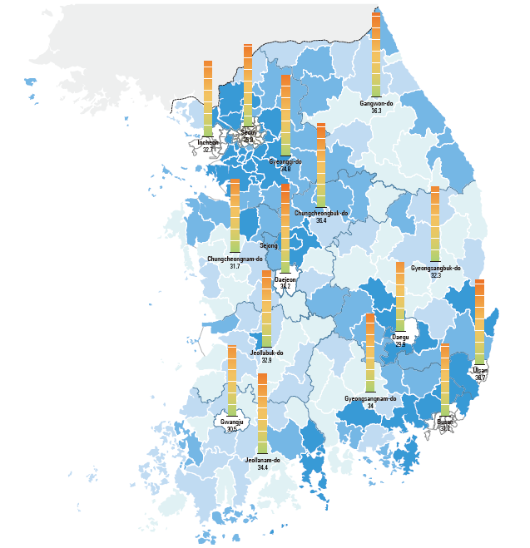
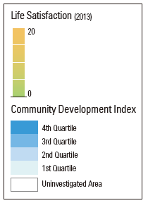
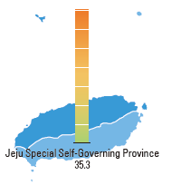
P. 105 – Happiness Index (Quality of Life)

Slide 46
Spatial thinking questions for the previous maps:
  How does one define an index for the Quality of Life? (Read p105 of the Atlas to find out)
  Would the Quality of Life differ between cultures and between religions?
  Would the perception and definition of Quality of Life differ for people in the United States?
  What are your own aspirations for Quality of Life? (Debate: Should you include video games as part of the equation?)

Slide 47
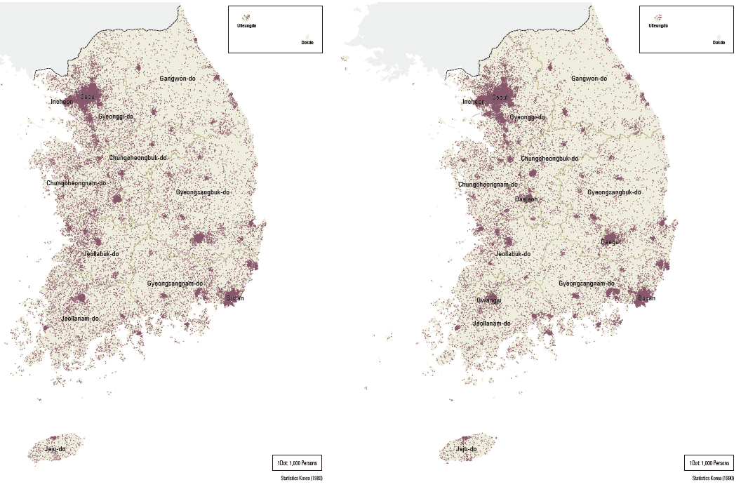
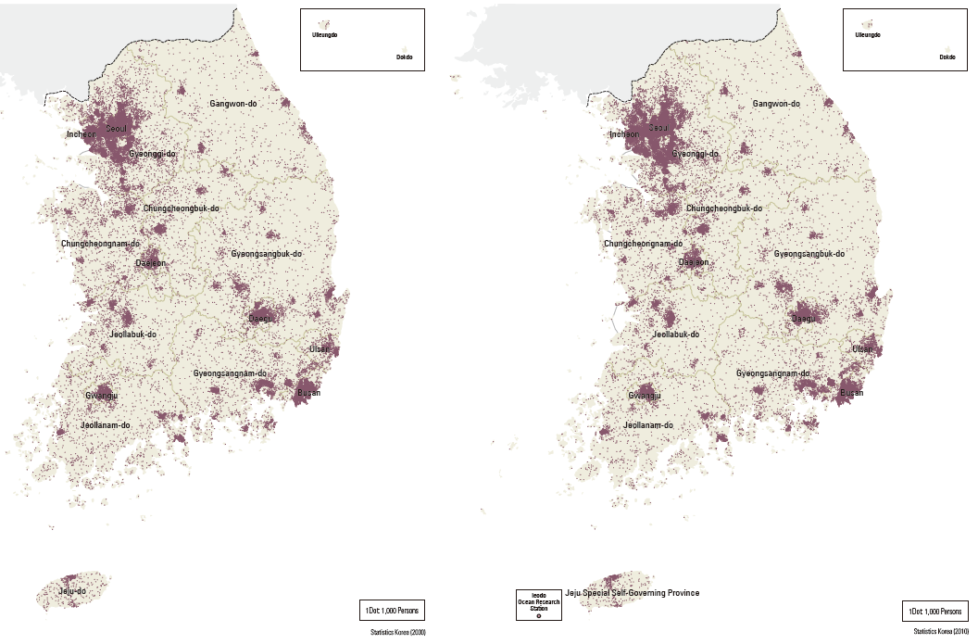
P. 113 – Population Distribution
1980
1990
2000
2010

Slide 48
Spatial thinking questions for the previous maps:
  This set of maps is titled Population Distribution. Do they show anything else? (Hint: change through time in the locations of population as well as increase in magnitude)
  What do you think about the representation of population on dot maps instead of shading a density over an area? (Dot maps are more precise by number and location, but are harder to create; they generally show the overall pattern and are not meant for you to count the dots and multiply by the number of persons each dot represents.)
  Even with current GIS technology, there are still mapping methodology questions about dot maps. Basically, one has to scrutinize the smallest area units for which the data are collected before one can decide on the accuracy of dot maps.

Slide 49
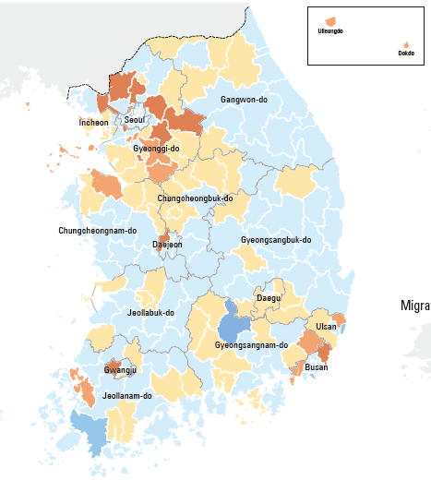
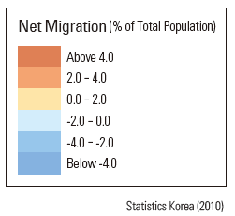

P. 116 – Net Migration, 2010

Slide 50
Spatial thinking questions for the previous maps:
  This map really shows a distinctive pattern between gain and loss in net migration by county, what can you conclude about this pattern?. (that the gains are mostly around urban centers)
  Using other maps from the Atlas, one can associate out- migration counties with counties with little or minimum industrial productions. What is the one caveat that a map reader has to be concerned about? (Answer: Spatial association is not a causal effect.)

Slide 51
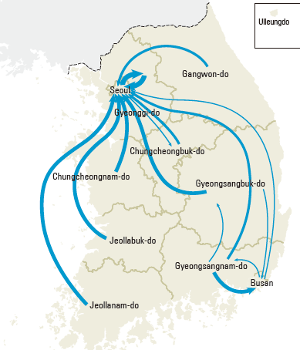
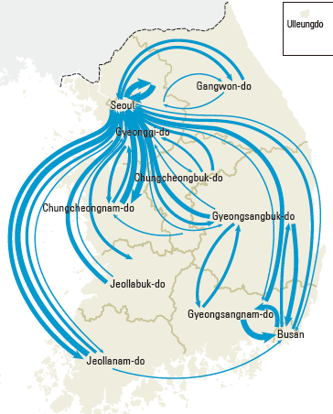
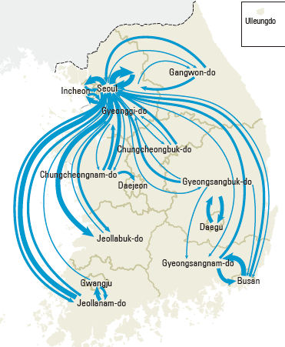
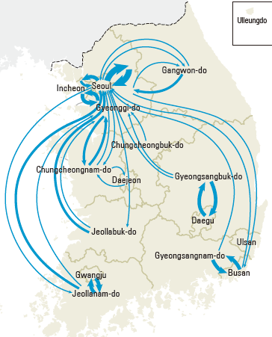
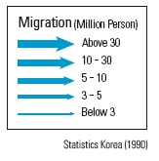
1970
1980
P. 116 –Migration
1990
2000

Slide 52
Spatial thinking questions for the previous maps:
  This sequence of maps show both time and space characteristics of migration in South Korea.
  Migrations activities are highest in the 1980s and 1990s, but have stabilized since 2000.
  The data were mapped by province and administrative regions and therefore lack specific locations of origins and destinations.
  What is the most important common element that must be applied to relate these time series maps together? (Answer: A consistent legend – the metrics that are used to scale the amount of migration for every map here.)

Slide 53
The above maps are only a limited portion of of all the maps, charts, statistics, and photographs from the National Atlas of Korea. There are many more of the same that are equally usable as lesson plan contents

Slide 54
Pages of the National Atlas of Korea can be downloaded from:
http://nationalatlas.ngii.go.kr
when this webpage goes live in the near future

Slide 55
This powerpoint presentation can be downloaded from:
https://sites.google.com/a/uwlax.edu/chu/advance-placement-in-human-geography-lesson-plans-using-national-atlas-of-korea

Slide 56
Please be sure to take advantage of such an enormous collection of maps and teaching materials.
Thank you for your attention.

